Slide 1
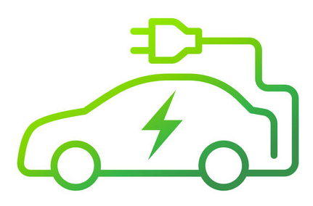
Electric Vehicle Technologies
Presented by V Amarnath Reddy

