Slide 1
Noise in Communication Systems
Introduction
Thermal Noise
Shot Noise
Low Frequency or Flicker Noise
Excess Resister Noise
Burst or Popcorn Noise
General Comments
Noise Evaluation – Overview
Matched Communication Systems
Signal - to – Noise
Noise Factor – Noise Figure
Noise Figure / Factor for Active Elements
Noise Temperature
Noise Figure / Factors for Passive Elements

Slide 2
1. Introduction
Noise is a general term which is used to describe an unwanted signal which affects a wanted signal. These unwanted signals arise from a variety of sources which may be considered in one of two main categories:-
Interference, usually from a human source (man made)
Naturally occurring random noise
Interference
Interference arises for example, from other communication systems (cross talk), 50 Hz supplies (hum) and harmonics, switched mode power supplies, thyristor circuits, ignition (car spark plugs) motors… etc.

Slide 3
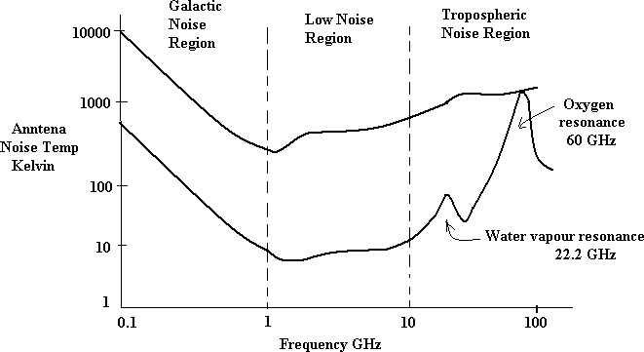
1. Introduction (Cont’d)
Natural Noise
Naturally occurring external noise sources include atmosphere disturbance (e.g. electric storms, lighting, ionospheric effect etc), so called ‘Sky Noise’ or Cosmic noise which includes noise from galaxy, solar noise and ‘hot spot’ due to oxygen and water vapour resonance in the earth’s atmosphere.

Slide 4
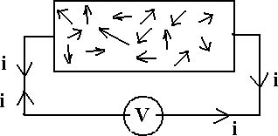
2. Thermal Noise (Johnson Noise)
This type of noise is generated by all resistances (e.g. a resistor, semiconductor, the resistance of a resonant circuit, i.e. the real part of the impedance, cable etc).
Experimental results (by Johnson) and theoretical studies (by Nyquist) give
the mean square noise voltage as
_ 2
V = 4 k TBR (volt ² )
Where k = Boltzmann’s constant = 1.38 x 10⁻²³ Joules per K T = absolute temperature
B = bandwidth noise measured in (Hz) R = resistance (ohms)

Slide 5
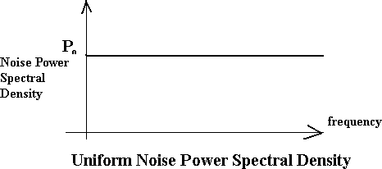
2. Thermal Noise (Johnson Noise) (Cont’d)
The law relating noise power, N, to the temperature and bandwidth is
N = k TB watts
Thermal noise is often referred to as ‘white noise’ because it has a uniform ‘spectral density’.

Slide 6
3. Shot Noise
Shot noise was originally used to describe noise due to random fluctuations in electron emission from cathodes in vacuum tubes (called shot noise by analogy with lead shot).
Shot noise also occurs in semiconductors due to the liberation of charge carriers.
For pn junctions the mean square shot noise current is
2
(I +2 I )q B
I =2
(amps)²
n
DC o e
Where
is the direct current as the pn junction (amps) is the reverse saturation current (amps)
is the electron charge = 1.6 x 10-19 coulombs B is the effective noise bandwidth (Hz)
Shot noise is found to have a uniform spectral density as for thermal
noise

Slide 7
4. Low Frequency or Flicker Noise
Active devices, integrated circuit, diodes, transistors etc also exhibits a low frequency noise, which is frequency dependent (i.e. non uniform) known as flicker noise or ‘one – over – f’ noise.
Excess Resistor Noise
Thermal noise in resistors does not vary with frequency, as previously noted, by many resistors also generates as additional frequency dependent noise referred to as excess noise.
Burst Noise or Popcorn Noise
Some semiconductors also produce burst or popcorn noise with a
spectral density which is proportional to ^{⎛ 1}
⎞2
⎜ _{f} ⎟
⎝ ⎠

Slide 8
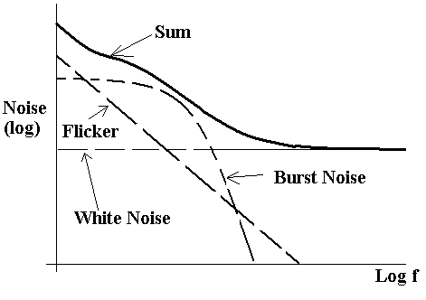
5. General Comments
For frequencies below a few KHz (low frequency systems), flicker and popcorn noise are the most significant, but these may be ignored at higher frequencies where ‘white’ noise predominates.

Slide 9
6. Noise Evaluation
The essence of calculations and measurements is to determine the signal power to Noise power ratio, i.e. the (S/N) ratio or (S/N)
expression in dB. _{⎛ S ⎞}
₌ S
N
⎜ _{N} ⎟
⎝
⎠ ratio
⎛ S ⎞
= 10 log
⎛ S ⎞
⎜ _{N} ⎟
10
⎜ ⎟
⎝
N
⎠ dB
⎝ ⎠
Also recall that
S = 10 log
⎛ S ( mW ) ⎞
dBm
10
⎜ ⎟
⎝
1mW
⎠
and N
= 10 log
⎛ N ( mW ) ⎞
dBm
10
⎜ ⎟
⎝
1mW
⎠
i.e. ^{⎛ S ⎞}
=10 log S − 10 log N
⎜ _{N} ⎟
10
10
⎝
⎠ dB
⎛ S ⎞
= S − N
⎜ _{N} ⎟
dBm
dBm
⎝
⎠ dB

Slide 10
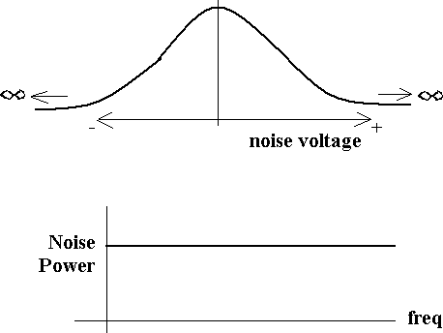
6. Noise Evaluation (Cont’d)
The probability of amplitude of noise at any frequency or in any band of frequencies (e.g. 1 Hz, 10Hz… 100 KHz .etc) is a Gaussian distribution.

Slide 11
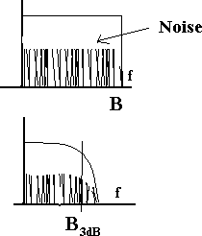
6. Noise Evaluation (Cont’d)
Noise may be quantified in terms of noise power spectral density, p_{o} watts per Hz, from which Noise power N may be expressed as
N= p_{o} B_{n} watts
Ideal low pass filter
Bandwidth B Hz = B_{n} N= p_{o} B_{n} watts
Practical LPF
3 dB bandwidth shown, but noise does not suddenly cease
at B_{3dB}
Therefore, Bn > B_{3dB}, Bn depends on actual filter. N= p0 B_{n}
In general the equivalent noise bandwidth is > B_{3dB}.

Slide 12
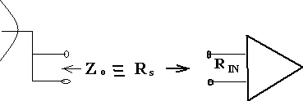
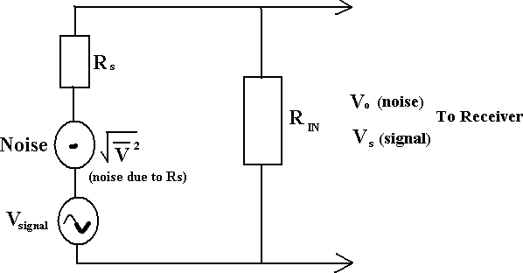
7. Matched Communication Systems
In communication systems we are usually concerned with the noise (i.e. S/N) at the receiver end of the system.
The transmission path may be for example:-
Or
An equivalent circuit, when the line is connected to the receiver is shown below.

Slide 13
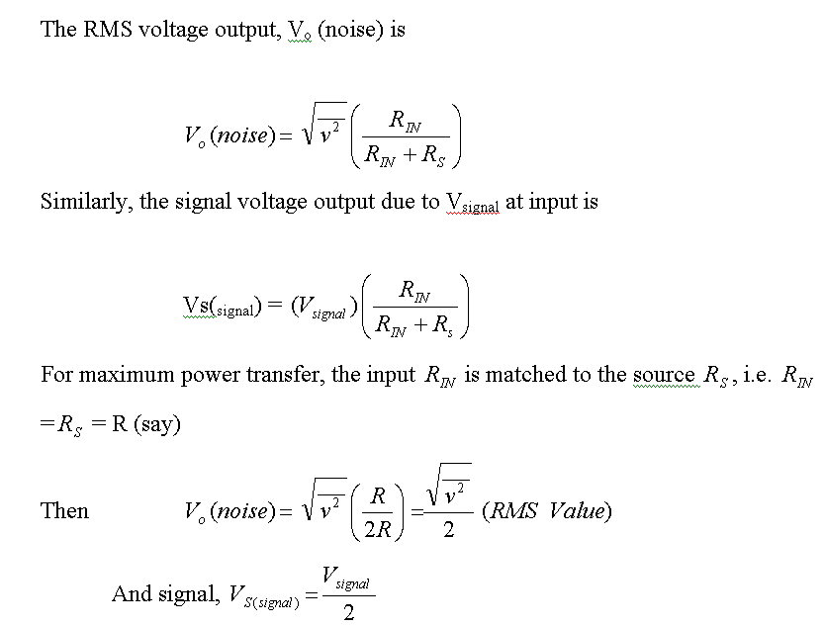
7. Matched Communication Systems (Cont’d)

Slide 14
8. Signal to Noise
The signal to noise ratio is given by
S ₌ Signal Power
N Noise Power
The signal to noise in dB is expressed by
⎛ S ⎞ ⎛ S ⎞
⎜ ⎟
=10 log
⎜ ⎟
N
dB 10
N
⎝ ⎠
⎝ ⎠
⎛ S ⎞
= S − N
⎜ _{N} ⎟
dB dBm
dBm for S and N measured in mW.
⎝ ⎠
12. Noise Factor- Noise Figure
Consider the network shown below,

Slide 15
9. Noise Factor- Noise Figure (Cont’d)
The amount of noise added by the network is embodied in the Noise Factor F, which is defined by
(^{S} _{N} )
₎ IN
Noise factor F =
(S
N
OUT
F equals to 1 for noiseless network and in general F > 1. The noise figure in the noise factor quoted in dB
Noise Figure F dB = 10 log10 F F ≥ 0 dB
The noise figure / factor is the measure of how much a network degrades the (S/N)IN, the lower the value of F, the better the network.

Slide 16
9. Noise Figure – Noise Factor for Active Elements
For active elements with power gain G>1, we have
(^{S} _{N} )
₎ IN
F =
(S
=
^{S}IN ^{N}OUT
^{N}IN ^{S}OUT
But
S_{OUT} = G S_{IN}
N OUT
Therefore
_{F =} ^{S}IN
^{N}OUT
₌ ^{N}OUT
^{N}IN
G S_{IN}
G N_{IN}
Since in general F v> 1 , then N_{OUT} is increased by noise due to the active element i.e.
Na represents ‘added’ noise measured at the output. This added noise may be referred to the input as extra noise, i.e. as equivalent diagram is

Slide 17
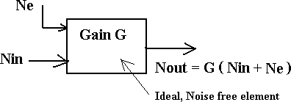
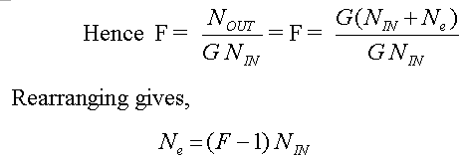
9. Noise Figure – Noise Factor for Active Elements (Cont’d)
Ne is extra noise due to active elements referred to the input; the element is thus effectively noiseless.

Slide 18
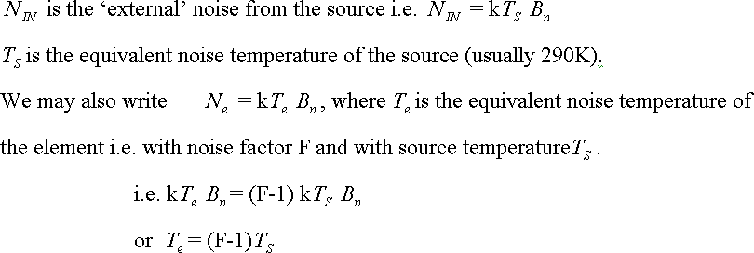
10. Noise Temperature

Slide 19
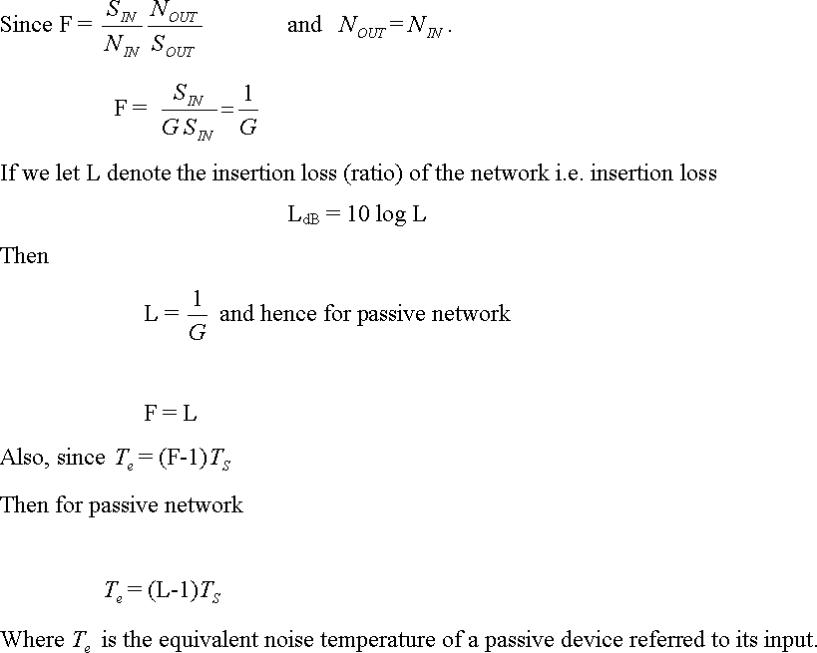
11. Noise Figure – Noise Factor for Passive Elements

