Slide 1
Unit III
VLSI CIRCUIT DESIGN PROCESSES
Topics
VLSI design flow
MOS layers
Stick diagrams
Design Rules and Layout
2 um CMOS design rules for wires
Contacts and Transistors
Layout diagrams for NMOS and
CMOS inverters and gates, Scaling of MOS circuits

Slide 2
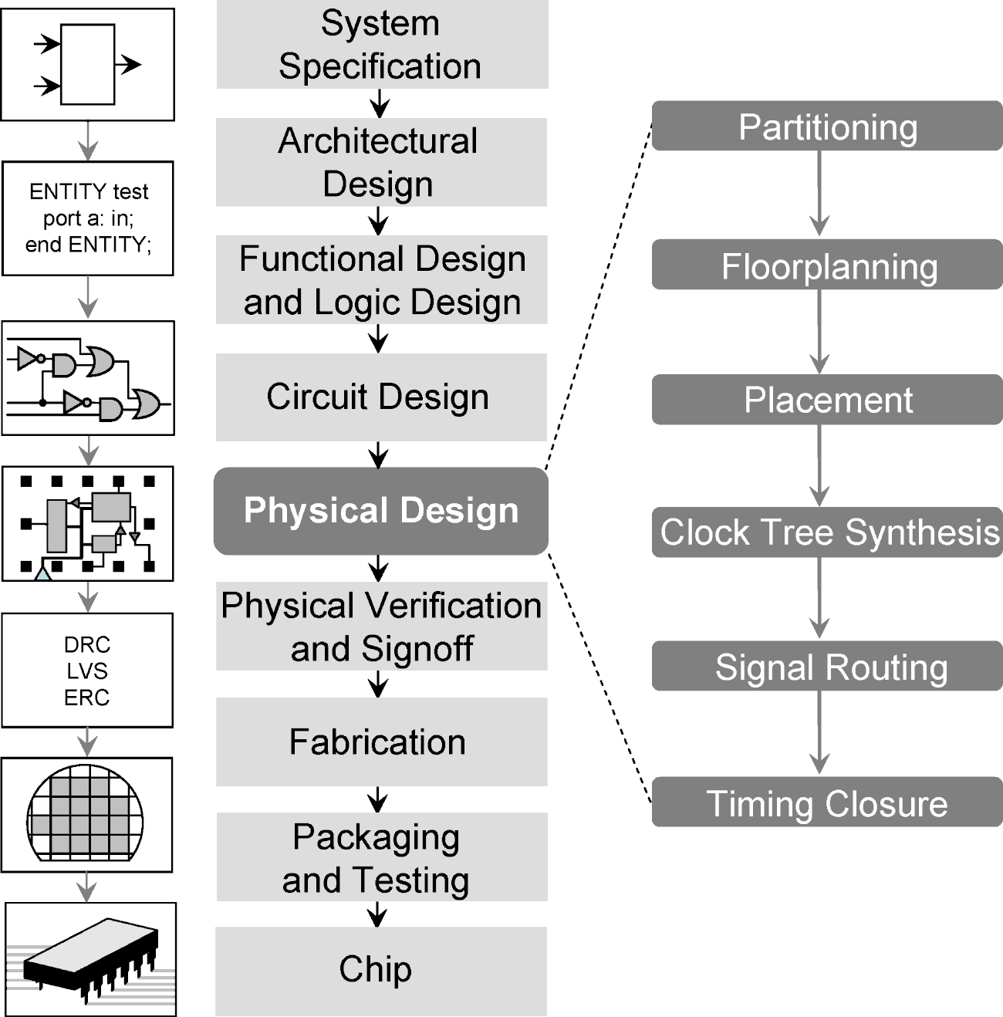
VLSI Design of approach of IC
62/038/2015

Slide 3
Layer Types
p-substrate
n-well
n+
p+
Gate oxide (thin oxide)
Gate (polycilicon)
Field Oxide
Insulated glass
Provide electrical isolation

Slide 4
Stick diagram
Encodings for a simple single metal nMOS process
COLOR | STICK ENCODING MONOCROME | LAYERS | MASK LAYOUT ENCODING MONOCROME | CIF LAYER
GREEN RED BLUE BLACK GRAY nMOS ONLY YELLO _{W}nMOS ONLY | NOT APPLICABLE | n- diffusion n⁺active Thniox Polysilicon Metal 1 Contact cut Overglass Implant Buried contact |  | N D NP N M N C N G NI NB
BROWN

Slide 5
Stick Diagrams
Metal
poly ndiff
pdiff
Can also draw in shades of gray/line style.
Buried Contact
Contact Cut

Slide 6
Stick Diagrams
VLSI design aims to translate circuit concepts onto silicon.
Stick diagrams are a means of capturing topography and layer information using simple diagrams.
Stick diagrams convey layer information through colour codes (or monochrome encoding).
Acts as an interface between symbolic circuit and the actual layout.
Does show all components/vias.
It shows relative placement of components.
Goes one step closer to the layout
Helps plan the layout and routing

Slide 7
Stick Diagrams
Does not show
Exact placement of components
Transistor sizes
Wire lengths, wire widths, tub boundaries.
Any other low level details such as parasitics..
Does show all components/vias.
It shows relative placement of components.
Goes one step closer to the layout
Helps plan the layout and routing

Slide 8
Stick Diagrams – Some rules
Rule 1.
When two or more ‘sticks’ of the same type cross or touch each other that represents electrical contact.
Rule 2.
When two or more ‘sticks’ of different type cross or touch each other there is no electrical contact.
(If electrical contact is needed we have to show the connection explicitly).

Slide 9
Stick Diagrams – Some rules
Stick Diagrams
Rule 3.
When a poly crosses diffusion it represents a transistor.
Note: If a contact is shown then it is not a transistor.

Slide 10
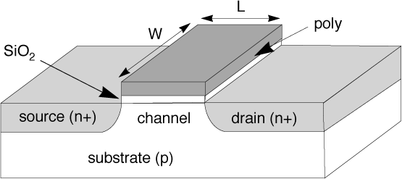
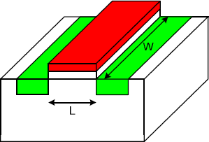
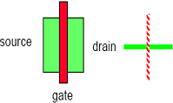
Stick Diagrams – Some rules
Stick Diagrams
Rule 4.
In CMOS a demarcation line is drawn to avoid touching of p-diff with n-diff. All pMOS must lie on one side of the line and all nMOS will have to be on the other side.

Slide 11
NMOS INVERTER
5 V
5 v
Dep
^{V}out
Enh
^{V}in
0 V
0V

Slide 12
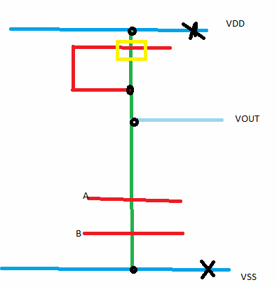
NMOS-NAND

Slide 13
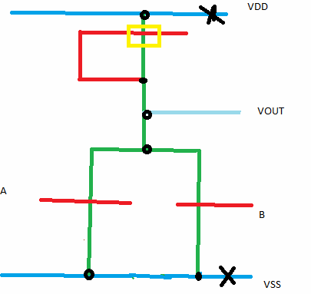
NMOS-NOR
6/3/2015
222

Slide 14
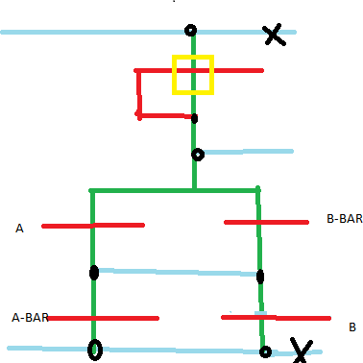
NMOS EX-OR
6/3/2015
223

Slide 15
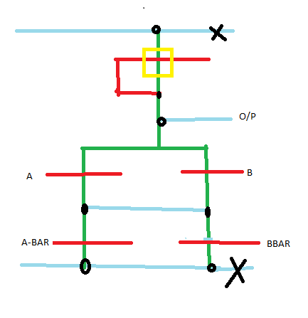
NMOS EX-NOR
6/3/2015
224

Slide 16
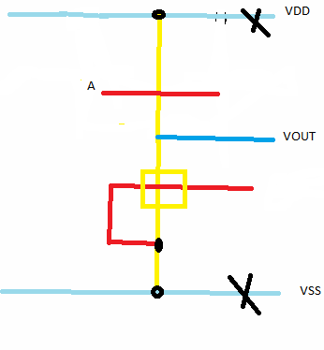
PMOS-INVERTER
6/3/2015
225

Slide 17
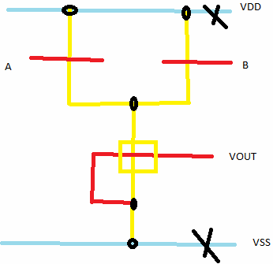
PMOS NAND
6/3/2015
226

Slide 18
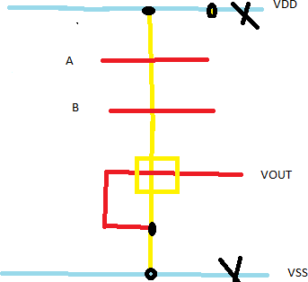
PMOS-NOR
6/3/2015
227

Slide 19
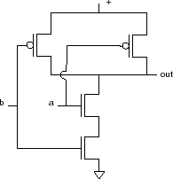
Sticks design CMOS NAND:
Start with NAND gate:
6/3/2015
228

Slide 20
NAND sticks
VDD
a
out
b
VSS
6/3/2015
229

Slide 21
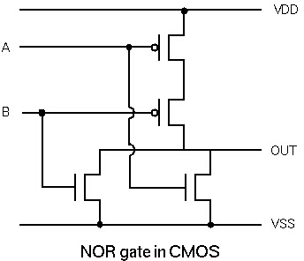
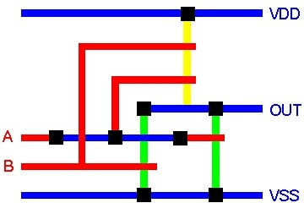
Stick Diagram - Example
A
OUT
B
NOR Gate
6/3/2015
230

Slide 22
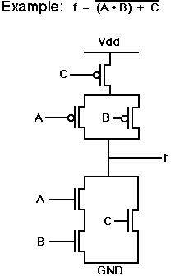
Stick Diagram - Example
Power
A
Out
C
B
Ground
6/3/2015
231

Slide 23
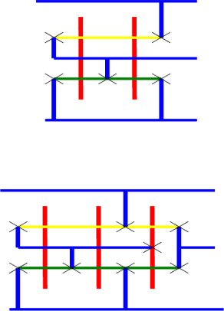
2 I/P OR GATE
6/3/2015
232

Slide 24
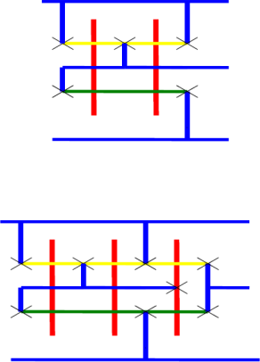
2 I/P AND
6/3/2015
233

Slide 25
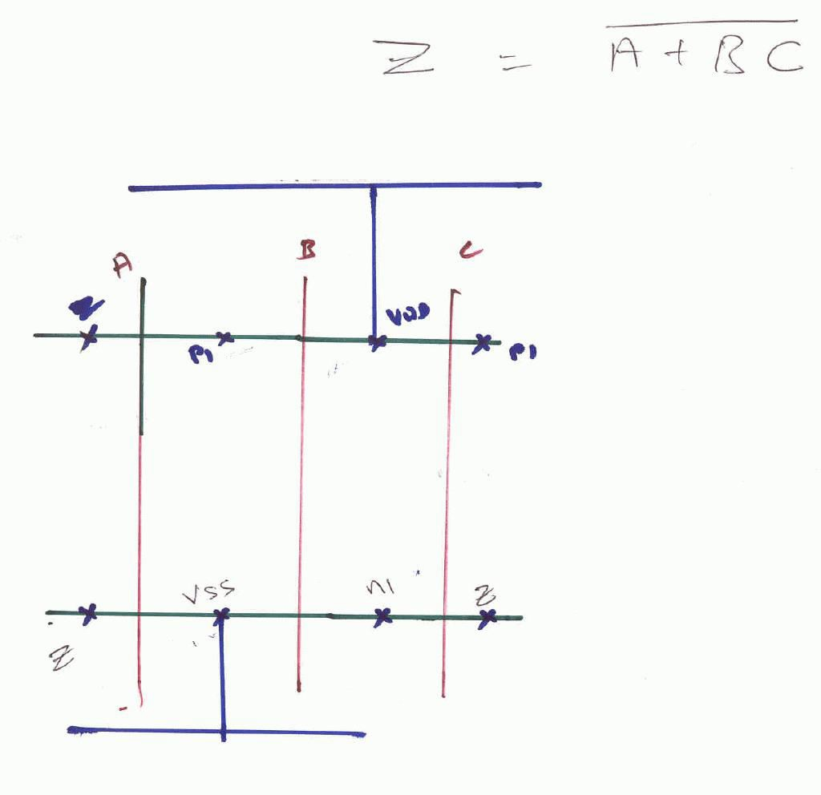
6/3/2015
234

Slide 26
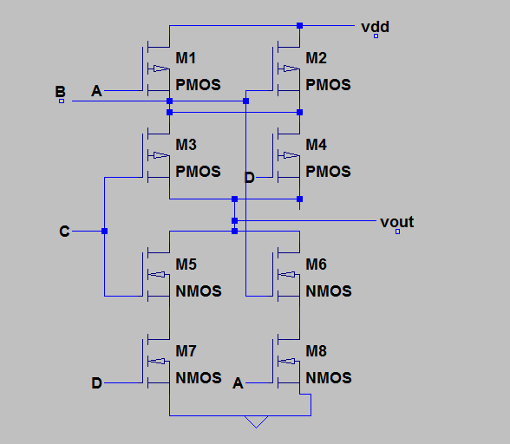
Y=(AB+CD)’
6/3/2015
235

Slide 27
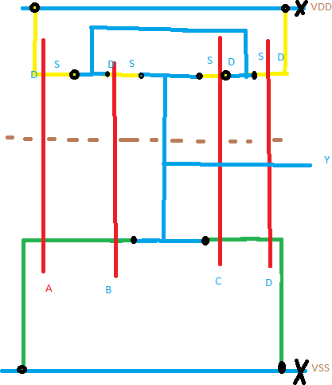
Y=(AB+CD)’ STICK
6/3/2015
236

