Slide 1
Introduction to Big Data Technology

Slide 2
Topics
Scope: Big Data & Analytics
Topics:
  Foundation of Data Analytics and Data Mining
  Hadoop/Map-Reduce Programming and Data Processing & BigTable/Hbase/Cassandra
  Graph Database and Graph Analytics

Slide 3
What’s Big Data?
No single definition; here is from Wikipedia:
Big data is the term for a collection of data sets so large and complex that it becomes difficult to process using on-hand database management tools or traditional data processing applications.
The challenges include capture, curation, storage, search, sharing, transfer, analysis, and visualization.
The trend to larger data sets is due to the additional information derivable from analysis of a single large set of related data, as compared to separate smaller sets with the same total amount of data, allowing correlations to be found to "spot business trends, determine quality of research, prevent diseases, link legal citations, combat crime, and determine real-time roadway traffic conditions.”

Slide 4
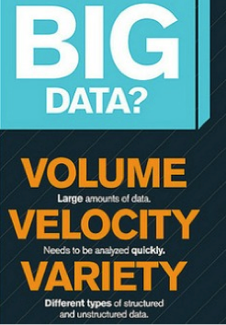
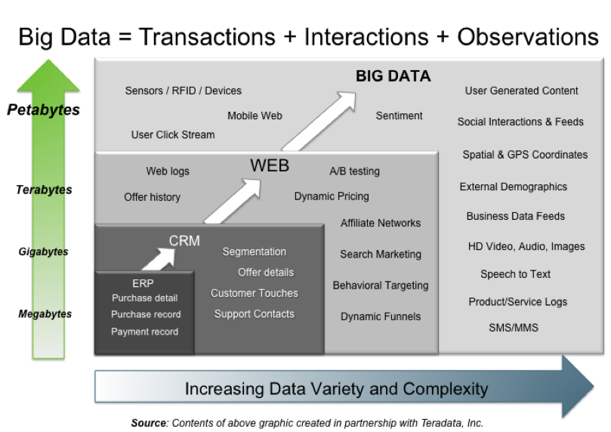
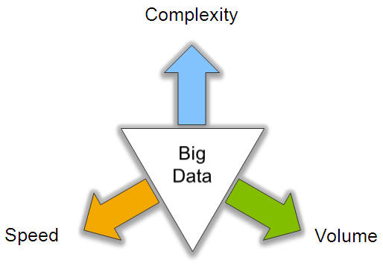
Big Data: 3V’s

Slide 5
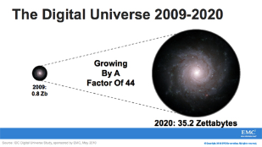
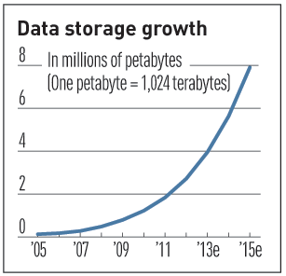

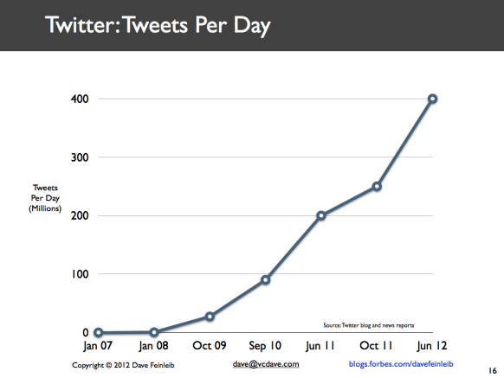
Volume (Scale)
Data Volume
  44x increase from 2009 2020
  From 0.8 zettabytes to 35zb
Data volume is increasing exponentially
Exponential increase in collected/generated data

Slide 6
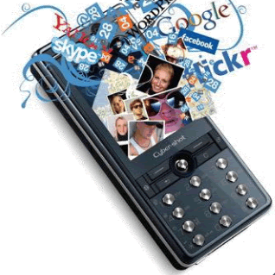
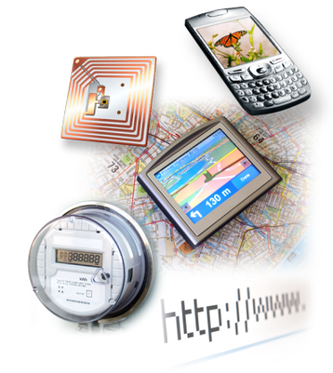

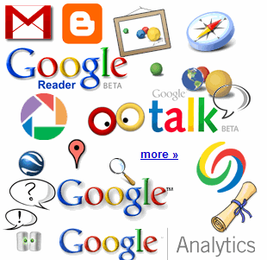

4.6 billion camera phones world wide
30 billion RFID tags today
(1.3B in 2005)
12+ TBs
of tweet data
every day
100s of millions of GPS enabled devices sold annually
? TBs of
data every day
25+ TBs of
log data every day
2+ billion people on the Web by end 2011
76 million smart meters in 2009…
200M by 2014

Slide 7
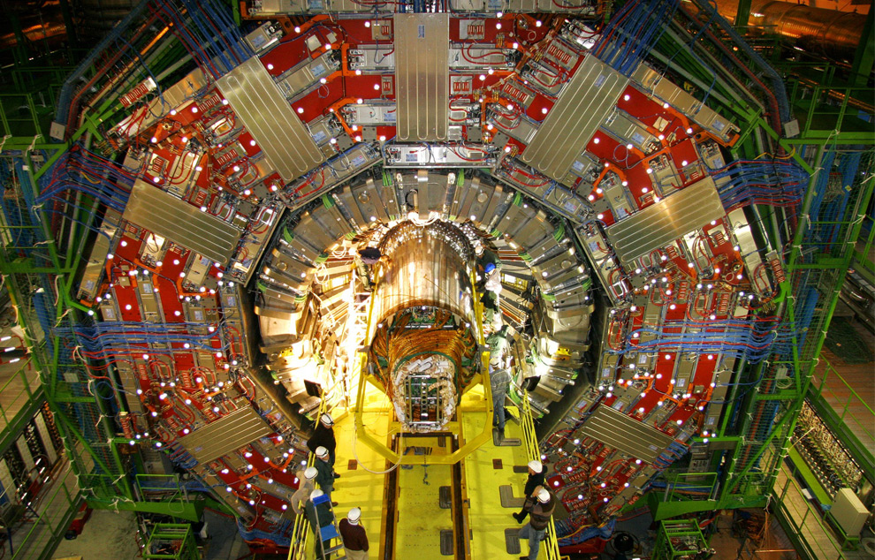
CERN’s Large Hydron Collider (LHC) generates 15 PB a year
Maximilien Brice, © CERN

Slide 8
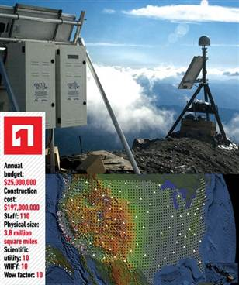
The Earthscope
1.
The Earthscope is the world's largest science project. Designed to track North America's geological evolution, this observatory records data over 3.8 million square miles, amassing 67 terabytes of data. It analyzes seismic slips in the San Andreas fault, sure, but also the plume of magma underneath Yellowstone and much, much more. (http://www.msnbc.msn.com/id/44363598/ns/technology_and_science-future_of_technology/#.TmetOdQ--uI)

Slide 9
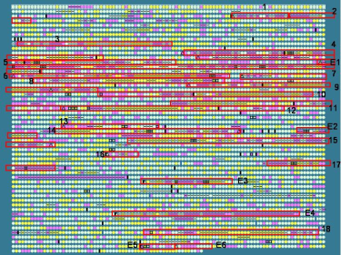
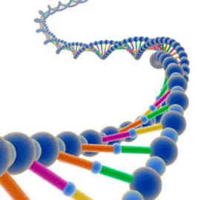
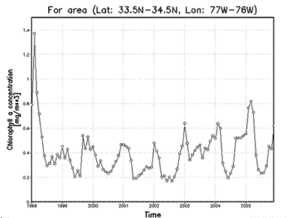
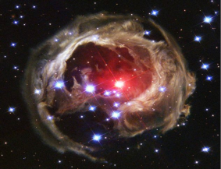
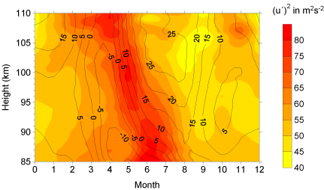
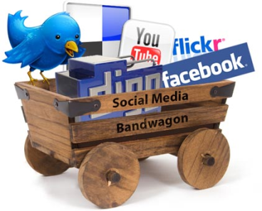
Variety (Complexity)
Relational Data (Tables/Transaction/Legacy Data)
Text Data (Web)
Semi-structured Data (XML)
Graph Data
  Social Network, Semantic Web (RDF), …
Streaming Data
  You can only scan the data once
A single application can be generating/collecting many types of data
Big Public Data (online, weather, finance, etc)
To extract knowledge➔ all these types of data need to linked together

Slide 10









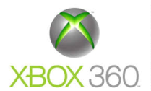







A Single View to the Customer
Social Media
Banking
Finance
Gaming
Our
Known
History
Customer
Entertain
Purchase

Slide 11
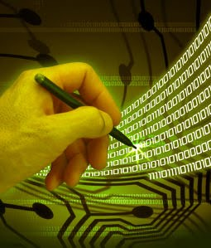
Velocity (Speed)
Data is begin generated fast and need to be processed fast
Online Data Analytics
Late decisions ➔ missing opportunities
Examples
  E-Promotions: Based on your current location, your purchase history, what you like ➔ send promotions right now for store next to you
  Healthcare monitoring: sensors monitoring your activities and body ➔ any abnormal measurements require immediate reaction

Slide 12
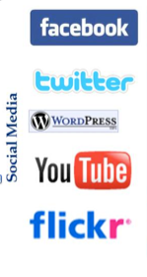
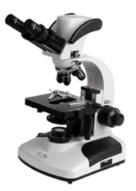
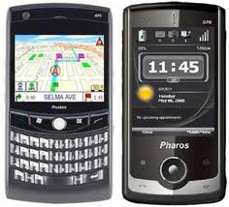
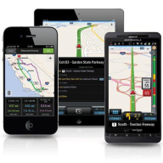
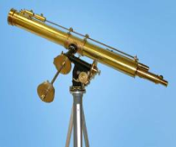
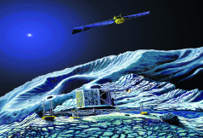
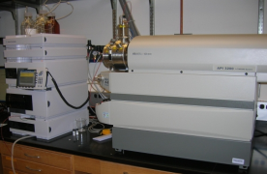
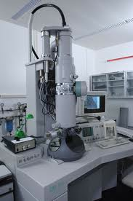
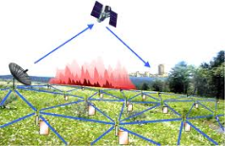
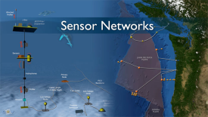
Real-time/Fast Data
Mobile devices
(tracking all objects all the time)
Social media and networks
(all of us are generating data)
Scientific instruments
(collecting all sorts of data)
Sensor technology and networks
(measuring all kinds of data)
The progress and innovation is no longer hindered by the ability to collect data
But, by the ability to manage, analyze, summarize, visualize, and discover knowledge from the collected data in a timely manner and in a scalable fashion

Slide 13
Real-Time Analytics/Decision Requirement
Product
Recommendations
that are Relevant
& Compelling
Learning why Customers
Switch to competitors
and their offers; in
time to Counter
Influence
Behavior
Customer
Friend Invitations
to join a
Game or Activity
that expands
business
Improving the
Marketing
Effectiveness of a
Promotion while it
is still in Play
Preventing Fraud
as it is Occurring
& preventing more
proactively

Slide 14
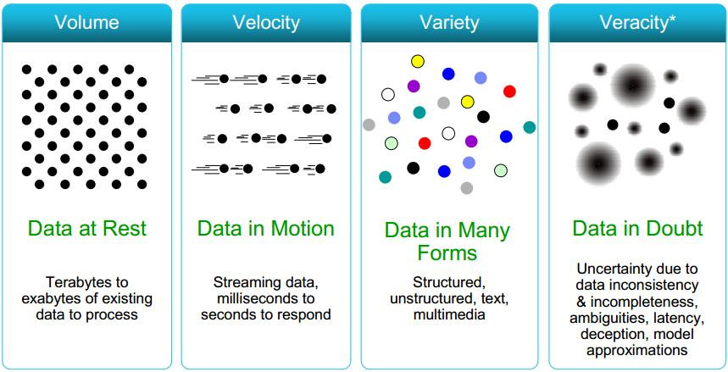
Some Make it 4V’s

Slide 15
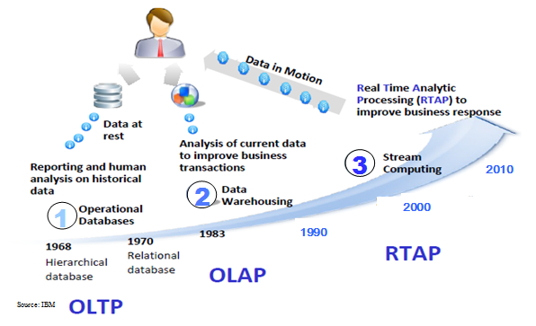
Harnessing Big Data
OLTP: Online Transaction Processing (DBMSs)
OLAP: Online Analytical Processing (Data Warehousing)
RTAP: Real-Time Analytics Processing (Big Data Architecture & technology)

Slide 16
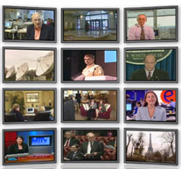
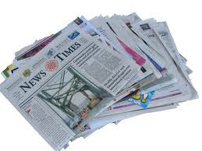
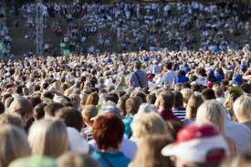

The Model Has Changed…
The Model of Generating/Consuming Data has Changed
Old Model: Few companies are generating data, all others are consuming data
New Model: all of us are generating data, and all of us are consuming data

Slide 17
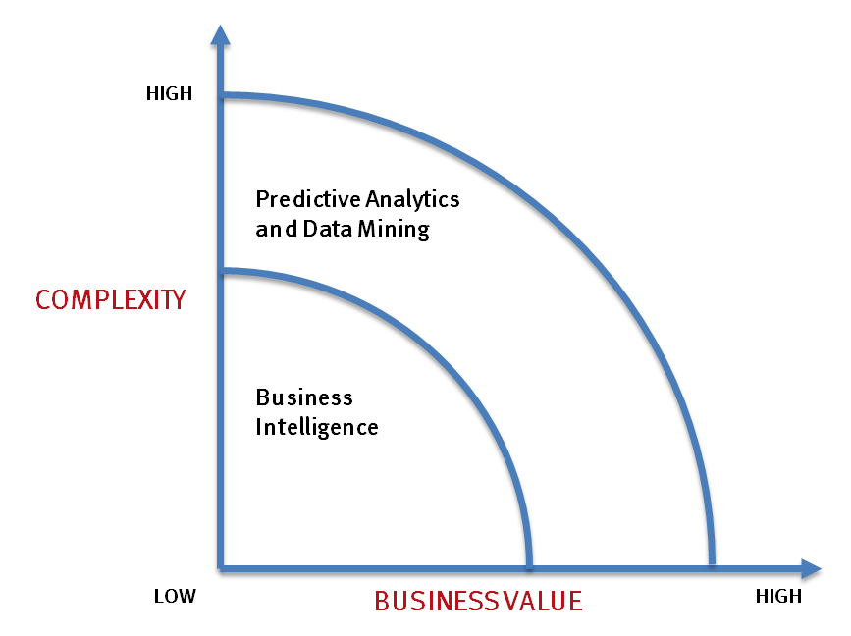
What’s driving Big Data
- Optimizations and predictive analytics
- Complex statistical analysis
- All types of data, and many sources
- Very large datasets
- More of a real-time
- Ad-hoc querying and reporting
- Data mining techniques
- Structured data, typical sources
- Small to mid-size datasets

Slide 18
The Evolution of Business Intelligence
Interactive Business Intelligence &
In-memory RDBMS
QliqView, Tableau, HANA
Big Data:
Real Time &
Single View
Graph Databases
Speed
Scale
BI Reporting
OLAP &
Dataware house
Business Objects, SAS, Informatica, Cognos other SQL Reporting Tools
Big Data:
Batch Processing &
Distributed Data Store
Hadoop/Spark; HBase/Cassandra
Scale
Speed
1990’s
2000’s
2010’s

Slide 19
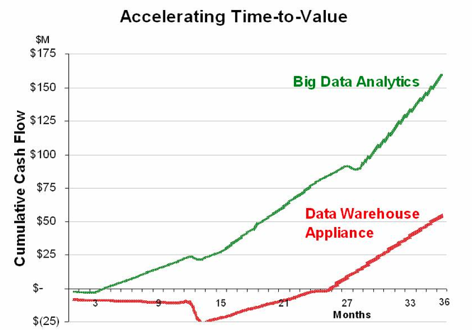
Big Data Analytics
Big data is more real-time in nature than traditional DW applications
Traditional DW architectures (e.g. Exadata, Teradata) are not well-suited for big data apps
Shared nothing, massively parallel processing, scale out architectures are well-suited for big data apps

Slide 20
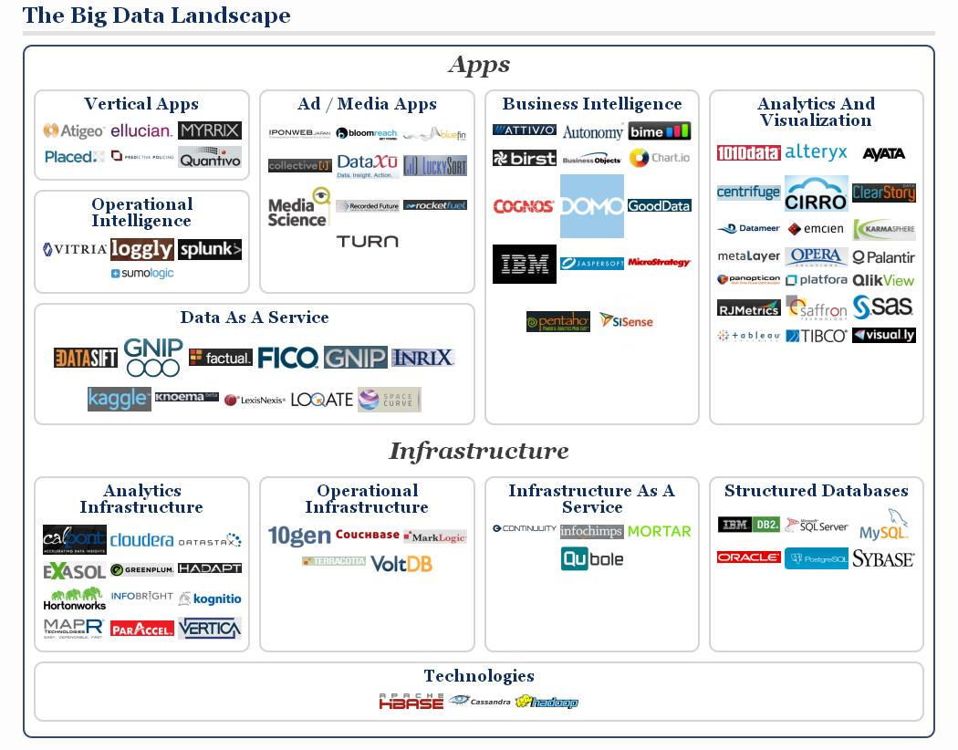

Slide 21
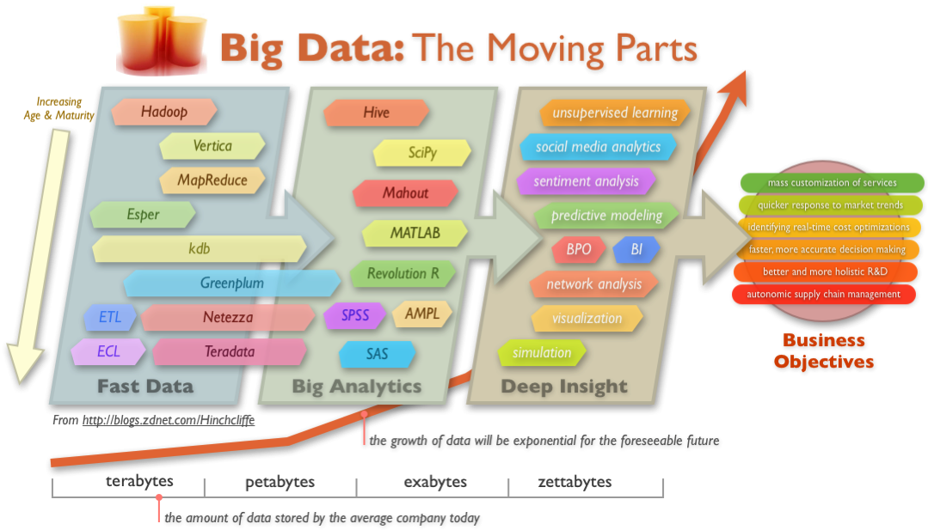
Big Data Technology

Slide 22
Cloud Computing
IT resources provided as a service
  Compute, storage, databases, queues
Clouds leverage economies of scale of commodity hardware
  Cheap storage, high bandwidth networks & multicore processors
  Geographically distributed data centers
Offerings from Microsoft, Amazon, Google, …

Slide 23
wikipedia:Cloud Computing

Slide 24
Benefits
Cost & management
  Economies of scale, “out-sourced” resource management
Reduced Time to deployment
  Ease of assembly, works “out of the box”
Scaling
  On demand provisioning, co-locate data and compute
Reliability
  Massive, redundant, shared resources
Sustainability
  Hardware not owned

Slide 25
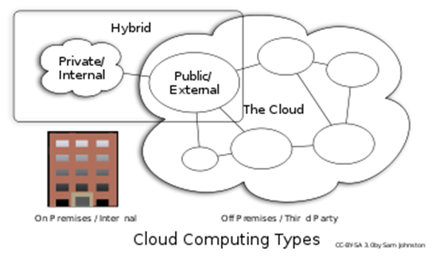
Types of Cloud Computing
Public Cloud: Computing infrastructure is hosted at the vendor’s premises.
Private Cloud: Computing architecture is dedicated to the customer and is not shared with other organisations.
Hybrid Cloud: Organisations host some critical, secure applications in private clouds. The not so critical applications are hosted in the public cloud
  Cloud bursting: the organisation uses its own infrastructure for normal usage, but cloud is used for peak loads.
Community Cloud

Slide 26
Classification of Cloud Computing based on Service Provided
Infrastructure as a service (IaaS)
  Offering hardware related services using the principles of cloud computing. These could include storage services (database or disk storage) or virtual servers.
  Amazon EC2, Amazon S3, Rackspace Cloud Servers and Flexiscale.
Platform as a Service (PaaS)
  Offering a development platform on the cloud.
  Google’s Application Engine, Microsofts Azure, Salesforce.com’s force.com .
Software as a service (SaaS)
  Including a complete software offering on the cloud. Users can access a software application hosted by the cloud vendor on pay-per-use basis. This is a well-established sector.
  Salesforce.coms’ offering in the online Customer Relationship Management (CRM) space, Googles gmail and Microsofts hotmail, Google docs.

Slide 27
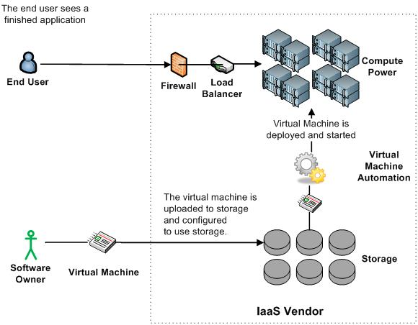
Infrastructure as a Service (IaaS)

Slide 28
More Refined Categorization
Storage-as-a-service
Database-as-a-service
Information-as-a-service
Process-as-a-service
Application-as-a-service
Platform-as-a-service
Integration-as-a-service
Security-as-a-service
Management/
Governance-as-a-service
Testing-as-a-service
Infrastructure-as-a-service
InfoWorld Cloud Computing Deep Dive

Slide 29
Topic 1: Data Analytics & Data Mining
Exploratory Data Analysis
Linear Classification (Perceptron & Logistic Regression)
Linear Regression
C4.5 Decision Tree
Apriori
K-means Clustering
EM Algorithm
PageRank & HITS
Collaborative Filtering

Slide 30
Topic 2: Hadoop/MapReduce Programming & Data Processing
Architecture of Hadoop, HDFS, and Yarn
Programming on Hadoop
Basic Data Processing: Sort and Join
Information Retrieval using Hadoop
Data Mining using Hadoop (Kmeans+Histograms)
Machine Learning on Hadoop (EM)
Hive/Pig
HBase and Cassandra

Slide 31
Topic 3: Graph Database and
Graph Analytics
Graph Database (http://en.wikipedia.org/wiki/Graph_database)
  Native Graph Database (Neo4j)
  Pregel/Giraph (Distributed Graph Processing Engine)
Neo4j/Titan/GraphLab/GraphSQL

