Slide 1
Antennas & Micro Wave Engineering
ANNAMACHARYA INSTITUTE OF TECHNOLOGY AND SCIENCES KADAPA

Slide 2
Basic Antenna Theory
Purpose
to refresh basic concepts related to the antenna physics
– needed to understand better the operation and design of microwave links and systems

Slide 3
Outline
Introduction
Review of basic antenna types
Radiation pattern, gain, polarization
Equivalent circuit & radiation efficiency
Smart antennas
Some theory
Summary
3

Slide 4
Quiz
We use a transmitting antenna to radiate radio wave and a receiving antenna to capture the RF energy carried by the wave.
Somebody told that the receiving antenna also radiates radio waves during the reception.
Is it a true fact or a slip of the tongue?
4

Slide 5
Intended & unintended radiators
Antennas intended to produce specified EM field
Radiocommunication antennas; Measuring antennas; EM sensors, probes; EM applicators (Industrial, Medical, Scientific)
Radiators not intended to generate any EM field, but producing it as an unintended side-effect
Any conductor/ installation with varying electrical current (e.g. electrical installation of vehicles)
Any slot/ opening in the screen of a device/ cable carrying RF current
Any discontinuity in transmission medium (e.g. conducting structures/ installations) irradiated by EM waves
– Stationary (e.g. antenna masts or power line wires); Time-varying (e.g. windmill or helicopter propellers); Transient (e.g. aeroplanes, missiles)
5

Slide 6
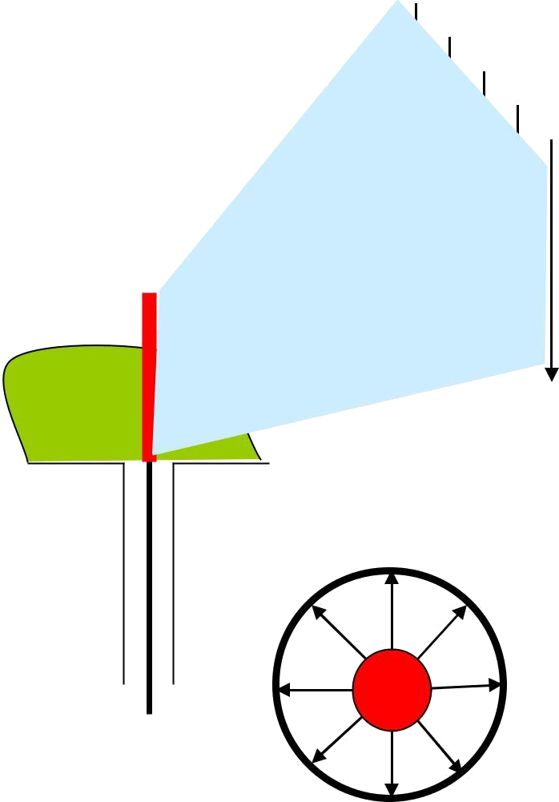
Antenna purpose
Transformation of a guided EM wave in transmission line (waveguide) into a freely propagating EM wave in space (or vice versa) with specified directional characteristics
Transformation from time-function in one-dimensional space into time- function in three dimensional space
The specific form of the radiated wave is defined by the antenna structure and the environment
Space wave
Guided wave
6

Slide 7
Antenna functions
Transmission line
Power transport medium - must avoid power reflections, otherwise use matching devices
Radiator
Must radiate efficiently – must be of a size comparable with the half-wavelength
Resonator
Unavoidable - for broadband applications resonances must be attenuated
7

Slide 8
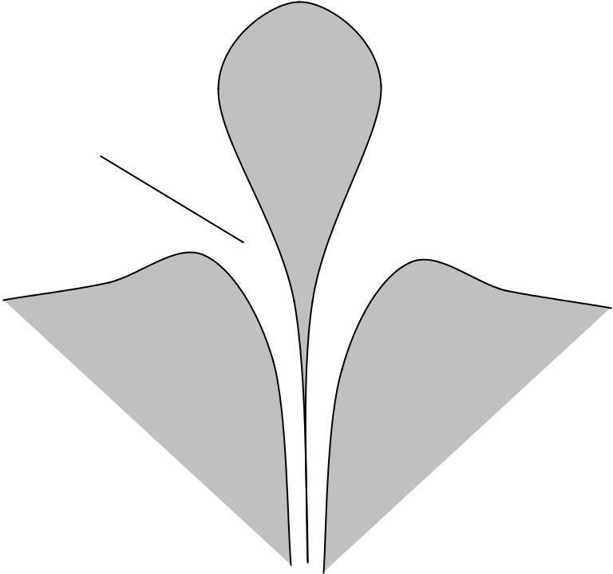
Monopole (dipole over plane)
High-Q Narrowband
Low-Q
Broadband
Smooth transition region
Uniform wave traveling along the line
If there is an inhomogeneity (obstacle) a reflected wave, standing wave, & higher field modes appear
With pure standing wave the energy is stored and oscillates from entirely electric to entirely magnetic and back
Model: a resonator with high Q = (energy stored) / (energy lost) per cycle, as in LC circuits
Kraus p.2
8

Slide 9
Outline
Introduction
Review of basic antenna types
Radiation pattern, gain, polarization
Equivalent circuit & radiation efficiency
Smart antennas
Some theory
Summary
9

Slide 10
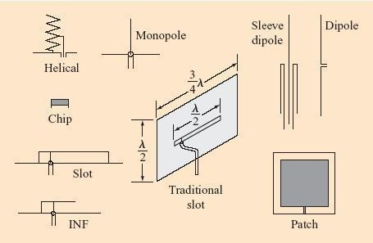
Antennas for laptop applications
Source: D. Liu et al.: Developing integrated antenna subsystemsPropertyforlaptopcomputers;ofRIBMStruzakJ.RES.& DEV. VOL. 47 NO. 2/3 MARCH/MAY 2003 p. 355-367 10

Slide 11
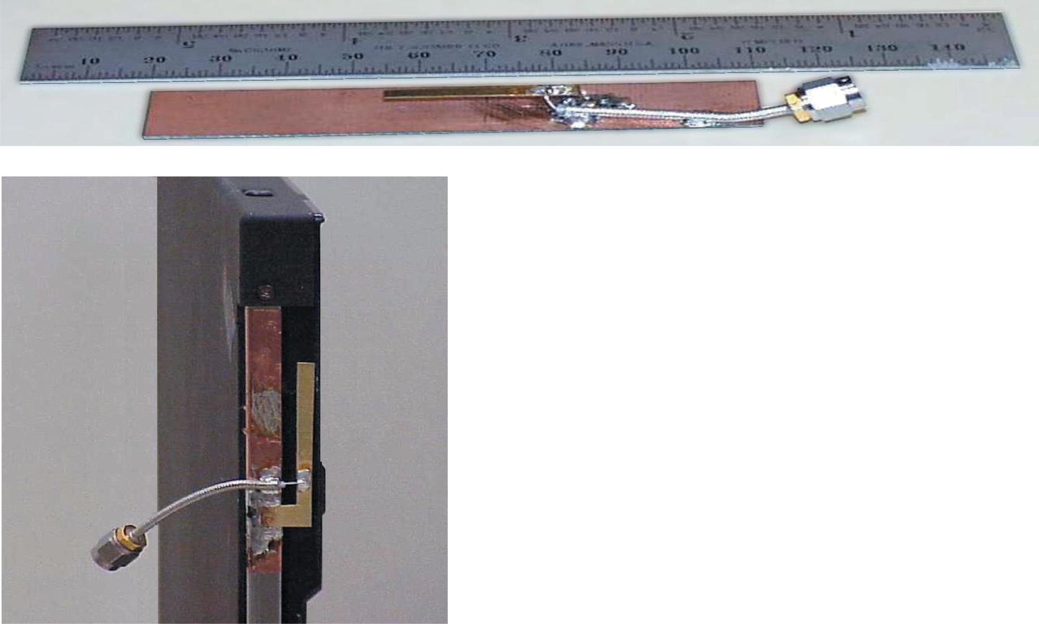
Patch and slot antennas derived from printed-circuit and micro-strip technologies
Ceramic chip antennas are typically helical or inverted-F (INF) antennas, or variations of these two types with high dielectric loading to reduce the antenna size
Source: D. Liu et al.: Developing integrated antenna subsystems for laptop computers; IBM J. RES. & DEV. VOL. 47 NO. 2/3 MARCH/MAY 2003 p. 355-367
11

Slide 12
Slot & INF antennas
Slot antenna: a slot is cut from a large (relative to the slot length) metal plate.
The center conductor of the feeding coaxial cable is
connected to one side of the slot, and the outside conductor of the cable - to the other side of the slot.
The slot length is some (λ/2) for the slot antenna and (λ/4) long for the INF antenna.
The slot and INF antennas behave similarly.
The slot antenna can be considered as a loaded version of the INF antenna. The load is a quarter-wavelength stub, i.e. a narrowband device.
When the feed point is moved to the short-circuited end of
the slot (or INF) antenna, the impedance decreases. When it is moved to the slot center (or open end of the INF antenna), the impedance increases
12

Slide 13
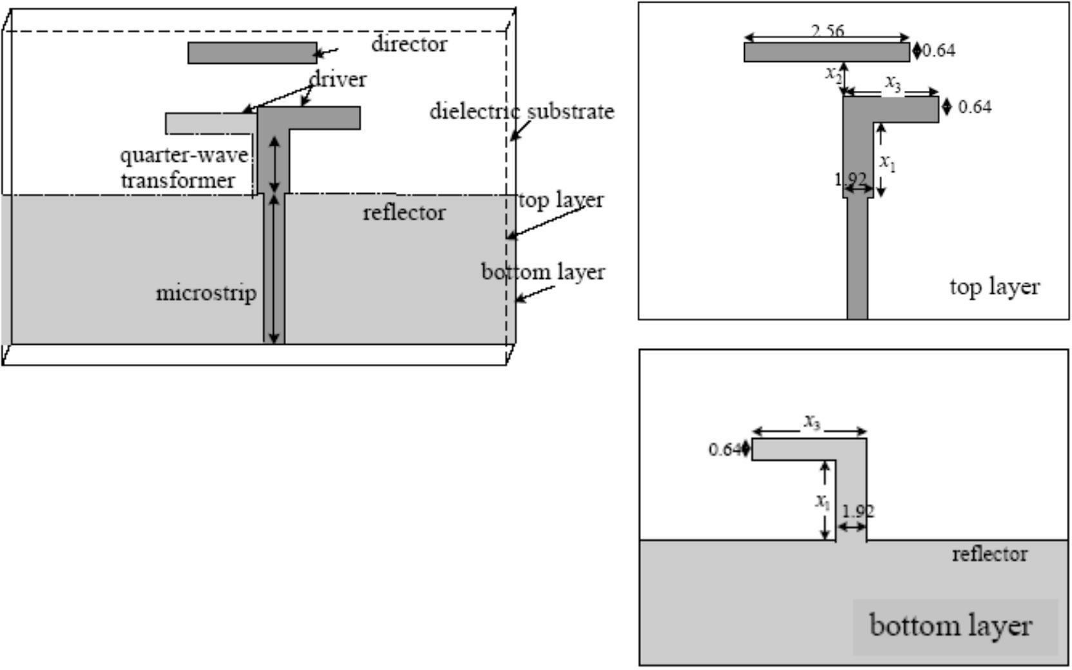
Example
double-layer printed Yagi antenna
Note: no galvanic contact with the director
Source: N Gregorieva
13

Slide 14
Patch and slot antennas are
Cheap and easy to fabricate and to mount
Suited for integration
Light and mechanically robust
Have low cross-polarization
Low-profile - widely used in antenna arrays
– spacecrafts, satellites, missiles, cars and other mobile applications
14

Slide 15
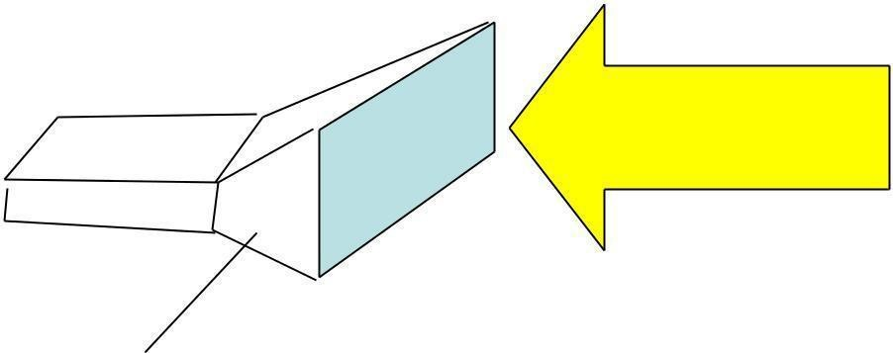
Aperture-antenna
EM wave
Aperture antennas derived from waveguide technology (circular, rectangular)
Can transfer high power (magnetrons, klystrons)
Above few GHz
Will be explored inprace during the school
Power density:
2
PFD [w/m ]
A = A*PFD
Power
absorbed: P [watt]
Effective aperture: A[m ]
2
Note: The aperture concept is applicable also to wired antennas. For instance,
the max effective aperture of linear
2
λ/2 wavelength dipole antenna is λ /8
15

Slide 16
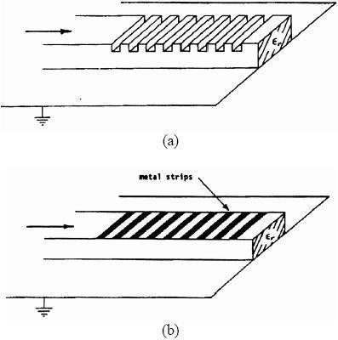
Leaky-wave antennas
Derived from millimeter- wave guides (dielectric guides, microstrip lines, coplanar and slot lines).
For frequencies > 30 GHz, including infrared
Subject of intensive study.
– Note: Periodical discontinuities near the end of the guide lead to substantial radiation leakage (radiation from the dielectric surface).
Source: adapted from N Gregorieva
16

Slide 17
Reflector antennas
Reflectors are used to concentrate flux of EM energy radiated/ received, or to change its direction
Usually, they are parabolic (paraboloidal).
The first parabolic (cylinder) reflector antenna was used by Heinrich Hertz in 1888.
Large reflectors have high gain and directivity
Are not easy to fabricate
Are not mechanically robust
Typical applications: radio telescopes, satellite telecommunications.
Source: adapted from N Gregorieva
17

Slide 18
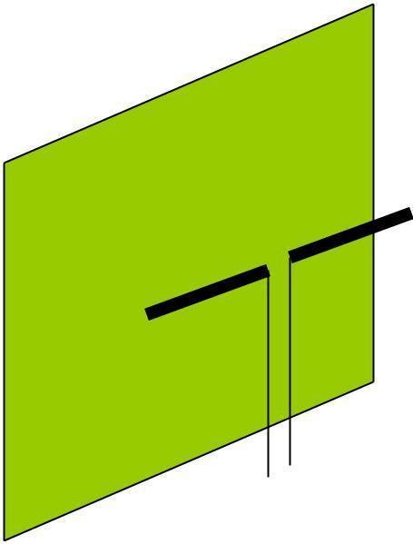
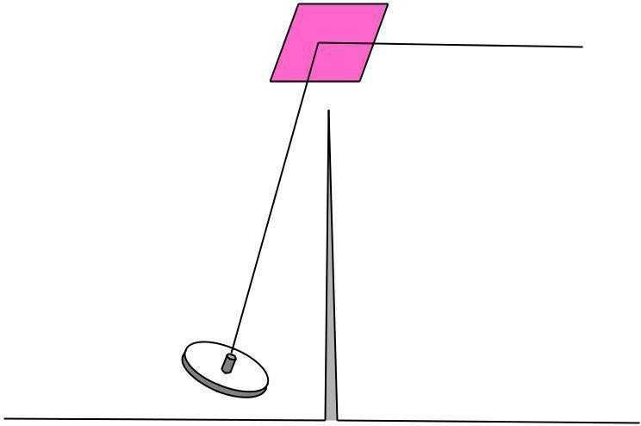
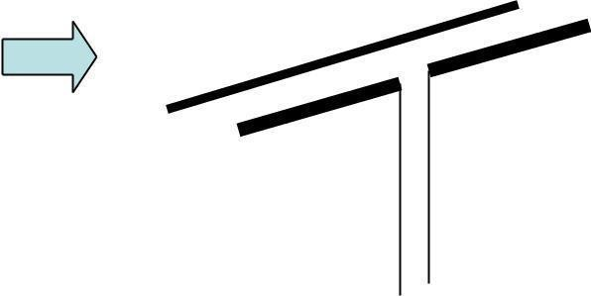
Planar reflectors
d
2d
Intended reflector antenna allows maintaining radio link in non-LOS conditions (avoiding propagation obstacles)
Unintended antennas create interference
Uda-Yagi, Log-periodic antennas

Slide 19
Paraboloidal reflectors
Front feed
Cassegrain feed

Slide 20
The largest radio telescopes
Max Plank Institüt für Radioastronomie radio telescope, Effelsberg (Germany), 100-m paraboloidal reflector
The Green Bank Telescope (the National Radio Astronomy Observatory)
– paraboloid of aperture 100 m
Source: adapted from N Gregorieva
20

Slide 21
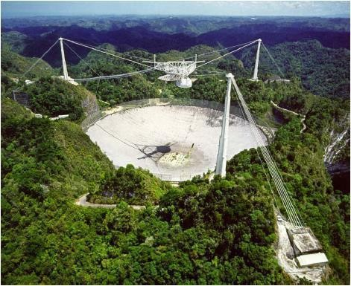
The Arecibo Observatory Antenna System
The world‘s largest single radio telescope
304.8-m
spherical reflector
National Astronomy and Ionosphere Center (USA), Arecibo, Puerto Rico

Slide 22
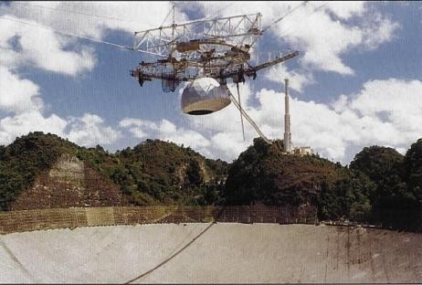
The Arecibo Radio Telescope
[Sky & Telescope Feb 1997 p. 29]

Slide 23
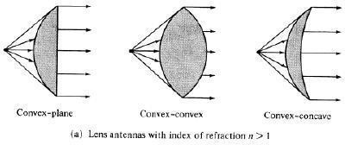
Lens antennas
Lenses play a similar role to that of reflectors in reflector antennas: they collimate divergent energy Often preferred to reflectors at frequencies > 100 GHz.
Source: Kraus p.382, N Gregorieva
23

Slide 24
Outline
Introduction
Review of basic antenna types
Radiation pattern, gain, polarization
Equivalent circuit & radiation efficiency
Smart antennas
Some theory
Summary

Slide 25
Radiation pattern
The radiation pattern of antenna is a representation (pictorial or mathematical) of the distribution of the power out-flowing (radiated) from the antenna (in the case of transmitting antenna), or inflowing (received) to the antenna (in the case of receiving antenna) as a function of direction angles from the antenna
Antenna radiation pattern (antenna pattern):
is defined for large distances from the antenna, where the spatial (angular) distribution of the radiated power does not depend on the distance from the radiation source
is independent on the power flow direction: it is the same when the antenna is used to transmit and when it is used to receive radio waves
is usually different for different frequencies and different polarizations of radio wave radiated/ received

Slide 26
Power pattern vs. Field pattern
The power pattern is the measured (calculated) and plotted received power: |P(θ, ϕ)| at a constant (large) distance from the antenna
The amplitude field pattern is the measured (calculated) and
Antenna |  | Auxiliary
 |  | antenna
under test
Large distance
Power or |  | Generator
field-strength meter
Turntable
plotted electric (magnetic)
field intensity, |E(θ, ϕ)| or |H(θ,
The power pattern and the field patterns are inter-related:
2 2
ϕ)| at a constant (large) distance from the antenna
P (θ, ϕ) = (1/η)*|E(θ, ϕ)| = η*|H(θ, ϕ)|
P = power

Slide 27
E = electrical field component vector H = magnetic field component vector
η = 377 ohm (free-space, plane wave
impedance) | 26

Slide 28
Normalized pattern
Usually, the pattern describes the normalized field (power) values with respect to the maximum value.
– Note: The power pattern and the amplitude field pattern are the same when computed and when plotted in dB.

Slide 29
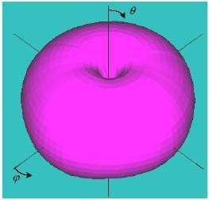
3-D pattern
Antenna radiation pattern is 3-dimensional
The 3-D plot of antenna pattern assumes both angles θ and ϕ varying, which is difficult to produce and to interpret
3-D pattern
Source: NK Nikolova
28

Slide 30
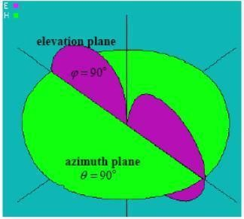
2-D pattern
Usually the antenna pattern is presented as a 2-D plot, with only one of the direction angles, θ or ϕ varies
It is an intersection of the 3-D one with a given plane
– usually it is a θ = const
plane or a ϕ= const plane that contains the pattern‘s maximum
Two 2-D patterns
Source: NK Nikolova
29

Slide 31
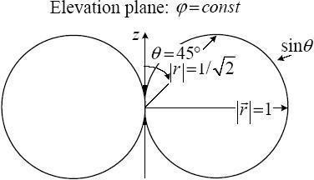
Example: a short dipole
on z-axis
Source: NK Nikolova
30

Slide 32
Principal patterns
Principal patterns are the 2-D patterns of linearly polarized antennas, measured in 2 planes
the E-plane: a plane parallel to the E vector and containing the direction of maximum radiation, and
the H-plane: a plane parallel to the H vector, orthogonal to the E-plane, and containing the direction of maximum
radiation
Source: NK Nikolova

Slide 33
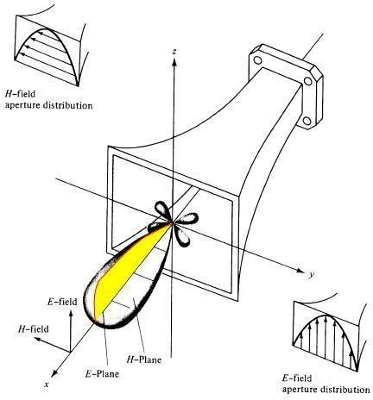
Example
Source: NK Nikolova

Slide 34
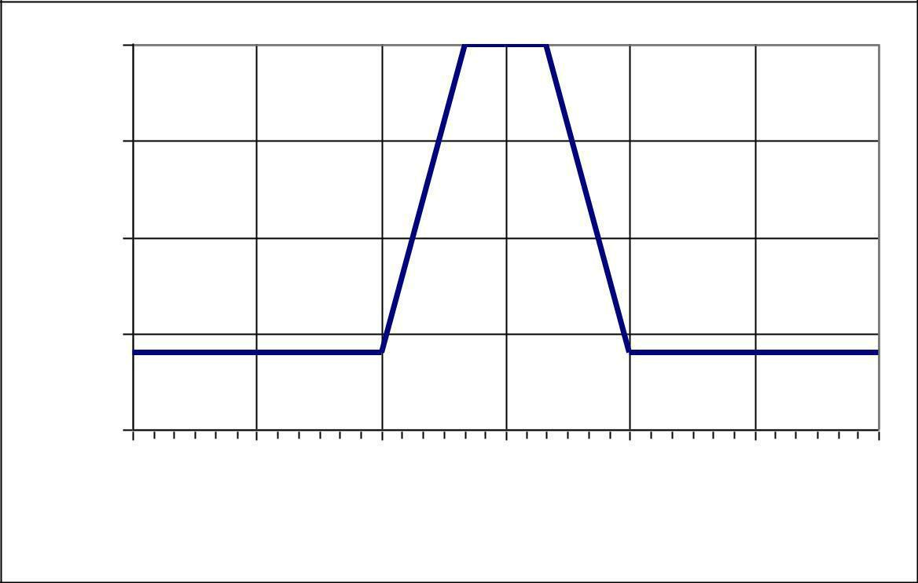
Antenna Mask (Example 1)
Typical relative directivity- mask of receiving antenna (Yagi ant., TV dcm waves)
0
-5
-10
-15
-20
-180 | -120 | -60 | 0 | 60 | 120 | 180
 | Azimith angle, degrees
Relative gain, dB
[CCIR doc. 11/645, 17-Oct 1989)

Slide 35
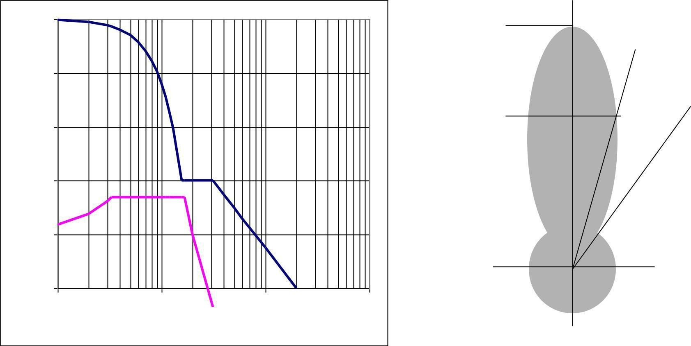
Antenna Mask (Example 2)
0dB
0
RR/1998 APS30 Fig.9
-10 | Phi
COPOLAR
-20 | -3dB
Relative gain(dB)
-30
-40
CROSSPOLAR
-50
0.1 | 1 | 10 | 100
Phi/Phi0
Reference pattern for co-polar and cross-polar components for satellite transmitting antennas in Regions 1 and 3 (Broadcasting ~12 GHz)

Slide 36
Isotropic antenna
Isotropic antenna or isotropic radiator is a hypothetical (not physically realizable) concept, used as a useful reference to describe real antennas.
Isotropic antenna radiates equally in all directions.
– Its radiation pattern is represented by a sphere whose center coincides with the
location of the isotropic radiator.
Source: NK Nikolova
35

Slide 37
Directional antenna
Directional antenna is an antenna, which radiates (or receives) much more power in (or from) some directions than in (or from) others.
– Note: Usually, this term is applied to antennas whose directivity is much higher than that of a half-wavelength dipole.
Source: NK Nikolova
36

Slide 38
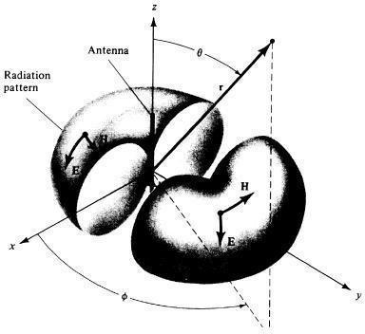
Omnidirectional antenna
An antenna, which has a non- directional pattern in a plane
– It is usually directional in other planes
Source: NK Nikolova
37

Slide 39
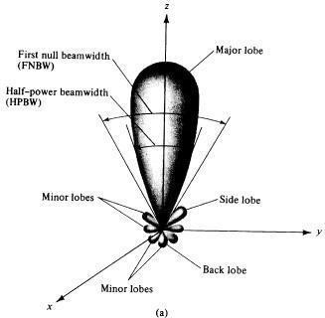
Pattern lobes
Pattern lobe is a portion of the radiation pattern with a local maximum
Lobes are classified as: major, minor, side lobes, back lobes.
Source: NK Nikolova
38

Slide 40
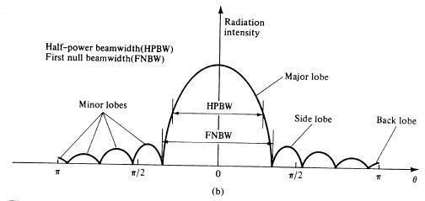
Pattern lobes and beam widths
Source: NK Nikolova
39

Slide 41
Beamwidth
Half-power beamwidth (HPBW) is the angle between two vectors from the pattern‘s origin to the points of the major lobe where the radiation intensity is half its maximum
Often used to describe the antenna resolution properties
» Important in radar technology, radioastronomy, etc.
First-null beamwidth (FNBW) is the angle between two vectors, originating at the pattern‘s origin and tangent to the main beam at its base.
» Often FNBW ≈ 2*HPBW

Slide 42
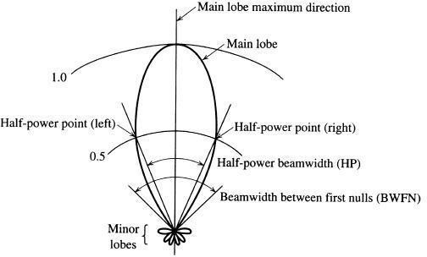
Example
Source: NK Nikolova

Slide 43
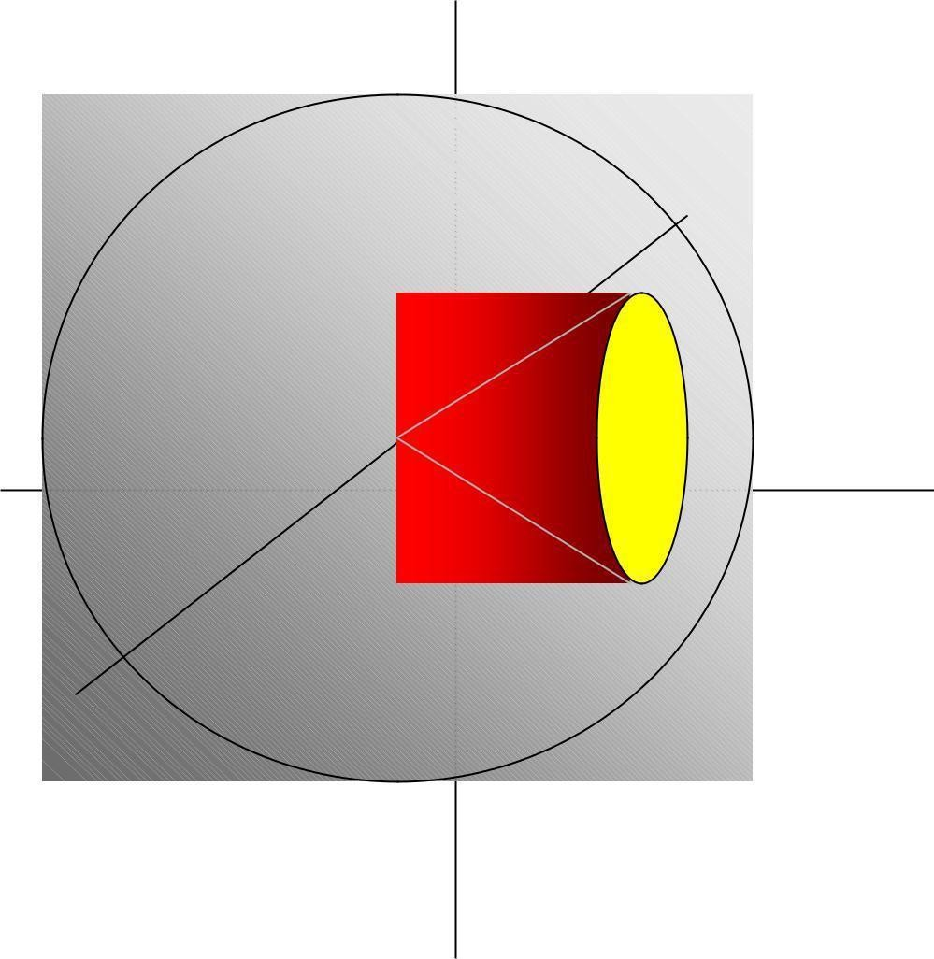
Anisotropic sources: gain
Every real antenna radiates more energy in some directions than in others (i.e. has directional properties)
 | Idealized example of directional
 | antenna: the radiated energy is
Isotropic sphere | concentrated in the yellow region
 | (cone).
 | Directive antenna gain: the power flux
 | density is increased by (roughly) the
 | inverse ratio of the yellow area and the
 | total surface of the isotropic sphere
 | – Gain in the field intensity may also be
 | considered - it is equal to the square
 | root of the power gain.

Slide 44
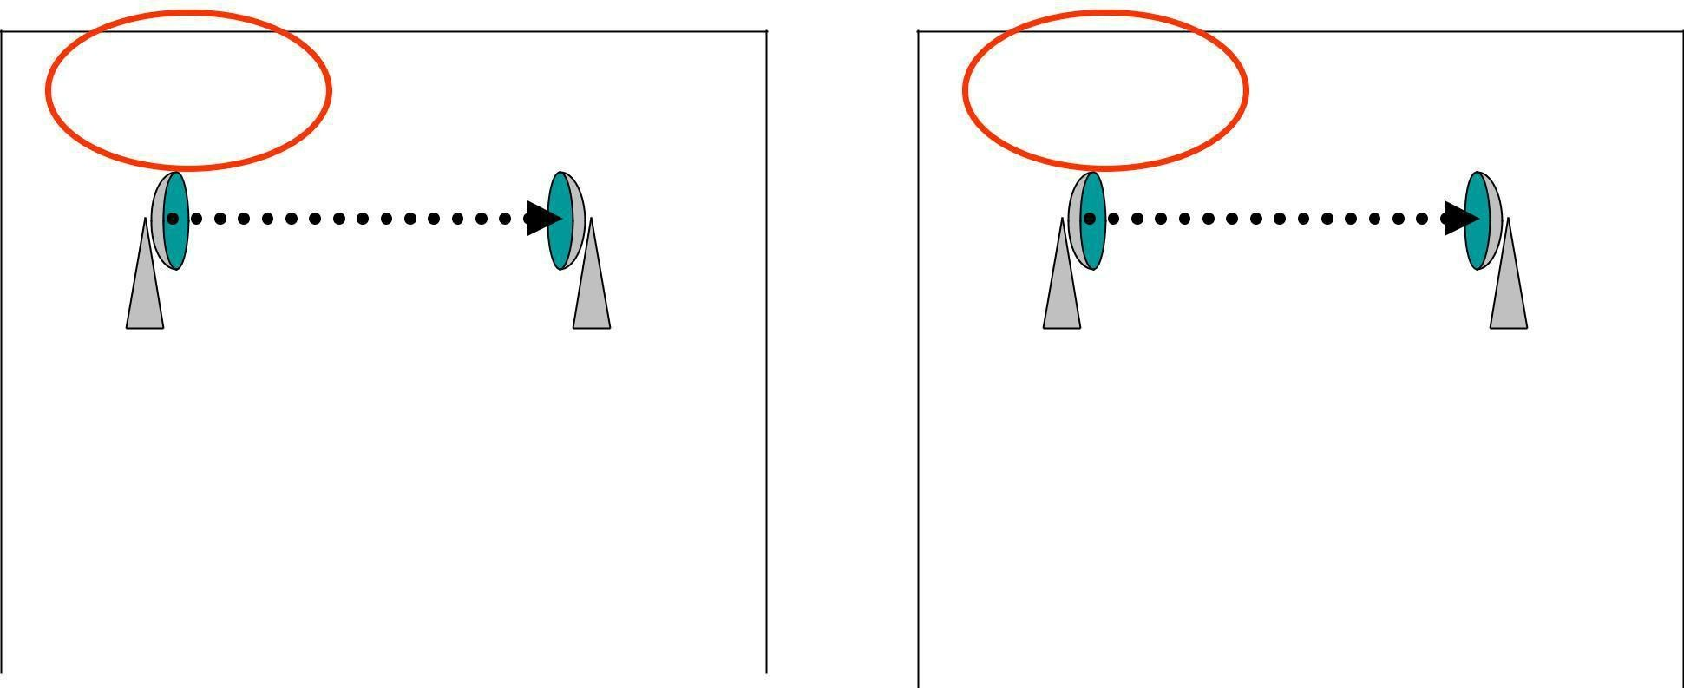
Antenna gain measurement
Reference | Measuring | Actual | Measuring
antenna | equipment | antenna | equipment
P_{o} = Power | S₀ = Power | P = Power | S = Power
delivered to | received | delivered to | received
the reference | (the same in | the actual | (the same in
antenna | both steps) | antenna | both steps)
Step 1: reference |  | Step 2: substitution
Antenna Gain = (P/P_{o}) _{S=S0}

Slide 45
Antenna Gains G_{i}, G_{d}
Unless otherwise specified, the gain refers to the direction of maximum radiation.
Gain is a dimension-less factor related to power and usually expressed in decibels
G_{i} ―Isotropic Power Gain‖ – theoretical concept, the reference antenna is isotropic
G_{d} - the reference antenna is a half- wave dipole

Slide 46
Typical Gain and Beamwidth
Type of antenna | G_{i} [dB] | BeamW.
Isotropic | 0 | 360 | x360
 |  |  | 0
Half-wave Dipole | 2 | 360 | x120
 |  |  | 0
Helix (10 turn) | 14 | 0 0 35 x35
Small dish | 16 | 0 0 30 x30
Large dish | 45 | 0 0 1 x1

Slide 47
Antenna gain and effective area
Measure of the effective absorption area presented by an antenna to an incident plane wave.
Depends on the antenna_{λ} gain and wavelength
A_{e} =η
π² G(θ , ϕ) [m² ]
4
Aperture efficiency: η_{a} = A_{e} / A
A: physical area of antenna’s aperture, square meters

Slide 48
Power Transfer in Free Space
λ: wavelength [m]
P_{R}: power available at the receiving antenna
P_{T}: power delivered to the transmitting antenna
G_{R}: gain of the transmitting antenna in the direction of the receiving antenna
G_{T}: gain of the receiving antenna in the direction of the transmitting antenna
Matched polarizations
P = PFD ⋅ A
R
e
⎛ GT PT
= ⎜
⎝
⎛
⎞
⎟
⎟
2
λ G
R
⎞⎜
4π
4πr
2
⎜
⎝⎠
₂ ⎠
⎛ λ ⎞
= P G G
⎜
⎟
R ⎝4πr ⎠
T T

Slide 49
48

Slide 50
e.i.r.p.
Equivalent Isotropically Radiated Power (in a given direction):
e.i.r . p. = PG_{i}
The product of the power supplied to the antenna and the antenna gain (relative to an isotropic antenna) in a given direction

Slide 51
Linear Polarization
In a linearly polarized plane wave the direction of the E (or H) vector is constant.
http://www.amanogawa.com/archive/wavesA.h tml

Slide 52
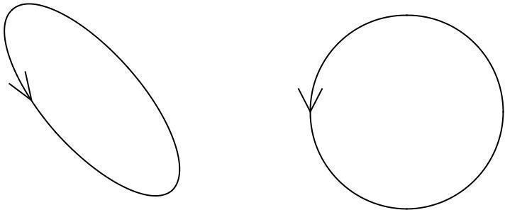
Elliptical Polarization
LHC
Ex = cos (wt) | Ex = cos (wt) | Ex = cos (wt) | Ex = cos (wt)
Ey = cos (wt) | Ey = cos (wt+pi/4) | Ey = -sin (wt) | Ey = cos (wt+3pi/4)
 | RHC
Ex = cos (wt) | Ex = cos (wt)
Ey = -cos (wt+pi/4) | Ey = sin (wt)
51

Slide 53
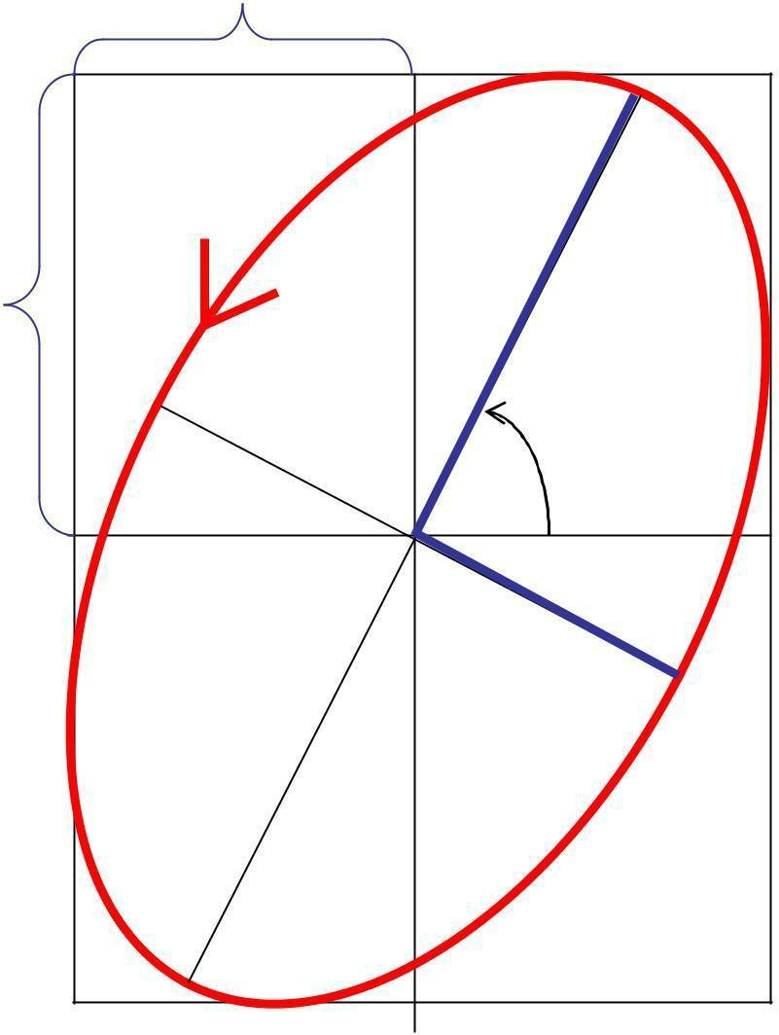
Polarization ellipse
E_{x}
The superposition of two plane-wave
M
components results in an elliptically polarized wave
E_{y}
ψ
The polarization ellipse is defined by its axial ratio N/M (ellipticity), tilt angle ψ and sense of rotation
N
52

Slide 54
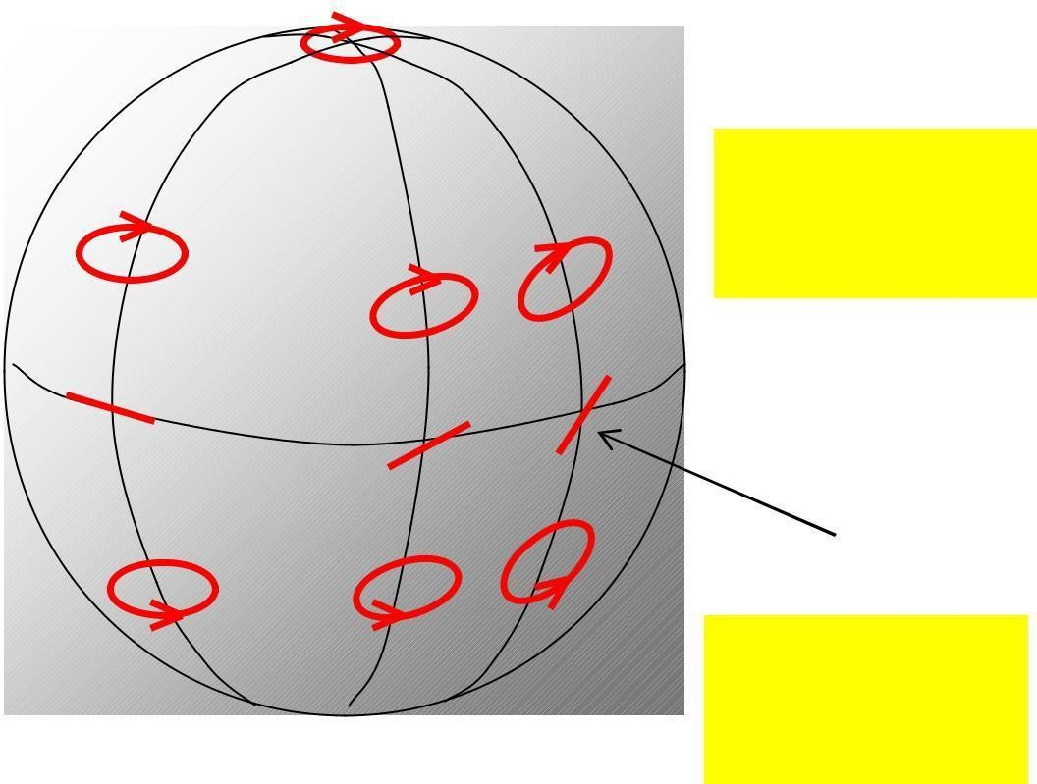
Polarization states
LHC | (Poincaré sphere)
UPPER HEMISPHERE: ELLIPTIC POLARIZATION LEFT_HANDED SENSE
LATTITUDE: REPRESENTS AXIAL RATIO
EQUATOR:
LINEAR POLARIZATION
LOWER HEMISPHERE: ELLIPTIC POLARIZATION RIGHT_HANDED SENSE
45 ⁰ LINEAR
LONGITUDE: REPRESENTS TILT ANGLE
RHC
POLES REPRESENT CIRCULAR POLARIZATIONS
53

Slide 55
Comments on Polarization
At any moment in a chosen reference point in space, there is actually a single electric vector E (and associated magnetic vector H).
This is the result of superposition (addition) of the instantaneous fields E (and H) produced by all radiation sources active at the moment.
The separation of fields by their wavelength, polarization, or direction is the result of ‗filtration‘.
54

Slide 56
Antenna Polarization
The polarization of an antenna in a specific direction is defined to be the polarization of the wave produced by the antenna at a great distance at this direction
55

Slide 57
Polarization Efficiency
The power received by an antenna
from a particular direction is maximal if the polarization of the incident wave and the polarization of the antenna in the wave arrival direction have:
the same axial ratio
the same sense of polarization
the same spatial orientation
.
56

Slide 58
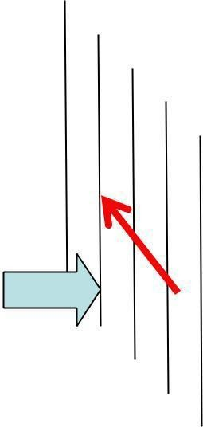
Polarization filters/ reflectors
Wall of thin parallel wires (conductors)
|E₁|>0
|E₂| = 0
|E₁|>0
|E₂| ~ |E2|
Vector E || wires Vector E ⊥ wires
Wire distance ~ 0.1λ
At the surface of ideal conductor the tangential electrical field component = 0
57

Slide 59
Outline
Introduction
Review of basic antenna types
Radiation pattern, gain, polarization
Equivalent circuit & radiation efficiency
Smart antennas
Some theory
Summary
58

Slide 60
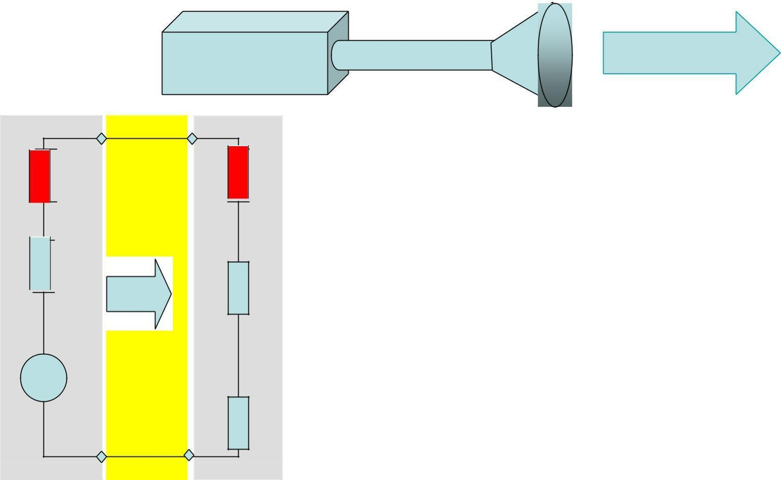
Transmitting antenna equivalent circuit
 | Antenna
Transmitter | Transm. line | Radio wave
The transmitter with the transmission line is represented
by an (Thevenin) equivalent generator
jX_{A} | The antenna is represented by its input impedance
 | (which is frequency-dependent and is influenced
by objects nearby) as seem from the generator
R r | jX_{A} represents energy stored in electric (E _{e}) and
 | magnetic (E_{m}) near-field components; if |Ee| = |E_{m}|
 | then X_{A} = 0 (antenna resonance)
jX_{G}
R_{G}
Generator
R_{r} represents energy radiated into space (far-
V_{G}
 | field components)
R_{l} | R_{l} represents energy lost, i.e. transformed into heat
 | in the antenna structure
59

Slide 61
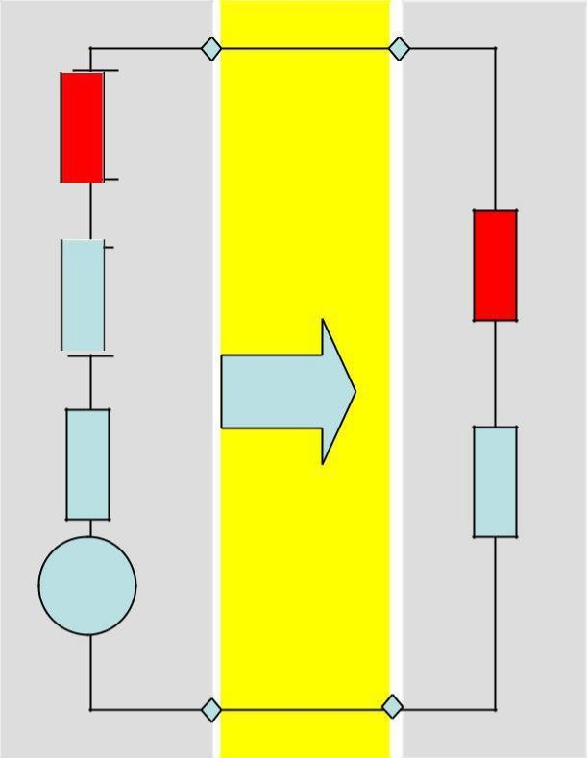
Receiving antenna equivalent circuit
Antenna
Radio wave
Transm.line Receiver
The antenna with the transmission line is represented by an (Thevenin) equivalent generator
jX_{A}
jX_{L}
The receiver is represented by its input impedance as seen from the antenna terminals (i.e. transformed by the transmission line)
R_{r}
R_{l} V_{A}
Antenna
R
L
VA is the (induced by the incident wave) voltage at the antenna terminals determined when the antenna is open circuited
Note: The antenna impedance is the same when the antenna is used to radiate and when it is used to receive energy
Thevenin equivalent
64

Slide 62
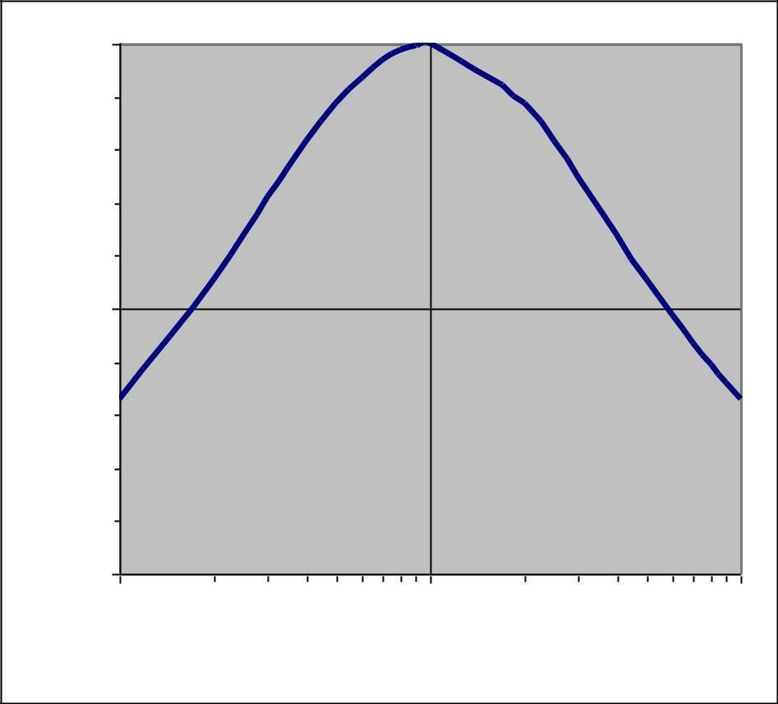
Power transfer
 |  | • | The maximum
 |  |  | power is delivered
 |  |  | to (or from) the
 |  |  | antenna when the
5 |  |  | antenna
 |  |  | impedance and
 |  |  | the impedance of
0.1 | 1 | 10 | the equivalent
 | RA / RG; (XA+XG = 0) |  | generator (or load)
1
PA / PAmax
0.
0
are matched
65

Slide 63
When the impedances are matched
– Half of the source power is delivered to the load and half is dissipated within the (equivalent) generator as heat
In the case of receiving antenna, a part (P_{l}) of the power captured is lost as heat in the antenna elements, , the other part being reradiated (scattered) back into space
Even when the antenna losses tend to zero, still only half of the power captured is delivered to the load (in the case of conjugate matching), the other half being scattered back into space
66

Slide 64
When the antenna impedance is not matched to the transmitter output impedance (or to the receiver input impedance) or to the transmission line between them, impedance-matching devices must be used for maximum power transfer
Inexpensive impedance-matching devices are usually narrow-band
Transmission lines often have significant losses
67

Slide 65
Radiation efficiency
The radiation efficiency e indicates how efficiently the antenna uses the RF power
It is the ratio of the power radiated by the antenna and the total power delivered to the antenna terminals (in transmitting mode). In terms of equivalent circuit parameters:
R
e = _{R}r R_{r} +
l

Slide 66
68

Slide 67
Outline
Introduction
Review of basic antenna types
Radiation pattern, gain, polarization
Equivalent circuit & radiation efficiency
Smart antennas
Some theory
Summary
69

Slide 68
Antenna arrays
Consist of multiple (usually identical) antennas (elements) ‗collaborating‘ to synthesize radiation characteristics not available with a single antenna. They are able
to match the radiation pattern to the desired coverage area
to change the radiation pattern electronically (electronic scanning) through the control of the phase and the amplitude of the signal fed to each element
to adapt to changing signal conditions
to increase transmission capacity by better use of the radio resources and reducing interference
Complex & costly
Intensive research related to military, space, etc. activities
» Smart antennas, signal-processing antennas, tracking antennas, phased arrays, etc.
Source: adapted from N Gregorieva
70

Slide 69
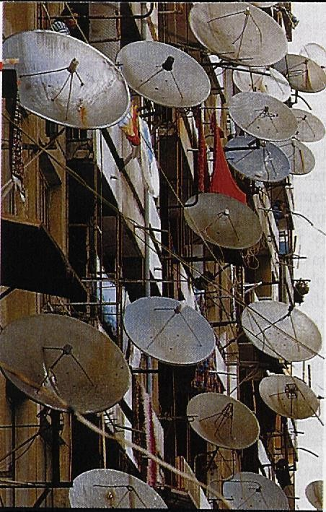
Satellite antennas (TV)
Not an array!

Slide 70
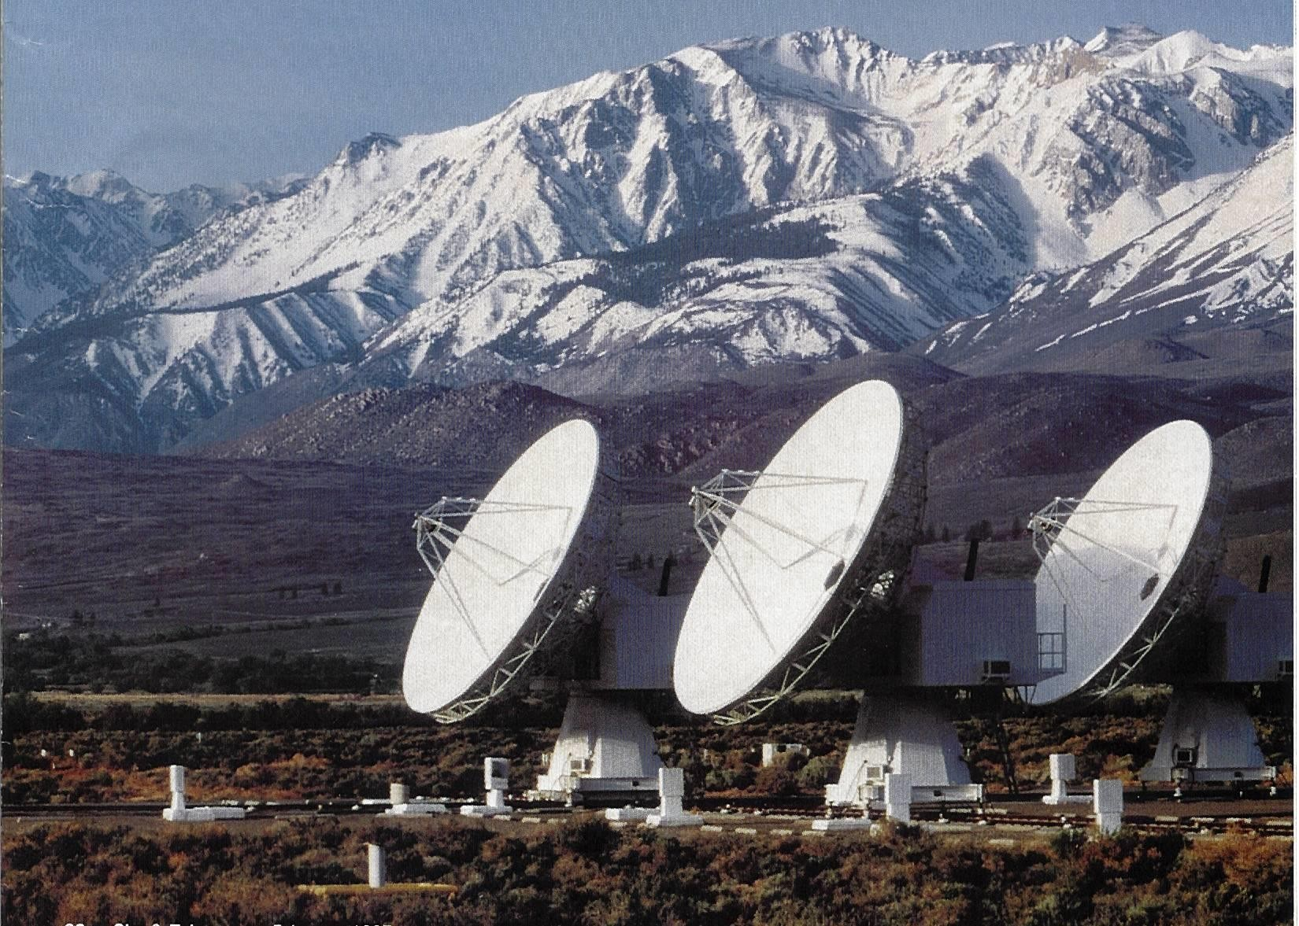
Owens Valley Radio
Observatory
The Earth‘s atmosphere is transparent in the narrow visible-light window (4000-
7000
angstroms) and the radio band
between 1 mm
and 10 m.
[Sky & Telescope Feb 1997 p.26]

Slide 71
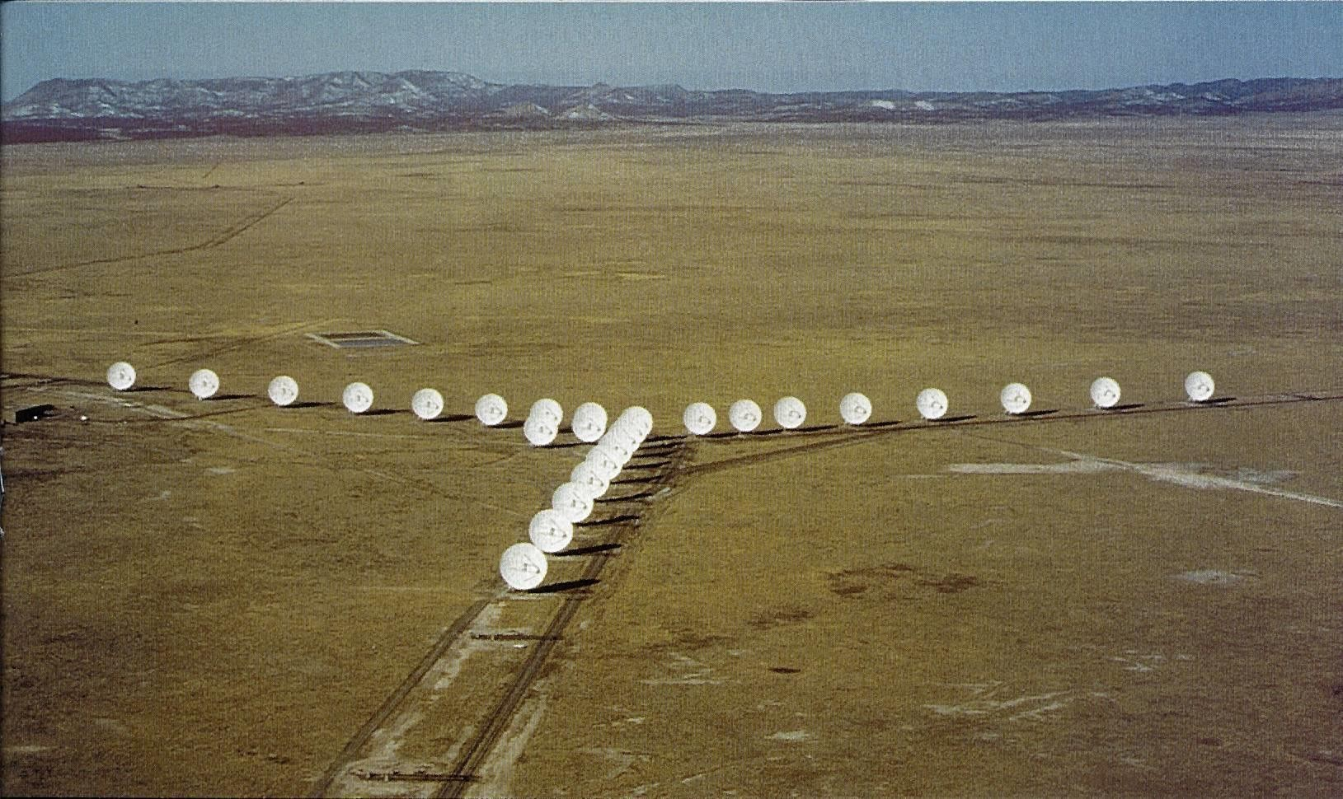
The New Mexico Very Large Array
[Sky & Telescope Feb 1997 p. 30]
27 antennas along 3 railroad tracks provide baselines up to 35 km.
Radio images are formed by correlating the signals garnered by
each antenna. | 73

Slide 72
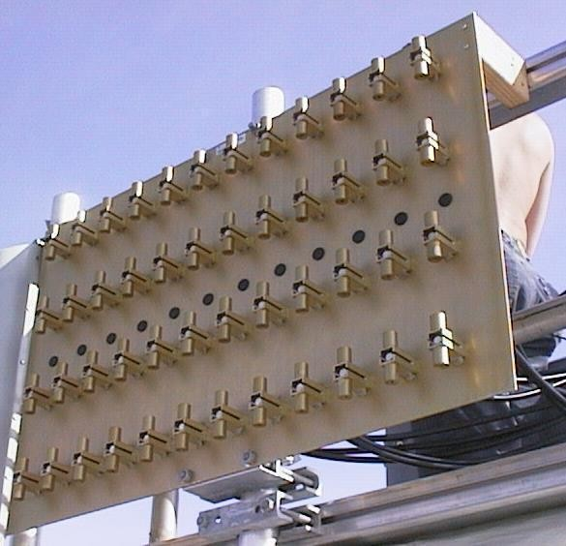
2 GHz adaptive antenna
A set of 48 2GHz antennas
– Source: Arraycomm
74

Slide 73
Phased Arrays
Array of N antennas in a linear or two- dimensional configuration + beam-forming & control device
The amplitude and phase excitation of each individual antenna controlled electronically (―software-defined‖)
Diode phase shifters
Ferrite phase shifters
Inertia-less beam-forming and scanning (μsec) with fixed physical structure
75

Slide 74
Switched beam antennas
Based on switching function between separate directive antennas or predefined beams of an array
Space Division Multiple Access (SDMA) = allocating an angle direction sector to each user
In a TDMA system, two users will be allocated to the same time slot and the same carrier frequency
They will be differentiated by different direction angles
76

Slide 75
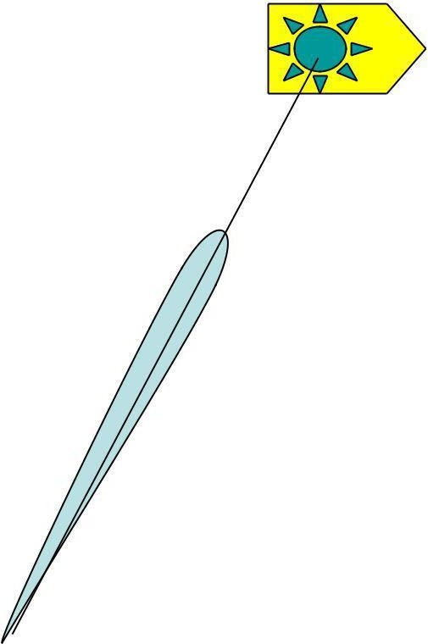
Dynamically phased array (PA):
A generalization of the
switched lobe concept
The radiation pattern continuously track the designated signal (user)
Include a direction of arrival
(DoA) tracking algorithm
77

Slide 76
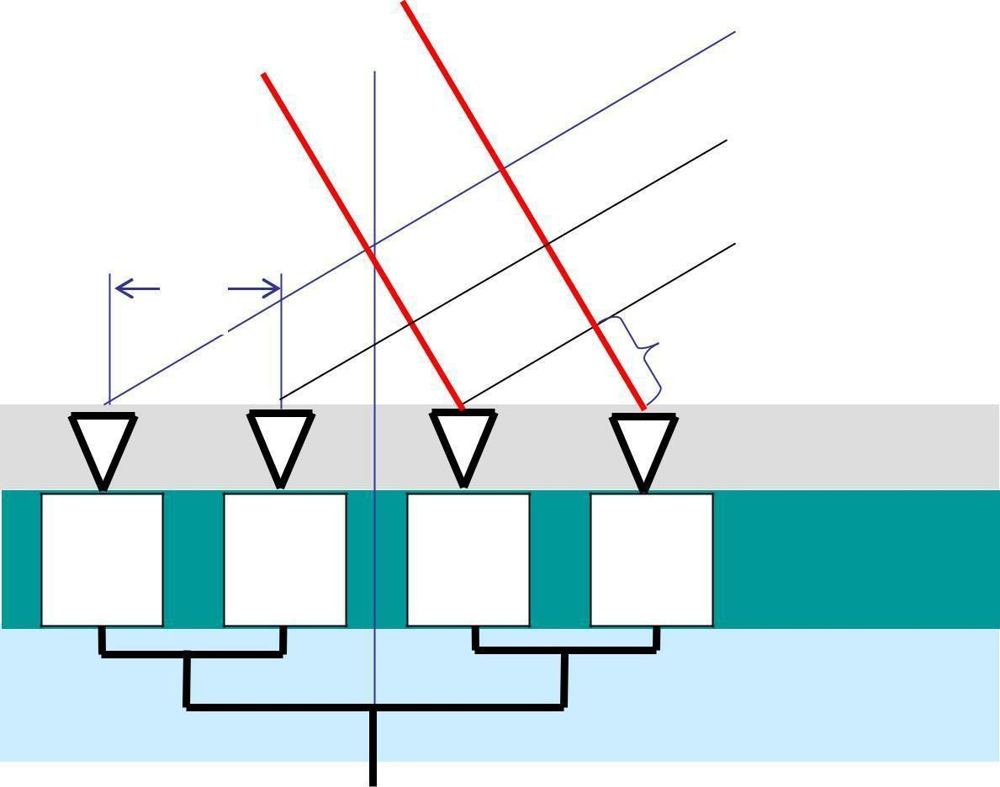
Beam Steering
Beam direction
Beam- steering using phase shifters at each radiating element
θ
Equi-phase wave front
d |  |  | Δ = [(2π/λ)d sinθ]
 |  |  |  | Radiating
 |  |  |  | elements
3Δ | 2Δ | Δ | 0 | Phase
 |  |  |  | shifters
Power distribution
78

Slide 77
4-Bit Phase-Shifter (Example)
Bit #4 | Bit #3 | Bit #2 | Bit #1
Input |  |  | Output
00 or 22.50 | 00 or 450 | 00 or 900 | 00 or 1800
Steering/ Beam-forming Circuitry
Alternative solution: Transmission line with controlled delay
79

Slide 78
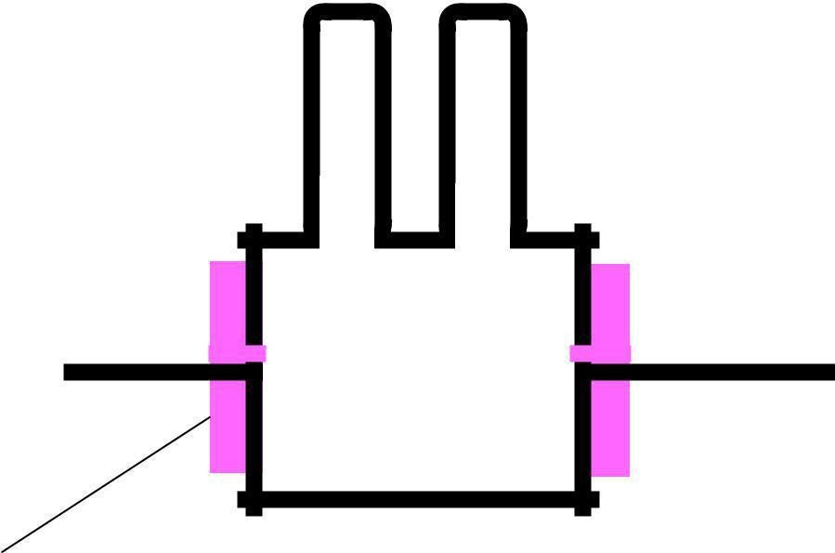
Switched-Line Phase Bit
Delay line #1a
Input
Output
Delay line #1b
Diode switch
Phase bit = delay difference
80

Slide 79
Simulation
2 omnidirectional antennas (equal amplitudes)
Variables
distance increment
phase increment
N omnidirectional antennas
Group factor (N omnidirectional antennas uniformly distributed along a straight line, equal amplitudes, equal phase increment)
http://www.amanogawa.com/archive/TwoDipole/ Antenna2-2.html (more details)
81

Slide 80
2 omnidirectional antennas
1
1
1
0.5
0.5
0.5
 |  | 0 |  |  |  | 0 |  |  |  | 0
-1 | -0.5 |  | 0 | 0.5 | 1-1 | -0.50 | 0.5 | 1 | -1 | -0.50 | 0.5 | 1
-0.5
-0.5
-0.5
-1
-1
-1
0
D = 0.5λ, θ= 180
D = 0.5λ, θ= 0⁰
D = 0.5λ, θ= 90⁰
82

Slide 81
N omnidirectional antennas
2.5
6
10
5
9
2
8
4
7
e ivat
gain
1.5
g a i n
gain
6
3
5
1
2
4
3
0.5
1
2
1
0
-180
0
-180
0
-180
-90
0
90
180
-90
0
90
180
-90
0
90
180
Azimuth angle, degrees
Azimuth angle, degrees
Azimuth angle, degrees
N = 2, θ = 90⁰ N = 5, θ = 180⁰
N = 9, θ = 45⁰
Array gain (line, uniform, identical power)
83

Slide 82
Antenna Arrays: Benefits
Possibilities to control electronically
Direction of maximum radiation
Directions (positions) of nulls
Beam-width
Directivity
Levels of sidelobes
using standard antennas (or antenna collections) independently of their radiation patterns
Antenna elements can be distributed along straight lines, arcs, squares, circles, etc.
84

Slide 83
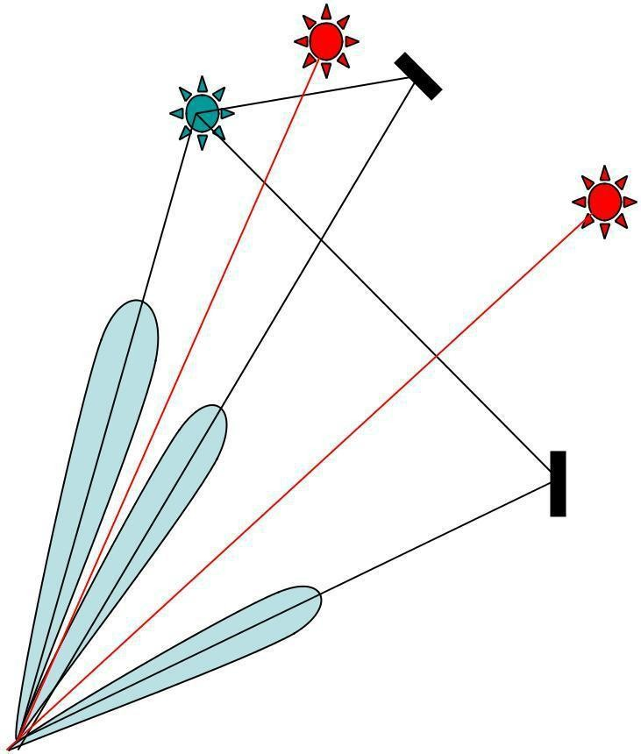
Adaptive (―Intelligent‖)Antennas
•
Array of N antennas in a linear,circular, or planar configuration
Used for selection signals from desired sources and suppress incident signals from undesired sources
The antenna pattern track the sources
It is then adjusted to null out the
interferers and to maximize the signal to interference ratio (SIR)
Able to receive and combine constructively multipath signals

Slide 84
85

Slide 85
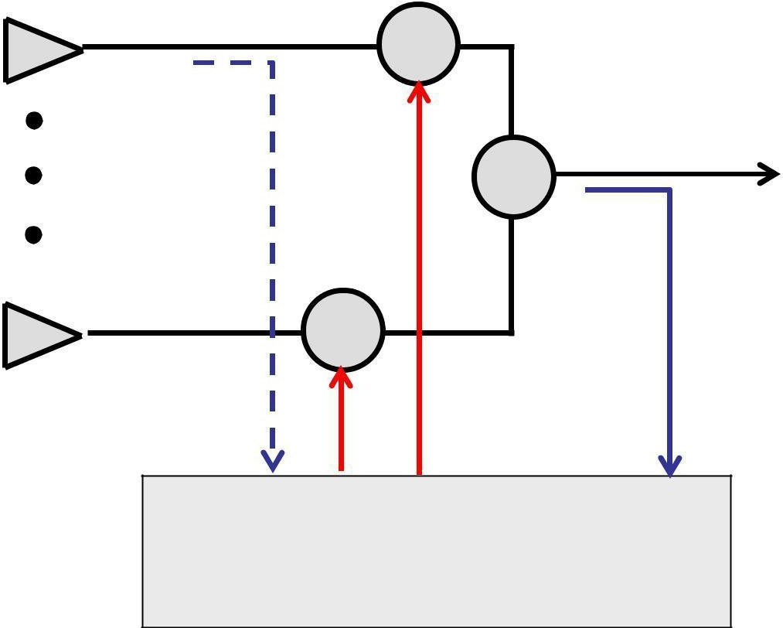
The amplitude/ phase excitation of each antenna controlled electronically (―software-defined‖)
The weight-determining algorithm uses a-priori and/ or measured information to adapt antenna to changing environment
The weight and summing circuits can operate at the RF and/ or at an intermediate frequency
1
w1
Σ
wN
N
Weight-determining algorithm
86

Slide 86
Antenna sitting
Radio horizon
Effects of obstacles & structures nearby
Safety
operating procedures
Grounding
lightning strikes
static charges
Surge protection
lightning searches for a second path to ground
87

Slide 87
Outline
Introduction
Review of basic antenna types
Radiation pattern, gain, polarization
Equivalent circuit & radiation efficiency
Smart antennas
Some theory
Summary
88

Slide 88
Maxwell‘s Equations
EM field interacting with the matter
2 coupled vectors E and H (6 numbers!), varying with time and space and satisfying the boundary conditions
(see http://www.amanogawa.com/archive/docs/EM1.pdf; http://www.amanogawa.com/archive/docs/EM7.pdf;
http://www.amanogawa.com/archive/docs/EM5.pdf)
Reciprocity Theorem
Antenna characteristics do not depend on the direction of energy flow. The impedance & radiation pattern are the same when the antenna radiates signal and when it receives it.
Note: This theorem is valid only for linear passive antennas (i.e. antennas that do not contain nonlinear and unilateral elements,
e.g. amplifiers)
89

Slide 89
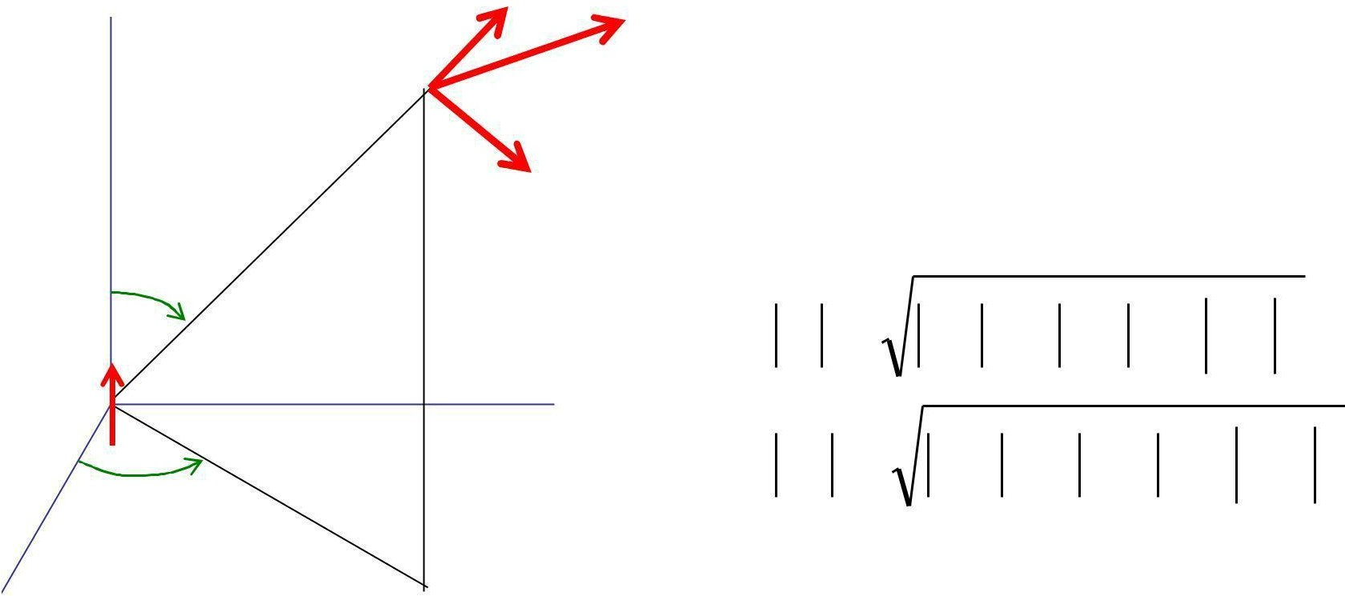
EM Field of Current Element
z | E_{r} | E θ | E = E_{r} + E_{ϑ} + E_{ϕ}
 | OP
 | E |  | H = H _{r} + Hϑ + Hϕ
ϕ |  | ϕ
 | r |  | E = E ₂ + E ² + E ²
 |  |  | r | ϑ | ϕ
I, dz |  |  |  | ₂ + H_{ϑ} ² + H_{ϕ} ²
θ | y |  | H = H_{r}
x
I: current (monochromatic) [A]; dz: antenna element (short) [m]
90

Slide 90
Short dipole antenna: summary
E_{θ} & H_{θ} are maximal in the equatorial plane, zero along the antenna axis
E_{r} is maximal along the antenna axis dz, zero in the equatorial plane
All show axial symmetry
All are proportional to the current moment Idz
Have 3 components that decrease with the distance-to-
wavelength ratio as
-2 -3
– (r/λ) & (r/λ) : near-field, or induction field. The energy oscillates from entirely electric to entirely magnetic and back, twice per cycle. Modeled
as a₋₁resonant LC circuit or resonator;
– (r/λ) : far-field or radiation field
– These 3 component are all equal at (r/λ) = 1/(2π)
91

Slide 91
Field components
β
1000
C
100 | C, Q: Induction fields Q
10
 | FF
1
0.1 | FF: Radiation field
0.01
FF
Q
0.001
C
0.1
1
Relative distance, Br
10
92

Slide 92
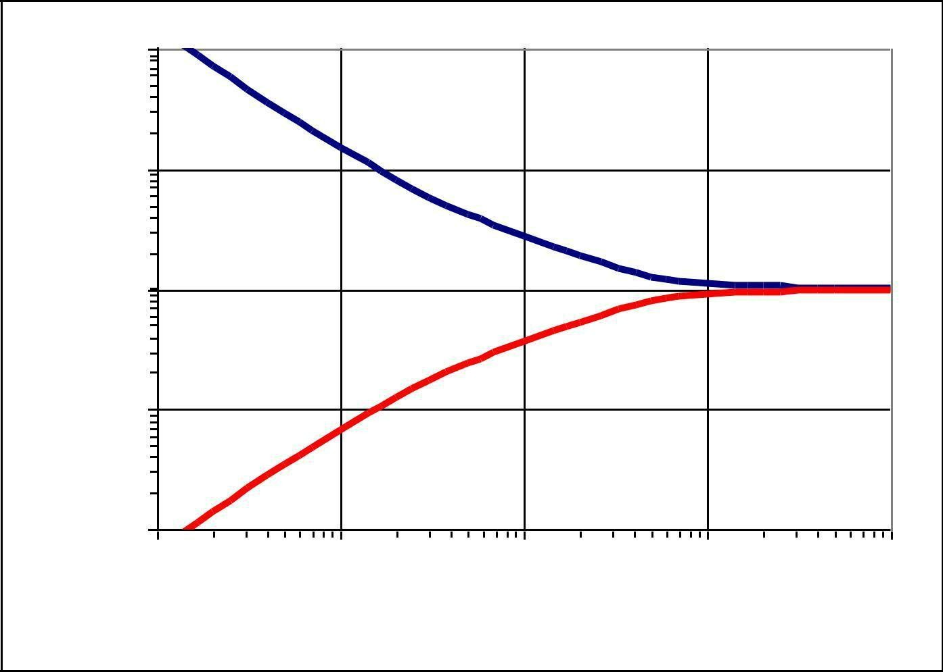
Field impedance
Field impedanc e
Z = E/H
depends
on the antenna type and
on distance
100
Short dipole
10
Z / 377
1
0.1
Small loop
0.01
0.01 | 0.1 | 1 | 10
100
Distance / (lambda/ 2Pi)
93

Slide 93
Far-Field, Near-Field
Near-field region:
Angular distribution of energy depends on distance from the antenna;
Reactive field components dominate (L, C)
Far-field region:
Angular distribution of energy is independent on distance;
Radiating field component dominates (R)
The resultant EM field can locally be treated as uniform (TEM)
94

Slide 94
Poynting vector
The time-rate of EM energy flow per unit area in
free space is the Poynting vector
(see http://www.amanogawa.com/archive/docs/EM8.pdf).
It is the cross-product (vector product, right-hand screw direction) of the electric field vector (E) and the magnetic field vector (H): P = E x H.
For the elementary dipole E_{θ} ⊥ H_{θ} and only
E_{θ}xH_{θ} carry energy into space with the speed of light.
95

Slide 95
Power Flow
In free space and at large distances, the radiated energy streams from the antenna in radial lines, i.e. the Poynting vector has only the radial component in spherical coordinates.
A source that radiates uniformly in all directions is an isotropic source (radiator, antenna).
For such a source the radial component of the Poynting vector is independent of θ and ϕ.
96

Slide 96
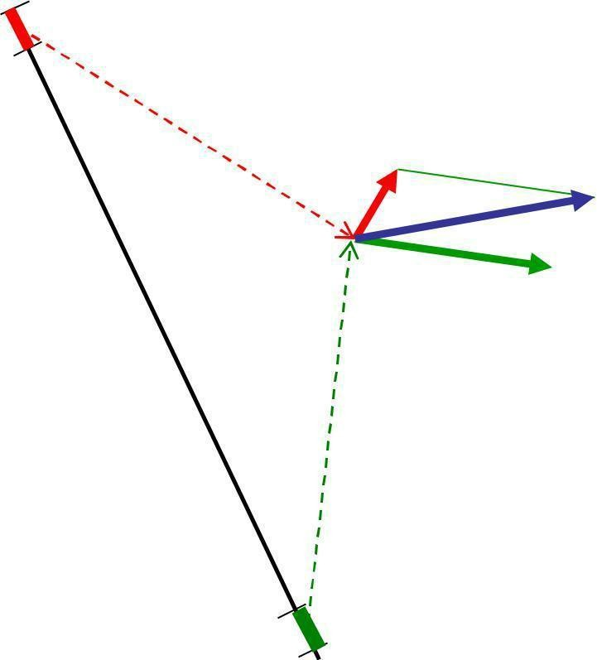
Linear Antennas
Summation of all vector components E (or H) produced by each antenna element
E = E₁ + E₂ + E₃ + ...
H = H₁ + H ₂ + H₃ + ...
O | In the far-field region, the
 | vector components are
 | parallel to each other
 | Phase difference due to
 | – Excitation phase difference
 | – Path distance difference
 | Method of moments
97

Slide 97
Simulation: Linear dipole antenna
http://www.amanogawa.com/archive/Dipol eAnt/DipoleAnt-2.html
Linear dipole antenna
http://www.amanogawa.com/archive/Ante n na1/Antenna1-2.html
Detailed analysis
98

Slide 98
Point Source
For many purposes, it is sufficient to know the direction (angle) variation of the power radiated by antenna at large distances.
For that purpose, any practical antenna, regardless of its size and complexity, can be represented as a point-source.
The actual field near the antenna is then disregarded.
99

Slide 99
The EM field at large distances from an antenna can be treated as originated at a point source - fictitious volume-less emitter.
The EM field in a homogenous unlimited medium at large distances from an antenna can be approximated by an uniform plane TEM wave
100

Slide 100
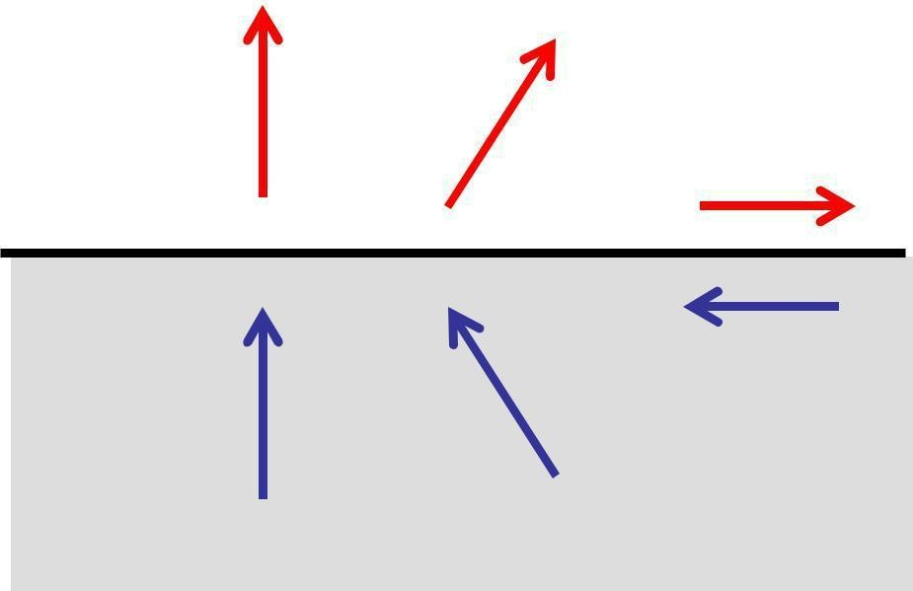
Image Theory
Antenna above perfectly conducting plane surface
Tangential electrical field component = 0
vertical components: the same direction
horizontal components: opposite directions
The field (above the ground) is the same as if the ground is replaced by an mirror image of the antenna
http://www.amanogawa.com/ archive/wavesA.html
+
-
Elliptical polarization: change of the rotation sense!
101

Slide 101
Summary
Introduction
Review of basic antenna types
Radiation pattern, gain, polarization
Equivalent circuit & radiation efficiency
Smart antennas
Some theory
102

Slide 102
Selected References
Nikolova N K: Modern Antennas in Wireless Telecommunications EE753 (lecture notes) talia@mcmaster.ca
Griffiths H & Smith BL (ed.): Modern antennas; Chapman & Hall, 1998
Johnson RC: Antenna Engineering Handbook McGraw-Hill Book Co. 1993
Kraus JD: Antennas, McGraw-Hill Book Co. 1998
Scoughton TE: Antenna Basics Tutorial; Microwave Journal Jan. 1998, p. 186-191
Stutzman WL, Thiele GA: Antenna Theory and Design JWiley &Sons, 1981
http://amanogawa.com
Software
http://www.feko.co.za/apl_ant_pla.htm
Li et al., ―Microcomputer Tools for Communication Engineering‖
Pozar D. ―Antenna Design Using Personal Computers‖
NEC Archives www.gsl.net/wb6tpu /swindex.html ()
103

Slide 103
Any questions?
Thank you for your attention
104

Slide 104
HISTORY
The first antennas were built in 1888 by German physicist Heinrich Hertz in his pioneering experiments to prove the existence of electromagnetic waves predicted by the theory of James Clerk Maxwell.
Hertz placed dipole antennas at the focal point of parabolic reflectors for both transmitting and receiving. He published his work in Annalen der Physik und Chemie (vol. 36, 1889).

Slide 105
INTRODUCTION
An antenna is an electrical device which converts electric currents into radio waves, and vice versa. It is usually used with a radio transmitter or radio receiver.
In transmission, a radio transmitter applies an oscillating radio frequency electric current to the antenna's terminals, and the antenna radiates the energy from the current as electromagnetic waves (radio waves).

Slide 106
Transmitting
Antenna: Any structure designed to
efficiently radiate electromagnetic radiation in a
preferred direction is called a transmitting antenna.
In reception, an antenna intercepts some of the power of an electromagnetic wave in order to produce a tiny voltage at its terminals, that is applied to a receiver to
be amplified. An antenna can be used for both transmitting and receiving.
Receiving Antenna: Any structure designed to efficiently receive electromagnetic radiation is called a receiving antenna

Slide 107
BASIC STRUCTURE
It is a metallic conductor system capable of radiating and receiving em waves.
Typically an antenna consists of an arrangement of metallic conductors (“elements"), electrically connected (often through a transmission line) to the receiver or transmitter.
An oscillating current of electrons forced through
the antenna by a transmitter will create an oscillating magnetic field around the antenna elements, while the charge of the electrons also creates an oscillating electric field along the elements.

Slide 108
These time-varying fields radiate away from the antenna into space as a moving electromagnetic field wave.
Conversely, during reception, the oscillating electric and magnetic fields of an incoming radio wave exert force on the electrons in the antenna elements, causing them to move back and forth, creating oscillating currents in the antenna.
Antenna reciprocity : can be used as transmitter and receiver.In two way communication same antenna can be used as transmitter and receiver.

Slide 109
Antennas may also contain reflective or directive elements or surfaces not connected to the transmitter or receiver, such as parasitic elements, parabolic reflectors or horns, which serve to direct the radio waves into a beam or other desired radiation pattern.
•
Antennas can be designed to transmit or receive
radio waves in all directions equally (omnidirectional antennas), or transmit them in a beam in a particular direction, and receive from that one direction only ( directional or high gain antennas).

Slide 110
WHY ANTENNAS ?
Need of antenna arisen when two person wanted to communicate between them when separated by some distance and wired communication is not possible.
Antennas are required by any radio receiver or transmitter to couple its electrical connection to the electromagnetic field.
Radio waves are electromagnetic waves which carry signals through the air (or through space) at the speed of light with almost no transmission loss.

Slide 111
Radio transmitters and receivers are used to convey signals (information) in systems including broadcast (audio) radio, television, mobile telephones , point-to-
point communications links (telephone, data
networks), satellite links.
Radio waves are also used directly for measurements
in technologies including Radar, GPS, and radio
astronomy.
In each and every case, the transmitters and receivers involved require antennas, although these are sometimes hidden (such as the antenna inside an AM radio or inside a laptop computer equipped with wi-fi).

Slide 112
WHERE USED?
Antennas are used in systems such as radio and
television broadcasting,
point LAN,
to point radar and
radio space
communication, wireless exploration
Antennas are most utilized in air or outer space
But can also be operated under water or even through soil and rock at certain frequencies for short distances

Slide 113
RADIATION MECHANISM
Ideally all incident energy must be reflected back when open circuit. But practically a small portion of electromagnetic energy escapes from the system that is it gets radiated.
This occurs because the line of force don’t undergo
complete phase reversal and some of them escapes.
G

Slide 114
The amount of escaped energy is very small due to mismatch between transmission line and surrounding space.
Also because two wires are too close to each other, radiation from one tip will cancel radiation from other tip.( as they are of opposite polarities and distance between them is too small as compared to wavelength )
G

Slide 115
To increase amount of radiated power open circuit must be enlarged , by spreading the two wires.
Due to this arrangement, coupling between transmission line and free space is improved.
Also amount of cancellation has reduced.
The radiation efficiency will increase further if two conductors of transmission line are bent so as to bring them in same line.

Slide 116
TYPES OF ANTENNAS
According to their applications and technology available, antennas generally fall in one of two categories:
Omnidirectional or only weakly directional antennas which receive or radiate more or less in all directions. These are employed when the relative position of the other station is unknown or arbitrary. They are also used at lower frequencies where a directional antenna would be too large, or simply to cut costs in applications where a directional antenna isn't required.
Directional or beam antennas which are intended to preferentially radiate or receive in a particular direction or directional pattern.

Slide 117
According to length of transmission lines available, antennas generally fall in one of two categories:
Resonant Antennas – is a transmission line, the length of which is exactly equal to multiples of half wavelength and it is open at both ends.
Non-resonant Antennas – the length of these antennas is not equal to exact multiples of half wavelength. In these antennas standing waves are not present as antennas are terminated in correct impedance which avoid reflections. The waves travel only in forward direction .Non-resonant antenna is a unidirectional antenna.

Slide 118
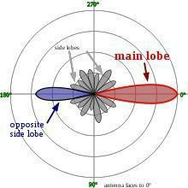
RADIATION PATTERN

Slide 119
The radiation pattern of an antenna is a plot of the relative field strength of the radio waves emitted by the antenna at different angles.
It is typically represented by a three dimensional graph, or polar plots of the horizontal and vertical cross sections. It is a plot of field strength in V/m versus the angle in degrees.
The pattern of an ideal isotropic antenna , which radiates equally in all directions, would look like a sphere.
Many non-directional antennas, such as dipoles, emit equal power in all horizontal directions, with the power dropping off at higher and lower angles; this is called an omni directional pattern and when plotted looks like a donut.

Slide 120
The radiation of many antennas shows a pattern of maxima or "lobes" at various angles, separated by “nulls", angles where the radiation falls to zero.
This is because the radio waves emitted by different parts of the antenna typically interfere, causing maxima at angles where the radio waves arrive at distant points in phase, and zero radiation at other angles where the radio waves arrive out of phase.
In a directional antenna designed to project radio waves in a particular direction, the lobe in that direction is designed larger than the others and is called the "main lobe".
The other lobes usually represent unwanted radiation and are called “sidelobes". The axis through the main lobe is called the "principle axis" or “boresight axis".

Slide 121
ANTENNA GAIN
Gain is a parameter which measures the degree of directivity of the antenna's radiation pattern. A high- gain antenna will preferentially radiate in a particular direction.
Specifically, the antenna gain, or power gain of an antenna is defined as the ratio of the intensity (power per unit surface) radiated by the antenna in the direction of its maximum output, at an arbitrary distance, divided by the intensity radiated at the same distance by a hypothetical isotropic antenna.

Slide 122
The gain of an antenna is a passive phenomenon - power is not added by the antenna, but simply redistributed to provide more radiated power in a certain direction than would be transmitted by an isotropic antenna.
High-gain antennas have the advantage of longer range and better signal quality, but must be aimed carefully in a particular direction.
Low-gain antennas have shorter range, but the
orientation of the antenna is relatively inconsequential.

Slide 123
For example, a dish antenna on a spacecraft is a high- gain device that must be pointed at the planet to be effective, whereas a typical Wi-Fi antenna in a laptop computer is low-gain, and as long as the base station is within range, the antenna can be in any orientation in space.
In practice, the half-wave dipole is taken as a reference instead of the isotropic radiator. The gain is then given in dBd (decibels over dipole)

Slide 124
ANTENNA EFFICIENCY
Efficiency of a transmitting antenna is the ratio of power actually radiated (in all directions) to the power absorbed by the antenna terminals.
The power supplied to the antenna terminals which is not radiated is converted into heat. This is usually through loss resistance in the antenna's conductors, but can also be due to dielectric or magnetic core losses in antennas (or antenna systems) using such components.

Slide 125
POLARIZATION
The polarization of an antenna is the orientation of the electric field (E-plane) of the radio wave with respect to the Earth's surface and is determined by the physical structure of the antenna and by its orientation.
A simple straight wire antenna will have one polarization when mounted vertically, and a different polarization when mounted horizontally.
Reflections generally affect polarization. For radio waves the most important reflector is the ionosphere - signals which reflect from it will have their polarization changed
LF,VLF and MF antennas are vertically polarized

Slide 126
BEAM-WIDTH
Beam-width of an antenna is defined as angular separation between the two half power points on power density radiation pattern OR
Angular separation between two 3dB down points on
the field strength of radiation pattern
It is expressed in degrees

Slide 127
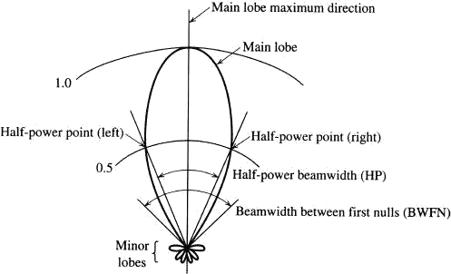

Slide 128
ISOTROPIC ANTENNA
Isotropic antenna or isotropic radiator is a hypothetical (not physically realizable) concept, used as a useful reference to describe real antennas.
Isotropic antenna radiates equally in all directions.
– Its radiation pattern is represented by a sphere whose center coincides with the location of the isotropic radiator.

Slide 129
It is considered to be a point in space with no dimensions and no mass. This antenna cannot physically exist, but is useful as a theoretical model for comparison with all other antennas.
Most antennas' gains are measured with reference to an isotropic radiator, and are rated in dBi (decibels with respect to an isotropic radiator).

Slide 130
HALF WAVE DIPOLE ANTENNA
The half-wave dipole antenna is just a special case
of the dipole antenna.
Half-wave term means that the length of this dipole antenna is equal to a half-wavelength at the frequency of operation.
The dipole antenna, is the basis for most antenna designs, is a balanced component, with equal but opposite voltages and currents applied at its two terminals through a balanced transmission line.

Slide 131
To make it crystal clear, if the antenna is to radiate at 600 MHz, what size should the half-wavelength dipole be?
One wavelength at 600 MHz is = c / f = 0.5 meters.
Hence, the half-wavelength dipole antenna's length is
0.25 meters.
The half-wave dipole antenna is as you may expect, a simple half-wavelength wire fed at the center as shown in Figure

Slide 132
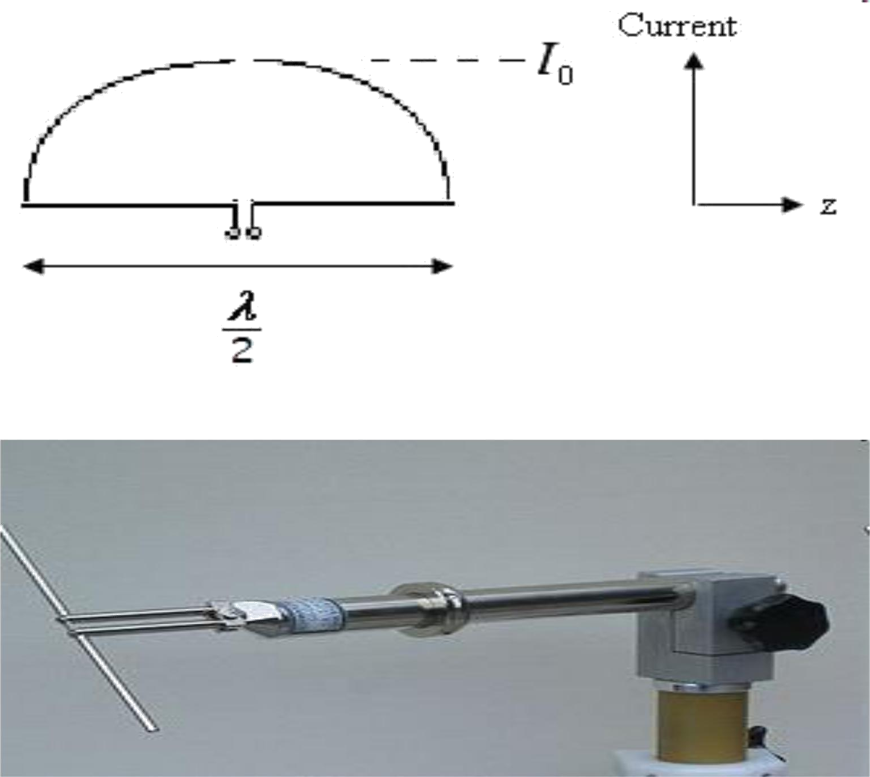

Slide 133
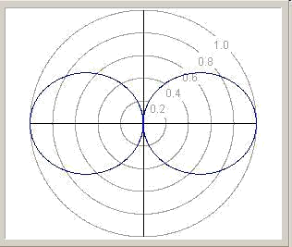
Dipoles radiation doughnut
have an pattern, symmetrical
about the axis of the dipole. The radiation is
maximum angles to
at right the dipole,
dropping off to zero on the antenna's axis.

Slide 134
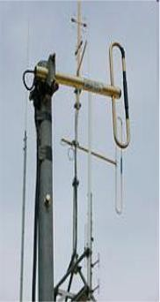
FOLDED DIPOLE
Folded antenna is a single antenna
but it consists of two elements.
First element is fed directly while second one is coupled inductively at its end.
Radiation pattern of folded dipole is same as that of dipole antenna i.e figure of eight (8).

Slide 135
Advantages
Input impedance of folded dipole is four times higher
than that of straight dipole.
Typically the input impedance of half wavelength
folded dipole antenna is 288 ohm.
Bandwidth of folded dipole is higher than that of straight dipole.

Slide 136
HERTZ ANTENNA
The Hertzian dipole is a theoretical short dipole (significantly smaller than the wavelength) with a uniform current along its length.
A true Hertzian dipole cannot physically exist, since the assumed current distribution implies an infinite charge density at its ends, and significant radiation requires a very high current over its very short length.

Slide 138
LOOP ANTENNA
A loop antenna is a radio antenna consisting of a loop of wire with its ends connected to a balanced transmission line
It is a single turn coil carrying RF current through it.
The dimensions of coil are smaller than the wavelength hence current flowing through the coil has same phase.
Small loops have a poor efficiency and are mainly used as receiving antennas at low frequencies. Except for car radios, almost every AM broadcast receiver sold has such an antenna built inside of it or directly attached to it.

Slide 139
A technically small loop, also known as a magnetic loop, should have a circumference of one tenth of a wavelength or less. This is necessary to ensure a constant current distribution round the loop.
As the frequency or the size are increased, a standing wave starts to develop in the current, and the antenna starts to have some of the characteristics of a folded dipole antenna or a self-resonant loop.
Self-resonant loop antennas are larger. They are typically used at higher frequencies, especially VHF and UHF, where their size is manageable. They can be viewed as a form of folded dipole and have somewhat similar characteristics. The radiation efficiency is also high and similar to that of a dipole.

Slide 140
Radiation pattern of loop
antenna is a doughnut pattern.
Can be circular or square loop
No radiation is received normal to the plane of loop and null is obtained in this direction.
Application: Used for direction finding applications

Slide 141
TURNSTILE ANTENNA
A turnstile antenna is a set of two dipole antennas aligned at right angles to each other and fed 90 degrees out-of-phase.
The name reflects that the antenna looks like a turnstile when mounted horizontally.
When mounted horizontally the antenna is nearly omnidirectional on the horizontal plane.

Slide 142
When mounted vertically the antenna is directional to a right angle to its plane and is circularly polarized.
The turnstile antenna is often used for communication satellites because, being circularly polarized, the polarization of the signal doesn't rotate when the satellite rotates.

Slide 143
RHOMBIC ANTENNA
Structure and construction
4 wires are connected in rhombic shape and terminated by a resistor.
Mounted horizontally and placed > ^/2 from
ground.
Highest development of long wire antenna is rhombic
antenna.

Slide 146
Advantages
Easier to construct
Its i/p impedance and radiation pattern are relatively constant over range of frequencies.
Maximum efficiency
High gain can be obtained.
Disadvantages
Large site area and large side lobes.

Slide 147
Application
Long distance communication, high frequency transmission and reception.
Point to point communication.
Radio communication.
Short wave radio broadcasting.

Slide 148
ANTENNA ARRAYS
Antenna arrays is group of antennas or antenna
elements arranged to provide desired directional
characteristics.
Generally any combination of elements can form an
array.
However equal elements of regualar geometry are usually used.

Slide 149
YAGI-UDA ANTENNA
It is a directional antenna consisting of a driven element (typically a dipole or folded dipole) and additional parasitic elements (usually a so-called reflector and one or more directors).
All the elements are arranged collinearly and close
together.
The reflector element is slightly longer (typically 5% longer) than the driven dipole, whereas the so-called directors are a little bit shorter.
The design achieves a very substantial increase in the antenna's directionality and gain compared to a simple dipole.

Slide 151
Typical spacing between elements vary from about 1/10 to 1/4 of a wavelength, depending on the specific design.
The elements are usually parallel in one plane.
Radiation pattern is modified figure of eight
By adjusting distance between adjacent directors it
is possible to reduce back lobe
Improved front to back ratio

Slide 153
ANTENNA APPLICATIONS
They are used in systems such as
Radio broadcasting
Broadcast television
Two-way radio
Communication receivers
Radar
Cell phones
Satellite communications.

Slide 154
ANTENNA CONSIDERATIONS
The space available for an antenna
The proximity to neighbors
The operating frequencies
The output power
Money

Slide 155
Antenna Fundamentals (1)
156

Slide 156
Note: These materials may be used for study, research, and education in not-for-profit applications. If you link to or cite these materials, please credit the author, Ryszard Struzak. These materials may not be published, copied to or issued from another Web server without the author's express permission. Copyright © 2001 Ryszard Struzak. All commercial rights are reserved. If you have comments or suggestions, please contact the author at ryszard.struzak@ties.itu.int.
157

Slide 157
Summary Slide
Introduction
PFD
Directivity and Gain
EIRP
158

Slide 158
Introduction
159

Slide 159
Radio Link
Antenna
Antenna
Radio wave
Receiver
Transmitter
Antennas: important elements of any radio link
160

Slide 160
Photographs of
Various Antenna Types
161

Slide 161
T-Antenna
Transmitting antenna transforms
power in the form of time-dependent electrical current
into
time-and-space-dependent electro-magnetic (EM) wave.
162

Slide 162
R-Antenna
Receiving antenna transforms time-and-space-dependent EM wave into
time-dependent electrical current (power)
163

Slide 163
Intended Antennas
Radiocommunication antennas
Transmitting
Receiving
EM applicators
Industrial
Medical
Measuring antennas
164

Slide 164
Unintended Antennas
Any conductor/ installation carrying electrical current
(e.g. electrical installation of vehicles)
Any conducting structure/ installation irradiated by EM waves
Permanent (e.g. Antenna masts, or power network)
Time-varying (e.g. Windmills, or helicopter propellers)
Transient (e.g. Re-radiating aeroplane)
165

Slide 165
PFD
166

Slide 166
PFD: Isotropic Radiator
Power Flux Density (PFD)
P
PFD =
T
4πr ²
r
Notes
Loss-less propagation medium assumed
Isotropic radiator cannot be physically realized
PFD does not depend on frequency/ wavelength
167

Slide 167
PFD: Distance Dependence
100
10
1
0.1
0.01
0.1
1
10
Distance
168

Slide 168
PFD: Example 1
_{PFD =} 1.8 •10² •10³
4 •π • (38 •10 )
≈ 1.8 •10⁵
What is the PFD from TV broadcast GEO satellite at Trieste?
EIRP = 180 kW (52.5 dB(W))
Distance: ~38'000 km
Free space
6 2
16
1.8 •10
−11 -2
= 1•10 Wm
= −100 dB(Wm ⁻² )
169

Slide 169
PFD: Example 2
What is the PFD from a hand-held phone at the head?
EIRP = 180 mW
Distance = ~3.8 cm
Free space
 | 1.8 •10 ⁻¹
PFD = | 4 •π • (3.8 •10⁻² ) ²
≈ 1.8 •10 ⁻¹
1.8 •10 ⁻²
= 10 Wm ⁻²
= 10 dB(Wm ⁻² )
170

Slide 170
PFD: Example 3
What is the ratio of the powers required to produce the same power flux density at a GEO-satellite and at a LEO-satellite.?
Distances:
– GEO: 38 000 km
– LEO: 1 000 km
^{PFD}GEO PFD |  | ⎛ | ⎞⎛ |  | ⎞2
 |  | ⎜ | P GEO ⎟⎜ |  | Dist LEO ⎟
 |  |  | ⎟⎜ |  | ⎟
 | = ⎜ | P |  | Dist
 |  | ⎝ 000 | LEO ⎠⎝ ⎞ 2 ⎟ = 1444 |  | GEO ⎠
LEO P ⎛38 GEO _{= ⎜} P
⎝ 1000 ⎠
LEO
171

Slide 171
PFD concept
Used often in the management/ regulating the use of the radio frequency spectrum
To define the restrictions imposed on radiocommunication systems
To assure electromagnetic compatibility
Relates to the field-strength of plane wave
172

Slide 172
PFD Limits
The WRC 2000 decided that the PFD at the Earth‘s surface produced by emission from a space station in Fixed-satellite service shall not exceed the limit shown in the figure.
The figure is valid for stations at the geostationary orbit in frequency band 10.7-11.7 GHz and reference band 4 kHz. For other cases see RR Table S21-4.
 | -138
 | -140
[dB(Wm^2)] | -142
 | -146
 | -144
PFD | -148
 | -150
 | -152
0 10 20 30 40 50 60 70 80 90
Angle of arrival (above the horizontal plane)
173

Slide 173
PFD: Real Antenna
PFD produced by physically realizable antennas depends on
power and distance (as isotropic source)
horizontal direction angle (θ)
vertical direction angle (ϕ)
174

Slide 174
Directivity and Gain
175

Slide 175
Radiation Intensity
measure of the ability of an antenna to concentrate radiated power in a particular direction
Radiation intensity = Power per steradian =
= Φ(θ,ϕ)
[watts/steradian]
z
OP
Transmitting antenna
ϕ
r
y
θ
x
Distance (r) is very large
176

Slide 176
Antenna Directivity
Total power radiated
π
D(ϑ,ϕ) = Φ(ϑ,ϕ) = Φ(ϑ,ϕ)
P₀ = ∫
2π
Φ
P 4π
0
0
∫0
Φ(θ ,ϕ)
avg
sin ϑdϑdϕ
Average radiation intensity
D Has no units
Note:
P₀ = power radiated
Φ = P
4 π⁰
avg

Slide 177
177

Slide 178
Antenna Gain
G(ϑ,ϕ) = ηD(ϑ,ϕ)
η=^{P}
T
P0
η: radiation efficiency (50% - 75%)
G has no units
Usually relates to the peak directivity of the main radiation lobe
Often expressed in dB
Known as ―Absolute Gain‖ or ―Isotropic Gain‖
The directivity and gain are measures of the ability of an antenna to concentrate power in a particular direction.
Directivity – power
radiated by antenna (P₀
)
Gain – power delivered
to antenna (P_{T})

Slide 179
178

Slide 180
PFD vs. Antenna Gain
_{S (ϑ,ϕ) =} Φ(ϑ,ϕ)ΔϑΔϕ
= Φ(ϑ,ϕ)
(rΔϑ)(rΔϕ)
P0
_{r} 2
= G(ϑ,ϕ) 4πr ²
= G(ϑ,ϕ)S₀
S₀ = PFD produced by a loss- less isotropic radiator
179

Slide 181
Other Definitions of Gain
For practical purposes, the antenna gain is defined as the ratio (usually in dB), of the power required at the input of a loss-free reference antenna to the power supplied to the input of the given antenna to produce, in a given direction, the same field strength or the same power flux-density at the same distance.
When not specified otherwise, the gain refers to the direction of maximum radiation.
The gain may be considered for a specified polarization. [RR 154]
180

Slide 182
Antenna Gain
Actual Measuring | Reference | Measuring
antenna equipment | antenna | equipment
P = Power | S = Power | P_{o} = Power | S = Power
Delivered to | received | Delivered to | received
the antenna | at a great | the antenna | at a great
 | distance |  | distance
Antenna Gain (in the specific direction) = P / P_{o}
181

Slide 183
Reference Antennas
Isotropic radiator
isolated in space (G_{i}, absolute gain, or isotropic gain)
Half-wave dipole
isolated in space, whose equatorial plane of
symmetry contains the given direction (G_{d})
Short vertical antenna
(much shorter than λ/4), close to, and normal to a perfectly conducting plane which contains the
given direction (G_{v})
182

Slide 184
Reference Antennas (1)
Isotropic antenna
Sends (receives) energy equally in (from) all directions
Gain = 1 (= 0 dB)
When supplied by P, produces at distance r
Radiation pattern in vertical plane
Radiation pattern In horizontal plane
power flux density = P
2
/(4πr )
Theoretical concept, cannot be physically realized
183

Slide 185
Reference Antennas (2)
Half-Wave Dipole
Linear antenna, realizable
Gain = 1.64 (= 2,15 dB)
in the direction of maximum radiation
Figure-eight-shaped radiation pattern in the dipole plane, omnidirectional (circular) in the orthogonal plan
Radiation pattern in vertical plane
Radiation pattern
In horizontal plane
184

Slide 186
Typical radiation pattern
Omnidirectional
Broadcasting
Mobile telephony
Pencil-beam
Microwave links
Fan-beam (narrow in one plane, wide in the other)
Shaped-beam
Satellite antennas
185

Slide 187
Typical Gain and Beam-width
Type of antenna | G [dB] | HPBW [ ]
 | i
Isotropic | 0 | 360x360
Dipole | 2 | 360x120
Helix (10 turn) | 14 | 35x35
Small dish | 16 | 30x30
Large dish | 45 | 1x1
186

Slide 188
Gain and Beam-width
Gain and beam-width of directive antennas are inter-related
G ~ 30000 / (θ₁*θ₂)
θ₁ and θ₂ are the 3-dB beam-widths (in degrees)
in the two orthogonal principal planes of antenna radiation pattern.
187

Slide 189
EIRP
188

Slide 190
e.i.r.p.
Equivalent Isotropically Radiated Power (in a given direction):
The product of the power supplied to the antenna and the antenna gain relative to an isotropic antenna in
a given direction
189

Slide 191
e.i.r.p.: Example 1
2
What is the maximum e.i.r.p. of a GEO satellite station if RR impose
PFD limits of (-160) 2
2
dB (W/(m *4kHz)) at
the earth surface in Equator (distance 35900 km) ?
PFD = e.i.r.p./(4πd )
2
-16
-160 dB → 10
2
W/(m *4kHz)
15
d ~ 1.29*10 m2
15
4πd² ~ 4*10
m2
e.i.r.p. ~ 0.4 W/4kHz
190

Slide 192
e.r.p.
Effective Radiated Power (in a given direction):
The product of the power supplied to the antenna and its gain relative to a
half-wave dipole in a given direction
191

Slide 193
Chapter Sixteen: Antennas

Slide 194
Introduction
The antenna is the interface between the transmission line and space
Antennas are passive devices; the power radiated cannot be greater than the power entering from the transmitter
When speaking of gain in an antenna, gain refers to the idea that certain directions are radiated better than others
Antennas are reciprocal - the same design works for receiving systems as for transmitting systems

Slide 195
Simple Antennas
The Isotropic Radiator would radiate all the power delivered to it and equally in all directions
The isotropic radiator would also be a point
source

Slide 196
The Half-Wave Dipole
A more practical antenna is the half-wave
dipole
Dipole simply means it is in two parts
A dipole does not have to be one-half wavelength, but that length is handy for impedance matching
A half-wave dipole is sometimes referred to as a Hertz antenna

Slide 197
Basics of the Half-Wave Dipole
Typically, the length of a half-wave dipole is 95% of one-half the wavelength measured in free space:
□ _{c}λ
•
f

Slide 198
The half_{Radiation}-wavedipoledoes_{Resistance}notdissipatepower,
assuming lossless material
It will radiate power into space
The effect on the feedpoint resistance is the same as if a loss had taken place
The half-wave dipole looks like a resistance of 70 ohms at its feedpoint
The portion of an antenna‘s input impedance that is due to power radiated into space is known as radiation resistance

Slide 199
Antenna Characteristics
It should be apparent that antennas radiate in
various directions
The terms applied to isotropic and half-wave dipole antennas are also applied to other antenna designs

Slide 200
Radiation Patterns
Antenna coordinates are shown in three- dimensional diagrams
The angle φ is measured from the x axis in the direction of the y axis
The z axis is vertical, and angle θ is usually measured from the horizontal plane to the zenith

Slide 201
Plotting Radiation Patterns
Typical radiation patters are displayed in a polar
plot

Slide 202
Gain and Directivity
In antennas, power gain in one direction is at the expense of losses in others
Directivity is the gain calculated assuming a lossless antenna

Slide 203
Beamwidth
A directional antenna can be said to direct a
beam of radiation in one or more directions
The width of this bean is defined as the angle
between its half-power points
A half-wave dipole has a beamwidth of about 79º in one plane and 360º in the other
Many antennas are far more directional than this

Slide 204
Front-to-Back Ratio
The direction of maximum radiation is in the horizontal plane is considered to be the front of the antenna, and the back is the direction 180º from the front
For a dipole, the front and back have the same radiation, but this is not always the case

Slide 205
Major and Minor Lobes
In the previous diagram, the antenna has one
major lobe and a number of minor ones
Each of these lobes has a gain and a beamwidth which can be found using the diagram

Slide 206
Effective Isotropic Radiated Power and Effective Radiated Power
In practical situations, we are more interested in the power emitted in a particular direction than in total radiated power
Effective Radiated Power represents the power input multiplied by the antenna gain measured with respect to a half-wave dipole
An Ideal dipole has a gain of 2.14 dBi; EIRP is
2.14 dB greater than the ERP for the same antenna combination

Slide 207
Impedance
The radiation resistance of a half-wave dipole situated in free space and fed at the center is approximately 70 ohms
The impedance is completely resistive at resonance, which occurs when the length of the antenna is about 95% of the calculated free-space, half-wavelength value
If the frequency is above resonance, the feedpoint impedance has an inductive component; if the frequency is below resonance, the component is capacitive

Slide 208
Ground Effects
When an antenna is installed within a few wavelengths of the ground, the earth acts as a reflector and has a considerable influence on the radiation pattern of the antenna
Ground effects are important up through the HF range. At VHF and above, the antenna is usually far enough above the earth that reflections are not significant
Ground effects are complex because the characteristics of the ground are variable

Slide 209
Other Simple Antennas
Other types of simple antennas are:
The folded dipole
The monopole antenna
Loop antennas
The five-eighths wavelength antenna
The Discone antenna
The helical antenna

Slide 210
The Folded Dipole
The folded dipole is the same length as a standard dipole, but is made with two parallel conductors, joined at both ends and separated by a distance that is short compared with the length of the antenna
The folded dipole differs in that it has wider bandwidth and has approximately four times the the feedpoint impedance of a standard

Slide 211
The Monopole Antenna
For low- and medium-frequency transmissions, it is necessary to use vertical polarization to take advantage of ground-wave propagation
A vertical dipole would be possible, but similar results are available from a quarter-wavelength monopole antenna
Fed at one end with an unbalanced feedline, with the ground conductor of the feedline taken to earth ground

Slide 212
Loop Antennas
Sometimes, smaller antennas are required for certain applications, like AM radio receivers
These antennas are not very efficient but perform adequately
Two types of loop antennas are:
Air-wound loops
Ferrite-core loopsticks

Slide 213
The Five-Eighths Wavelength Antenna
The five-eighths wavelength antenna is used vertically either as a mobile or base antenna in VHF and UHF systems
It has omnidirectional response in the horizontal plane
Radiation is concentrated at a lower angle, resulting in gain in the horizontal direction
It also has a higher impedance than a quarter-wave monopole and does not require as good a ground

Slide 214
The Discone Antenna
The discone antenna is characterized by very wide bandwidth, covering a 10:1 frequency range
It also has an omnidirectional pattern in the horizontal plane and a gain comparable to that of a dipole
The feedpoint resistance is typically 50 ohms
Typically, the length of the surface of the cone is about one-quarter wavelength at the lowest operating frequency

Slide 215
The Helical Antenna
Several types of antennas are classified as helical
The antenna in the sketch has its maximum radiation along its long axis
A quarter-wave monopole can be shortened and wound into a helix— common in rubber ducky antenna

Slide 216
Antenna Matching
Sometimes a resonant antenna is too large to
be convenient
Other times, an antenna may be required to operate at several widely different frequencies and cannot be of resonant length all the time
The problem of mismatch can be rectified by matching the antenna to the feedline using an LC matching network

Slide 217
Antenna Arrays
Simple antenna elements can be combined to form arrays resulting in reinforcement in some directions and cancellations in others to give better gain and directional characteristics
Arrays can be classified as broadside or end-fire
Examples of arrays are:
The Yagi Array
The Log-Periodic Dipole Array
The Turnstile Array
The Monopole Phased Array
Other Phased Arrays

Slide 218
Reflectors
It is possible to construct a conductive surface that reflects antenna power in the desired direction
The surface may consist of one or more planes or may be parabolic
Typical reflectors are:
Plane and corner Reflectors
The Parabolic Reflector

Slide 219
Cell-Site Antenna
For cellular radio systems, there is a need for omnidirectional antennas and for antennas with beamwidths of 120º, and less for sectorized cells
Cellular and PCS base-station receiving antennas are usually mounted in such a way as to obtain space diversity
For an omnidirectional pattern, typically three antennas are mounted on a tower with a triangular cross section and the antennas are mounted at 120º intervals

Slide 220
Mobile and Portable Antenna
Mobile and portable antennas used with cellular and PCS systems have to be omnidirectional and small
The simplest antenna is the quarter-wavelength monopole are these are usually the ones supplied with portable phones
For mobile phones, and common configuration is the quarter-wave antenna with a half-wave antenna mounted collinearly above it

Slide 221
Test Equipment: The Anechoic Chamber
The anechoic chamber is used to set up antennas in a location that is free from reflections in order to evaluate them

Slide 222
Chapter 10 Potentials and Fields
The Potential Formulation
Continuous Distributions
Point Charges

Slide 223
10.1 The Potential Formulation
Scalar and vector potentials
Gauge transformation
Coulomb gauge and Lorentz gauge

Slide 224
10.1.1 Scalar and Vector Potentials
ρ(r,t) | ⎫ | ⎧ E(r,t) | field formulism
 | ⎬ | ⎨
J(r,t) ⎭ ⎩B(r,t)
or
potential formulism
⎧V(r,t)
⎨
⎩A(r,t)
Maxwell‘s eqs
ρ
∇ ⋅ E = ε
0
⎤MS
∂ E
∂t ⎥
⎥
⎥
⎦
∇ ⋅ BB = ∇ × A
0
0
0
∇ ⋅ B = 0
∂B
∂t
^{ES} ∇ × E = 0E = −∇V
∇ × E = −
∂ (∇ × A)
B = ∇ × A
∂t
∂
A) = 0
∇ ×(E +
∂ ∂t
∂A
_{V} = −∇ −
E
∂t

Slide 226
10.1.1 (2)
ρ
∇ ⋅ E =ε
0
∂A ρ
∇ ⋅[−∇V − ∂t ]= ε0
∂E
∂
∇² V +∂t (∇ ⋅ A) = −
ρ
0
⁰ ∂t
0
0
∂
∂
∂t
∇ ×(∇ × A)
= μ J + μ
0 0 0
[−∇V −
A]
ε
∂t
2
∇ × (∇ × A) = ∇(∇ ⋅ A) − ∇ A
2
∂
A
∂V
(∇ A − μ ε
2
^{) − ∇(∇ ⋅ A + μ ε} ) = −μ J
2
₀ ∂t
0 0 ∂t
0
0

Slide 227
10.1.1 (3)
Ex.10.1
V = 0
^{⎧μ0 k} (ct −
2 ˆ
) z for
< ct ρ, J = ?
A = ⎨ 4c⎪
x
x
⎪
⎩0
for x > ct
c = (μ₀ε₀ )
(ct − x )z
−
1
where k is a constant,
2
= −
k
0
E = −
A
Sol:
∂t
2
ˆ
k
2
0
B = ∇ ×A = − 0
μ k ∂
(ct − x ) y = ±
(ct −
ˆ
x )yˆ
4c ∂x 2c
for x < ct
,(E = B = 0 for x > ct )
∇ ⋅ B = 0
∇ ⋅ E= 0
∇ × E = −
0
k
∂
(ct − x )(−y) =
0k _{y}
ˆ
2
ˆ
2 ∂x
μ k ∂ μ k
∇ × B = ± 0(ct − x )(z) = − 0 z
ˆ
₂ ˆ
2c ∂x

Slide 228
10.1.1 (4)
∂E = −μ₀ kc z
∂B = ±μ₀ k y
∂t
2
∂t
2
ρ = ε₀∇ ⋅ E = 0
μ kc
1
∂E
∂t
k
z = 0
1
J =
(∇ × B) − ε
= −
z − ε
0
(με = )
μ
2c ˆ ₂ ₀
0
0
ˆ
as E = E E
1 2, x = 0
0 0 c
− +
2
at x = 0,Ex =0 = Ex =0
z z
−
+
1
−
+₁
_{y}x=0 _{y}x=0
B ≠ B
_{y}x=0 x =0
_{B} −
×xˆ
μ0
B _{y} μ0 = K _{f}
[(− kt ) − (− kt)]y = K (z × x)
fˆ ˆ
= kt z
f ˆ
2 2
ˆ
K
− yˆ

Slide 229
10.1.2 Gauge transformation
∂A
E = −∇V −
∂t
′ ′
∇V for V = V + β, β(r, t) = β(t)∇β = 0
How about A′ = A + α?
B = ∇ × A = ∇ × A′ for A′ = A + α ,α = ∇λ(r, t)
∇ × ∇λ = 0
∂A ∂A′
E = −∇V − ∂t = −∇V′ + ∇β − ∂t
∂α
∂t
_{= −∇V′ −} ∂A′ + ∇(β + )
∂t
∂t
β = − + k(t) = −
_{∂A}= −∇V′ − ∂ t ′
k(t)
∂t
∂t
∂λ
λ′ →₌λ_{− ∂t}

Slide 230
10.1.2 (2)
When
A′ = A + ∇λ⎫
⎪
∂λ ⎬Gauge
transformation
V′ = V − ⎪
∂t ⎭
B = ∇ × A = ∇ × A′
∂A
′
∂A′
E = −∇V − _{∂t} = −∇V
₋ ∂t
The fields are independent of the gauges.
(note: physics is independent of the coordinates.)

Slide 231
10.1.3 Coulomb gauge and Lorentz gauge
Potential formulation
= − ρ
∇² _{V +} ∂ (∇ ⋅ A)
∂t
(∇ 2 A − μ ε
∂V
ε
+μ ε ) = −μ J
∂ ) − ∇(∇ ⋅ A
2
₀ ₀ ∂t
∂t ²
0
0 0
∂A
E = −∇V −
∂t
Sources:
ρ, J V,A
B = ∇ × A
Coulomb gauge:
∇ ⋅ A = 0
1
ρ
′
ρ(r , t)
R
V
2
easy to solve
( , ) ⁼
4 πε
′
∇
V = −
ε
∂ A
V r t
₀ ∫
dτ
∂V
2 A −μ ε
= −μ J +μ ε ∇(
0 0 0
difficult to solveA
∇
₀ ₀ ∂t 2
∂t )

Slide 232
10.1.3 (2)
Lorentz gauge:
∂ V
∂ t
⎫
_{∇ ⋅ A} = −μ ε
0 0
= −μ
J
⎪
2
2
⎪
∇ A − με ∂ A
2
₀ ∂t
² A = −μ J
inhomogeneous wave eq.
0
V − με
ρ
_{∂2 V} = − ⎪
∇2
ρ ⎬ ⁰
ε ⎪
² V = −
0
∂t ²
⎭
ε ₀
0 0
0
∂₂
2
the d‘Alembertion
2 ≡ 2
∇ − μ₀ε₀
∂t
 | 2 f = 0 wave equation
 | 2
[Note:Since ₊ | is with ,the_{t} potentials² with both
and | are solutions.]
t | t

Slide 233
10.1.3 (3)
Gauge transformation
A′ = A + ∇λ
∂ λ V′ = V − _{∂ t}
Coulomb gauge : |  | ∇ ⋅ A = 0
 | A | ∇ ⋅ A | ≠ 0 | ∇ ⋅ A | = ∇ ⋅ A + ∇ λ
If you have aand′ |  | ,′ |  | ′ | 2
Find ,λ | ∇λ = ∇ ⋅ A | ′
2
and_{A}
Then, you have a solution
∇ ⋅ A = 0

Slide 234
10.1.3 (4)
₀∂V
Lorentz gauge : | ∇ ⋅ A = −μ₀ | ∂t
′
≠ −μ ε_{∂V′}
If you have a set of
A
and′
, and
∇ ⋅ A
V
′
∂t
′ ∂V′
∇ ⋅ A 0 0 ∂_{t}
Find λ, ∇ λ − με
0
∂V
0 ∂t
0 0
∂² λ
A
2
0 0 ∂_{t} 2
2
0
′
2
∂ λ = ∇ ⋅ A′+ μ ε ∂V
0 ∂t
2
0 0 ∂t
_{and A} , and _{V}
Then ,you have a set if solutions
= −μ ε ^{∂V}
∇ ⋅
A
0 0 ∂_{t}

Slide 235
10.2 Continuous Distributions :
, ∂V
∇ ⋅ A = −μ 0 0 ∂t
2
2 2 ∂
With the Lorentz gauge
1
where
2
V = − ε 0 ρ
= ∇ − μ0 ε⁰ ∂t
∂A
A = −μ₀ J E = −∇V − _{∂ t} , _{B = ∇ × A}
2
∂t
∂
→ 0) , = ∇
In the static ca₁se
2
2 ,
∇ ² V = − ρ
ε
∇ ² A = −μ₀ J
1
ρ(r′)_{dτ′}
V(r ) =4πε 0 ∫ R
( ′)
0
μ
J r
A(r ) = 4π⁰∫ R ^{dτ′}

Slide 236
10.2 (2)
For nonstatic case, the above solutions only valid
when
r − r ′ << (t − t _{r} )c
( ′, )
of J r t
for , and due to
and
)
,
r
R = r − r′ ,
where
the pensencet of the delay is
A( r, t)
′
isV (ther,t )retarded time. Because the messager
ρ (r , t
and
; that is ,
ρ
must travel a distance
r
J
R / c
R
t _{r} ≡ t − _{c}
(Causality)

Slide 237
10.2 (3)
The solutions of retarded potentials for nonstatic sources are
′
V(r, t) 1
′
=
4πε ∫
ρ(r , t _{r} )
( , )
0
R dτ
μ ( ′, )
J r t
A r t ₌ 4π⁰ ∫
Proof:
R ^{r} dτ′
1 ⎡
1
R
1 ⎤
R ⎦
∇V (r ,t) =
∫ ⎢(∇ρ)
+ ρ∇ (
)⎥dτ′
4πε₀ ⎣
1 1
R R 2
′
∇ρ(r , t _{r}
ˆ
R
R 2
R ∂ρ
c ∂t r
R
R =
′
r − r
1
c
ρ _{ˆ}
R
c
= t −
) =
∇t _{r} = ρ (− ∇R) = −

Slide 238
10.2 (4)
⎡ ˆ
∫⎢
⎣ c R R ⎦
1
ρ R _{− ρ} R
ˆ ⎤
∇V =
_{2 ⎥}dτ′
4πε₀
⎧ 1 _{ˆ}⎡ R
R ⎤ ⎡ _{ˆ}
R _{ˆ}
⎤⎫
1
R
ˆ
2
∇ V =
∫ ⎨− ⎢_{R} ⋅(∇ρ) + ρ∇ ⋅
⎥
⎢ ₂ ⋅(∇ρ) + ρ∇ ⋅(
)⎥⎬dτ′
⎦⎭
4πε₀ ⎩ c ⎣
R ⎦ ⎣R
R
∇ρ = ^{∂ρ} ∇t r = − ^{ρ ˆ}R
_{ˆ} ∂t _{r} c
1
ˆ
∇ ⋅ ( ^{R} ) = 4πδ (R )
_{R} 2
∇ ⋅ (^{R}
) = 1 ∂ _{(R}
) = 1
2
R
R ∂R
R
_{R} 2
2
1 ⎧⎡ 1 ρ
∫ ⎨⎢ 2 −
1 ρ ⎤ ⎡ 1 ρ
3
2 + ρ 4πδ(R)⎥⎬dτ′
⎤⎫
∇ V =
2
⎥ ⎢
4πε₀
⎦ ⎣ c R
⎩⎣c R c R
1
= c ∂ t (4πε
⎦⎭
1 ∂ ²
t
ρ(r ′
R dτ ) − ε
ρ(r, t = t)
2 2
r
′ r
∫
1 ∂² V
₁ 0
0
A.
= −
c² ∂t²
ε ρ(r, t)
The same procedure is for proving
0

Slide 239
10.2 (5)
Example 10.2
t ≤ 0 E(s, t) = ?
B(s, t) = ?
t > 0
0, for
I(t) = ⎨
I
⎩ 0 , for
Solution:
ρ = 0 ⇒ V = 0
0
∞
A(s, t) =
z ^{r} dz
ˆ ∫
4π A(s, t) = 0
−∞
R
for
t < ,
E(s, t) = B(s, t) = 0
c
for t > ^{s} , only z ≤
c
(ct ) − s
contribute s

Slide 240
10.2 (6)
A(s, t) = ( ^{0 I0} z)2 dz
ˆ ∫
4π ⁰
2 2
d
_{dz} ln( |  | 2 2 s + z + z)
1 |  | 2z | +1
2 |  | 2 _{+z} 2
s ²+ z²
2 2
(ct) −s
= ^{μ} 0I 0 z ln( s + z + z)
2π ^{ˆ}
0
s
= μ₀I₀ zˆ[ln(ct + (ct ) − s ) − lns]
= s² + z² + z
1
2π
I
= s² + z²
=
_{0 ln(} ct +
2 2
0
(ct ) − s
)z
2π |  | s | ˆ
∂A E(s, t) = − = − |  | μ₀ I₀ c | z
∂t | 2π | (ct )² − s² | ˆ
∂A z ˆ
B(s, t) = ∇ × A = − ∂s φ
μ I s
0 0
22
⎧ 1 ⎡ (−2s)
2 ⎤ ⎫
_{) ⎥ ⎬}φˆ ⎦⎭
2
s ⁻ (ct ⁺ (ct ) − _{s}
= −
⎨ ⎢
2
2
2

Slide 241
2π ct + (ct ) | − s ⎩^{s ⎣2} (ct ) − s

Slide 242
10.2 (7)
μ I
1
0 0
⎡s²
+ ct (ct )² − s² + (ct )²
− s² ⎤
=
⎢
⎥
⎦
2
2
22
2πs ct + (ct ) − s ⎣
(ct ) − s
ct ˆ
− s² φ
μ 0 I0
B(s, t) = 2πs (ct )²
Note:
_{D =} ct + (ct )² − s²
∂
= α + α²
c 1 ⎡
_{α =} ct
s
2α ⎤
−1
s
c ∂
ln D = ln D = ⎢1 +
⎥
2
∂t s ∂α s D ⎣ 2 α − 1⎦
₌ c 1 α + α² −1 ₌ c 1
_{α}2
s Dα² −1
s
−1
₌ c 1 ₌ c
s
( ^{ct} ) ² −1
(ct )² − s²
s

Slide 243
10.2 (8)
∂ ∂α ∂
∂α ∂t ∂
⋅ ⋅ ln D
∂s ∂α ∂t
ln D = ln D =
∂s
∂s ∂α
= ct(− 1) ⋅ s ⋅ ∂ ln D
_{s}2c
∂t
= −t c
s
(ct )² − s²
t → ∞,
E = 0
I
B= _{2πs} φ
μ | 0 |  | 0 ˆ | recover the static case

Slide 244
10.3 Point Charges
Lienard-Wiechert Potentials
The Fields of a Moving Point Charge

Slide 245
10.3.1 Lienard-Wiechert potentials
Consider a point charge q moving on a trajectory |  | W(t)
retarded position | R = r − w(t r )
location of the observer at time t
R
c
t _{r} = t −
Two issues
•There is at most one point on the trajectory communicating
with at any time t.
r
Suppose there are two points:
1 = c(t − t₁ )
R₁ − R ₂ = c(t ₂ − t₁ )
2 = c(t − t ₂ ),
R 2
→< V >= 1 = c
R
t ₂ − t₁

Slide 246
Since q can not move at the speed of light, there is only one point at meet.

Slide 247
10.3.1 (2)
•
′
′
∫
the point chage
′ ′
∫ρ(r , t _{r} )dτ =
q
ˆ
1 − R ⋅ V / c
due to Doppler –shift effect as the point charge is considered as an extended charge.
Proof.
consider the extended charge has a length L as a
train (a) moving directly to the observer
time for the light to arrive the observer.
L′ + x L′ − L x c ⁼ v ⁺ c
E F
L
L′ = 1 − v / c

Slide 248
10.3.1 (3)
(b)moving with an angle
to theθ observer
L ′ cosθ + x = L ′ − _{L + x}
c v
c
L
L′ =1 − v cos θ / c
∴ The apparent volume
′
τ
actual volume
τ =
1 −
ˆ
R ⋅ _{c}v
′ | ′ | ˆ | q
∴∫ρ(r , t _{r} )dτ =
 |  | 1 − R ⋅ v / c

Slide 249
10.3.1 (4)
1
′
ρ(r , t _{r} )
′ 1
dτ =
q
V(r, t) =
∫
R
ˆ
4πε₀
4πε0 R(1 − ^{R ⋅ v} )
c
1 qc
4πε0 Rc − R ⋅ v
V(r, t) =
′
μ₀
ρ( _{r}
μ v
′ 0
′
′
^{, t} r ^{)v(t} r ⁾
A(r, t) = 4π ∫
R
dτ = 4π R ∫ ρ(r , t _{r} ) dτ
A(r, t) = ^{μ 0}
qcv
= ^{v} V (r, t)
_{c}2
4π (Rc − R ⋅ v)
Lienard-Wiechert Potentials for a moving point charge

Slide 250
10.3.1 (5)
Example 10.3
V(r, t) = ? (
, ) = ?
q
v
=
cons
A r t
t
Solution:
let w(t = 0) = 0
∴ w(t) = vt
R = r − vt _{r} = c(t − t _{r} )
r ² − 2r ⋅ vt _{r} + v ²
_{t r =} (c ² t − r ⋅ v) ±
² = c² (t ² − 2 t t + t ² )
r r r
(c ²t _{− r ⋅ v)} ² + (c ²− v ² )(r ² − c ² t ² )
1
2 2
⎡
c − v
⎤
consider
v → 0, t = t ± r → t −r
retarded
r
⎥
⎥
⎢
⎢ c c

Slide 251
⎣∴choose − sign
⎦

Slide 252
10.3.1 (6)
ˆ r
R = c(t − t _{r} ) R
vt _{r}
c(t − t _{r} )
⎡
_{R} ˆ_{v}⋅ ∴
⎤
⎥
R(1 − c )
v r − vt r
= c(t − t _{r} )⎢1 −
⋅
⎣
c
c(t − t _{r} )⎦
2
₎ ₋ v ⋅ r ₋ v
= c(t − t
r
r
c c
1 1
2 2
= c (c t − r ⋅ v)
2 2 2 2 2
+ (c − v )(r − c t )
qc
V r t
1
qc
ˆ
R ⋅ v
Rc(1 − c )
1
( , ) = 4πε 0
=
2
2 2 2 2 2 2
t − r ⋅ v) + (c − v )(r − c t )
4πε₀ (c
A(r, t) =
c
μ₀
qcv
2 2 2
v
V(r, t)
2
1 ²
2
c = μ0ε 0 4π (c t − r ⋅ v)
2
2 2
+ (c − v )(r − c t )

Slide 253
ChargeLienard-Weichert potentials:
10.3.2 The Fields of a Moving Point
1 qc
4πε₀ (Rc − R ⋅ v)
∂A
E
V(r, t) =
( , ) = v A r t V(r, t)
_{c}2
_{V}= −∇ −
∂t
B = ∇ × A
R r
= −
( ), = ( w t _{r} R − ), = ( ) t _{r} and v w t _{r}
c t
Math., Math., and Math,…. are in the following:
qc −1
∇V = ∇(Rc − R ⋅ v)
4
2
πε0 (Rc − R ⋅ v)

Slide 254
10.3.2 (2)
∇R = −c∇t _{r}
∇(R ⋅ v) = (R ⋅ ∇)v + (v ⋅ ∇)R + R × (∇ × v) + v × (∇ × R)
∂
∂t _{r ˆ}
_{r} ) j = R _{i} ∂t _{r} v _{j} ∂i j = a(R ⋅ ∇t _{r} )
(R ⋅ ∇)v = R
i ∂
i ^{v} j (t
(v ⋅ ∇)R = (v ⋅ ∇)r − (v ⋅ ∇)w
a
= v
ˆ ˆ
= v_{i}∂_{i} r_{j}z j = v_{i}δ_{ij}
(v ⋅ ∇)r
j = v
_{∂w j} ∂t
(v ⋅ ∇)w = v ∂ w
i i
(t ) j = v
j r
i
r
j = v(v ⋅ ∇t )
∂t _{r} ∂i
r
ˆ
∂v _{j}
t
r ˆ
ˆ
= −a × ∇t _{r}
∇ × v = ∂_{i} v _{j} (t _{r} )k =
k = a _{j}∂_{i} t _{r} k
∂t _{r}
∂i
∇ × R = ∇ × r − ∇ × w⋅(t_{∇r} )_{t}= −₎(−v × ∇t _{r} ) = v × ∇t _{r}
∇(R
⋅ v) = a(R ⋅ ∇t _{r} ) + v+ v(v
r
− R × (a × ∇t _{r} ) + v× (v × ∇t _{r} )
0
0
=
a(R ⋅ ∇t _{r} ) − ∇t _{r} (R ⋅ a)

Slide 255
10.3.2 (4)
qc −1
∇V =
∇(Rc − R ⋅ v)
πε0 (Rc − R ⋅ v)
qc −1
2
2
=
[− c ∇t _{r} − v
−(R ⋅ a − v )∇t _{r} ]
πε0 (Rc − R
1 qc ⎡
2 ⎢v + (c
⋅ v)
22
− v + R ⋅ a)⎥
− R ⎤
=
4πε0 (Rc − R ⋅ v) ⎣
1 qc
Rc − R ⋅ v⎦
− (c − v
R ⋅ a)R ]
=
πε0 (Rc − R ⋅ v)
qc
[(Rc − R ⋅ ^{v)v}
⎡
3⎢(Rc
R 2
⎤
R ⋅ a)v⎥
⎦
∂A Prob.10.17 ₁
Ra
2
∂t
− R ⋅ v)(−v +
) + (c − v
c c
4πε0 (Rc − R ⋅ v) ⎣

Slide 256
10.3.2 (3)
_{0 = v × (v× ∇t r ) =} v(v ⋅ ∇t _{r} ) − ∇t _{r} (v ⋅ v)
2
∴v(v ⋅ ∇t _{r} )= v ∇t _{r}
∇(R ⋅ v) = v + (R ⋅ a − v )∇t _{r}
1
2
− c∇t _{r} = ∇R = ∇(
R ⋅ R ) = ∇(R ⋅ R)
2 R ⋅ R
= [(R ⋅ ∇)R + R × (∇ × R)]
 |  | =
 | R | ^{R − v(R ⋅ ∇t} r ⁾ | v × ∇t _{r}
= | 1 | [R − v(R ⋅ ∇t _{r} ) + R × (v × ∇t _{r} )]
 | R
= | 1 | [R − (R ⋅ v)∇t _{r} ] | v(R ⋅ ∇t _{r} ) − ∇t _{r} (R ⋅ v)
 | R
R

Slide 257
∇t r =
Rc − R ⋅ v

Slide 258
10.3.2 (5)
∂A
E(r, t) = −∇V − ∂t = −
qc
4πε ( Rc − R ⋅ v) 3 [(Rc − R ⋅ v)v −
1
2
(c − v + R ⋅ a)R
R
2
0
Ra
2 2
⎤
R ⋅ a)v⎥
+ (Rc − R ⋅ v)(−v +
) +
(c− v
c c⎦
₃ [(c ²
1 qR
2
ˆ ˆ
v)a
=
− v + R ⋅ a)(cR − v) − R ⋅ (cR ]
4πε₀ (Rc − R ⋅ v)
ˆ
u = cR − v
define
→ R ⋅ u = Rc − R ⋅ v
1 qR
2
2
− v )u+ u(R ⋅ a) − a(R ⋅ u)]
E(r, t) = 4πε0 ( R ⋅ u) ³ [^{(c}
1 qR
2
2
E(r, t) =
4πε₀ (R ⋅ u)
₃ [(c
− v )u + R × (u × a)] _{u = cR − v} ˆ
generalized Coulomb field radiation field or acceleration
field dominates at large R
if
1 q ˆ E(r, t) = 4πε₀ R ²
Electrostatic field
a = 0, v = 0,

Slide 260
10.3.2 (6)
v
V ₁
1
∇ × (Vv) = c2 [V(∇ × v) − v × (∇V)]
A =
c2
B = ∇ × A
c2
a × R
∇ × v = −a × ∇t _{r} =
1 qc
Rc − R ⋅ v
3 [(Rc − R ⋅ v)v − (c
2
2
v + R ⋅ a)R]
∇V =
4πε0 (Rc − R ⋅ v)
₌ 1
B
⋅ ) × ⎤ a v R⎥
⎦
⎡ 1 qc
a × R
1 qc
2 _{− v} 2
c₂
⎢
+
₃ (c
R
⎣ 4πε₀ (Rc − R ⋅ v) (Rc − R ⋅ v) 4πε₀ (Rc − R ⋅ v)

Slide 261
10.3.2 (7)
1 q 1
2
− v )]
2
=
3 R × [− a(R ⋅ u) − v(R ⋅ a) − v(c
c 4πε0 (R ⋅ u)
1 ˆ ⎧ 1 qR
2
2
− v ) + (R − v )(R
⎫
⋅ a) − a(R ⋅ u)]⎬
⎭
= R × ⎨
3 [(R − v)(c
c ⎩4πε₀ (R ⋅ u)
1 ˆ ⎧ 1 qR
2
2
v ) + u(R
⎫
= R × ⎨
3 [u(c
⋅ a) − a(R ⋅ u)]⎬
⎭
⎫
c ⎩4πε₀ (R ⋅ u)
1 ˆ ⎧ 1 qR
= R × ⎨
2
2
− v ) + R × (u × a)]⎬
3 [u(c
c ⎩4πε0 (R ⋅ u)
1 _{ˆ}
= c R × E(r, t)
⎭
1 ˆ
B(r, t) =c R× E(r, t)

Slide 262
10.3.2 (8)
The force on a test charge Q with velocity
due to aVmoving
charge q with velocity is
v
F = Q(E+ VB)
qQR ⎧⎡ 2
2
− v )u + R × (u × a) +
V ˆ 2
× [R × [(c − v
2
⎤⎫
)u + R × (u × a)]] ⎬
⎥
⎦⎭
=
c
3 ⎨ (
⎢
4πε0 (R ⋅ u) ⎩⎣
c
Where
R, u, v, and a are all evaluated at t r

Slide 263
10.3.2 (9)
( , ) = ?
E r t
( , ) = ?
v = const
Example 10.4
q
B r t
Solution:
a = 0 w = v t
t = 0 w at origin
2 2
q (c − v )R
E(r, t) = 3 u
4πε0 (R ⋅ u)
Ru = cR − Rv = c(r − Vt _{r} ) − c(t − t _{r} )v = c(r − vt)
− c² t ² )^{]1}
2 2 2 2 2
2
Ex.10.3
[(c t − r ⋅ v) + (c − v )(r
R ⋅ u = Rc − R⋅ v
Prob.10.14
= −
R r vt
2 2
1 − v sin θ / c
cR
Rc
q2 2
E(r, t) = 4πε₀ (c − v ) ⎡
_{1 ⎤}3
⎢Rc(1 − v
⎢
⎣
sin
θ / c) ⎥
⎥
⎦

Slide 264
10.3.2 (10)
q | 1 − v | 2 | / c | 2 | ˆ
 |  |  |  |  | R
E(r, t) =
4πε
0 (1 − v
2 R 2
p
1 ˆ
B(r, t) =c [R × E(r, t)]
E | point | to pˆ
by | coincidenc e
 | (r − vt) + (t − t )v |  | Pv
 |  | r
= | R | = | R | + | c
 | 1 |  |  | r − vt
 |  |  |  |  | r
B(r, t) = | _{c}2 | [v × E(r, t)] |  | R = | R
when v² << c² ,
 |  | 1 | q | ˆ
μ₀ q ˆ
E(r ,t) = 4πε
Coulomb`s law
P² R , B(r ,t) =4π P² (v × P)
―Biot-savart Law for a point charge.‖
0

Slide 265
Introduction to antennas
Michel Anciaux / APEX
November 2004

Slide 266
What is an antenna?
Region of transition between guided and free space propagation
Concentrates incoming wave onto a sensor (receiving case)
Launches waves from a guiding structure into space or air (transmitting case)
Often part of a signal transmitting system over some distance
Not limited to electromagnetic waves (e.g. acoustic waves)

Slide 267
Free space electromagnetic wave
Electric Field [V/m]
x Electric
field
Direction of propagation
z
Time [s]
y
Magnetic field
Magnetic Field [A/m]
Disturbance of EM field
Velocity of light (~300 000 000 m/s)
•E and H fields are orthogonal
•E and H fields are in phase
•Impedance, Z₀: 377 ohms
Time [s]

Slide 268
EM wave in free space
^{∂2 E} x = 1 ∂² E
Ex = E0e
x
j (ωt ±βz )
∂t
μ ε ∂z
0 0
_{H y = H0e} j (ωt ±βz )
2
2
∂ H y ₌
∂t
1 ∂ H _{y}
με ∂z
0 0
ω
f = 2π
1
x Electric
field
frequency
wavelength λ =
μ₀ε₀ f
Direction of
propagation
β = 2 π
λ
y
Phase constant
z
Magnetic field
Z | E₀ | μ | 0
0 = H ₀ |  | Z0 = ε₀

Slide 269
Wave in lossy medium
−γz jωt −αz − jβz jωt
E_{x} = E₀e e = E₀ ⋅e ⋅e ⋅e
Attenuation increases with z
Phase varies with z
Periodic time
variation
γ = α + jβ Propagation constant
α Attenuation constant
β
Phase constant

Slide 270
Power flow
Poynting vector
S = E × H
1
Average power density | S
 | 2 | 1 | 1
= | E_{x} | =
2 |  | Z 0 | 2
2
av
H _{y} Z₀

Slide 271
Polarisation of EM wave
circular
vertical
Electrical field, E horizontal

Slide 272
Reflection, refraction
Reflection | θ_{r} = θ_{i}
Reflection coefficient: |  | ρ = | E_{r} | Depends on media, polarisation
 |  |  | E_{i} | of incident wave and angle of incidence.
η
Refraction sin( θ_{t} ) = 1 sin( θ_{i} )
η₂
if both media are losslesssin( θ_{t} ) =
μ1ε1
μ₂ε₂ sin( θ_{i} )
Reflection and refraction affect polarisation

Slide 273
Guided electromagnetic wave
Cables
Used at frequencies below 35 GHz
Waveguides
Used between 0.4 GHz to 350 GHz
Quasi-optical system
Used above 30 GHz

Slide 274
Guided electromagnetic wave (2)
TEM wave in cables and quasi-optical systems (same as free space)
TH,TE and combinations in waveguides
E or H field component in the direction of propagation
Wave bounces on the inner walls of the guide
Lower and upper frequency limits
Cross section dimensions proportional to wavelength

Slide 275
Rectangular waveguide

Slide 276
Launching of EM wave
Open up the cable and separate wires
Open and flare up
wave guide
Dipole antenna
Horn
antenna

Slide 277
Transition from guided wave to free space wave

Slide 278
Reciprocity
Transmission and reception antennas can be used interchangeably
Medium must be linear, passive and isotropic
Caveat: Antennas are usually optimised for reception or transmission not both !

Slide 279
Basic antenna parameters
Radiation pattern
Beam area and beam efficiency
Effective aperture and aperture efficiency
Directivity and gain
Radiation resistance

Slide 280
Radiation pattern
Far field patterns
Field intensity decreases with increasing distance, as 1/r
2
•Radiated power density decreases as 1/r
•Pattern (shape) independent on distance
•Usually shown only in principal planes
Far field : r > 2 D₂
D : largest dimension of the
antenna e.g. r > 220 km for APEX at 1.3 mm !

Slide 281
Radiation pattern (2)
Field patterns
E_{θ} (θ ,φ)
E_{φ} (θ,φ)
+ phase patterns
ϕ_{θ} (θ,φ)
ϕ_{φ} (θ ,φ)
E (θ,φ) + E (θ,φ)
P(θ,φ) = ^{θ2 φ2} r ²
Z₀
P_{n} (θ,φ) =
P (θ ,φ)
θ φ
P( ,
⁾max
HPBW: half power beam width

Slide 282
Beam area and beam efficiency
Ω_{A} = ∫₀^{2π} ∫₀^{π} P_{n} (θ,φ) ⋅sin( θ )dθdφ = ∫∫ P_{n} (θ,φ)dΩ
4π
Beam area
Ω_{M} = ∫∫P_{n} (θ,φ)dΩ
Main beam
Main beam area
Ω_{m} = ∫∫P_{n} (θ,φ)dΩ
min or lobes
Minor lobes area
Ω_{A} = Ω_{M} + Ω_{m}
Main beam efficiency
εM = ΩM
Ω_{A}

Slide 283
Effective aperture and aperture efficiency
Receiving antenna extracts power from incident wave
P =S ⋅A
rec in
e
A
= λ²
ΩA
Aperture and beam area are linked:
e
For some antennas, there is a clear physical aperture and an aperture efficiency can be defined
A_{e}
ε_{ap} =
A_{p}

Slide 284
Directivity and gain
Directivity |  | P(θ,φ)_{max}
 | P(θ,φ)
 | D = |  | average
From pattern |  | 4π | = Ω_{A} | 4π
 | ^{D =} ∫∫ P (θ,φ)dΩ n
 | 4π
A
From aperture | D = 4π | e | Isotropic antenna: Ω = 4π D = 1
 |  | 2
 | λ |  |  | A
Gain G = k_{g} D
k_{g} = efficiency factor (0 < k_{g} <1)
G is lower than D due to ohmic losses only

Slide 285
Radiation resistance
Antenna presents an impedance at its terminals
Z_{A} = R_{A} + jX _{A}
•Resistive part is radiation resistance plus loss resistance
R_{A} = R_{R} + R_{L}
The radiation resistance does not correspond to a real resistor present in the antenna but to the resistance of space coupled via the beam to the antenna terminals.

Slide 286
Types of Antenna
Wire
Aperture
Arrays

Slide 287
Wire antenna
Dipole
Loop
Folded dipoles
Helical antenna
Yagi (array of dipoles)
Corner reflector
Many more types
Horizontal dipole

Slide 288
Wire antenna - resonance
Many wire antennas (but not all) are used at or near resonance
Some times it is not practical to built the whole resonant length
The physical length can be shortened using loading techniques
Inductive load: e.g. center, base or top coil (usually adjustable)
Capacitive load: e.g. capacitance ―hats‖ (flat top at one or both ends)

Slide 289
Yagi-Uda
Elements | Gain | Gain
 | dBi | dBd
3 | 7.5 | 5.5
4 | 8.5 | 6.5
5 | 10 | 8
6 | 11.5 | 9.5
7 | 12.5 | 10.5
8 | 13.5 | 11.5

Slide 290
Aperture antenna
Collect power over a well defined aperture
Large compared to wavelength
Various types:
Reflector antenna
Horn antenna
Lens

Slide 291
Reflector antenna
Shaped reflector: parabolic dish, cylindrical antenna …
Reflector acts as a large collecting area and concentrates power onto
a focal region where the feed is located
Combined optical systems: Cassegrain, Nasmyth …
Two (Cassegrain) or three (Nasmyth) mirrors are used to bring the focus
to a location where the feed including the transmitter/receiver can be
installed more easily.

Slide 292
Cassegrain antenna
Less prone to back scatter than simple parabolic antenna
Greater beam steering possibility: secondary mirror motion amplified by optical system
Much more compact for a given f/D ratio

Slide 293
Cassegrain antenna (2)
Gain depends on diameter, wavelength, illumination
Effective aperture is limited by surface accuracy, blockage
Scale plate depends on equivalent focal length
Loss in aperture efficiency due to:
Tapered illumination
Spillover (illumination does not stop at the edge of the dish)
Blockage of secondary mirror, support legs
Surface irregularities (effect depends on wavelength)
⎛ | δ ⎞ ₂
K g = cos⎜4π | ⎟ | δ = rms of surface deviation
⎝ | λ ⎠
At the SEST: | taper efficiency | : ε_{t} | = 0.87
 | spillover efficiency |  | : εs = 0.94
 | blockage efficiency |  | : ε_{b} = 0.96

Slide 294
Horn antenna
Rectangular or circular waveguide flared up
Spherical wave fronts from phase centre
Flare angle and aperture determine gain

Slide 295
Short dipole
_{Er =} I ₀ le cos(θ )
j (ωt −βr )
2πε
0
1 1
j ωr )
(cr +
E =
θ
I
le j ( t r ) sin( θ ) ₍ jω ₊
ω −β
1 ₊ 1 ₎
0
4πε
c r cr jωr
0
H = | I ₀ le ^{j (ωt −βr )} sin( θ ) | ( | jω | + | 1 | )
φ | 4π |  | cr |  | r ₂
Length much shorter than wavelength
Current constant along the length
Near dipole power is mostly reactive
As r increases E_{r} vanishes, E and H gradually become in phase
 | λ |  |  | 1 | j60πI e ^{j (ωt −βr )} sin( θ ) l
for r >>
 | 2π | , | Eθ and Hφ vary as | r | E_{θ} = | r | λ
0
1
P varies as
_{r} 2

Slide 296
Short dipole pattern
 | 90
120 |  | 60
 | 0.8
150 | 0.6 | 30
 | 0.4
PN | 0.2
180 | 0 | 0
210 |  | 330
240 | 270 | 300
 | θ |  | ⎛ l ⎞²
 | . 8π | 2
Ω_{A} = |  | R_{r} = 80π | ⎜ ⎟ ⎝
 |  |  | λ ⎠
 | 3
Short dipole power pattern
Short dipole power pattern
( X, Y, Z)
.
D =1.5
( X, Y, Z)
.

Slide 297
Thin wire antenna
•Wire diameter is small compared to wavelength •Current distribution along the wire is no longer constant
⎛2π ⎜ L
⎟ ⎞
0
⎜
⎟
e.g. I ( y) = I
sin ⎜
± y
⎟
⎠⎠
⎝ λ ⎝ 2
centre - fed dipole
Using field equation for short dipole,
replace the constant current with actual distribution
⎛
j (ωt −βr ) ⎜ cos
⎜
⎛ βL cos(θ )⎞
⎛ βL ⎞⎞
⎜ ⎟ − cos⎜
⎟ ⎟
E = j60I0e
⎝
2
sin
⎠
⎝ 2 ⎠ ⎟
⎜
⎜
⎝
⎟
⎟
⎠
r
(
)
θ
centre - fed dipole, I₀ = current at feed point

Slide 298
Thin wire pattern
thin wire centre fed dipole power pattern
thin wire centre fed dipole power pattern
thin wire centre fed dipole power pattern
( X, Y, Z)
l = 1 λ
2
Ω = 7.735
A
D = 1.625
( X, Y, Z)
l = 1.395 λ
Ω _{A} = 5.097
D = 2.466
( X, Y, Z)
l = 10 λ
Ω _{A} = 1.958
D = 6.417

Slide 299
Array of isotropic point sources – beam shaping
Field Pattern of 2 isotropic sources Power pattern of 2 isotropic sources
Power pattern of 2 isotropic sources
90
90
90
120 60 120 60
120 60
1.5
30 1
150
150
30
E(φ_{i})
150
30
P
n
0.5
180
180
0
0
0
n
180
0
210
210
330
330
240
y
210
330
240
300
270
300
240
300
270
φ
φ
i
270
φ
λ
λ
d = 12 δ = −45 deg
d = 1
2
δ = 0 deg
φ
Field Pattern of 2 isotropic sources
x
Power pattern of 2 isotropic sources 90
90 120 60
d
Power pattern of 2 isotropic sources
90
120 60
120
60
150
1.5
1
30
150
E(φ_{i})
30
150
30
0.5
0
P
n
P
n
180
0
180
0
180
0
210
330
210
330
240
210
330
240
300
270
i
300
240
300
270
φ
270
φ
d = 1 λ δ = −135 deg 2
d = 1 λ
2
δ = −90 deg

Slide 300
Array of isotropic point sources – centre-fed array
2πd
ψ (φ) = cos(φ) + δ
λ
⎛nψ ⎞
sin ⎜ ⎟
y
φ
x
d
−2δ | −δ | 0 | −δ | −2δ
E_{n} (ψ ) = ^{1 ⎝ 2 ⎠}
n sin (ψ / 2)
Field Pattern of n isotropic sources
Field Pattern of n isotropic sources
90
120 60
 | 90
120 |  | 60
 | 0.8
150 | 0.6 | 30
 | 0.4
Ef _{i} 0 |  | .2
180 0 |  | 0
210 |  | 330
240 |  | 300
 | 270
0.8
0.6
0.4
150
30
Ef _{i}
0.2
0
180
0
210
330
240
270
φ_{i}
δ = 0 deg
300
φ_{i}
δ = −67.5 deg
n = 3
d = 0.5 λ
n = 8
d = 0.5 λ

Slide 301
Array of isotropic point sources – end-fired
2πd π
ψ (φ) = (cos(φ)−1)−
y
λ
n
⎛ nψ ⎞
_{⎛ π ⎞}sin ⎜
⎟
⎠
φ
x
⎝ 2
E_{n} (ψ ) = sin ⎜ ⎟
⎝ 2n ⎠
⎛ψ ⎞
d
0 | δ | 2δ | 3δ | 4δ
sin ⎜ ⎟
⎝ 2 ⎠
end-fired array,n elements power pattern
Field End-fired, n isotropic sources
 | 90
120 | 60
 | 0.8
150 | 0.6 | 30
 | 0.4
Ef _{i} | 0.2
180 | 0 | 0
210 |  | 330
240 | 300
 | 270
 | φ_{i}
n = 10 | δ = −108 deg | d = 1 λ
 |  | 4
( X, Y, Z)
n = 10 | d = 0.25 λ
Ω _{A} = 0.713 | D = 17.627

Slide 302
Pattern multiplication
The total field pattern of an array of non-isotropic but similar point sources is the product of the individual source pattern and the pattern of an array of isotropic point sources having the same locations,relative amplitudes and phases as the non-isotropic point sources.
Primary field pattern |  |  |  | Secondary field pattern
 | 90 |  |  | 90
120 | 60 |  |  | 120 | 60
 | 0.8 |  |  | 0.8
150 | 0.6 | 30 | 150 | 0.6 | 30
 | 0.4 |  |  | 0.4
Ef1_{i} | 0.2 | Ef2 |  | 0.2
 |  | i
180 | 0 | 0 | 180 | 0 | 0
210 |  | 330 | 210 |  | 330
240 | 300 |  |  | 240 | 300
 | 270
 |  |  |  | 270
 | i |  |  | φ i
n = 2 | δ1 = −104 deg | d1 = 0.3 λ
 |  |  | n = 2 | δ2 = 180 deg | d2 = 0.6 λ
Total field pattern
 | 90
120 |  | 60
 | 0.8
150 | 0.6 | 30
 | 0.4
Ef i 0 |  | 2
180 0 |  | 0
210 |  | 330
240 |  | 300
 | 270
.
φ_{i}
Total pattern of two primary sources (each an array of two isotropic sources) replacing two isotropic sources (4 sources in total).

Slide 303
Patterns from line and area distributions
When the number of discrete elements in an array becomes large, it may be easier to consider the line or the aperture distribution as continuous.
line source:
E(u) = | l | +∫1 f (x)e ^{jux}dx | u = | πl | sin( φ) , l = length, φ = anglefrom normal to line
 | 2 | −1 |  | λ
•2-D aperture source:
E(θ,φ)= ∫∫ f (x, y)e jβ sin(θ )(x cos(φ )+ y sin(φ ))dx dy
aperture
f (x, y) = aperture field distributi on

Slide 304
Fourier transform of aperture illumination Diffraction limit
HPBW = λ rough estimate only
D
 | 1.4 |  | 1.4
 | 1.2 |  | 1.2
 | 1 |  | 1
 | 0.8 |  | 0.8
 | 0.6 |  | 0.6
Ep | 0.4 | Ep | 0.4
 | 0.2 |  | 0.2
 | 0 |  | 0
 | 0.2 |  | 0.2
 | 0.4 |  | 0.4
0.6 ₁₀
5
0
xp
Far field
5
10
0.6 ₁₀
5 | 0 | 5 | 10
 | xp
 | Far field |  | − 3
− 3
0
5
10
15
20
25
30
35
40
45
50 300 240 180 120 60 0 60 120 180 240 300
angular distance [arcsec]
0
5
10
15
20
25
30
35
40
45
52040310800 120 60 0 60 120 180 240 300 angular distance [arcsec]
ern [dB]
Pow patter

Slide 305
Far field pattern from FFT of Aperture field distribution
Predicted power pattern - SEST 1.3 mm - on axis
Predicted power pattern - SEST 1.3 mm - off axis 130 mm
Predicted power pattern - flat illumination
EFN
.
EFN
.
EFN
.

Slide 306
Effect of edge taper
Predicted power pattern -8dB taper |  | Predicted power pattern -16dB taper
EFN
EFN
.
.

Slide 307
dBi versus dBd
dBi indicates gain vs. isotropic antenna
Isotropic antenna radiates equally well in all directions, spherical pattern
dBd indicates gain vs. reference half-wavelength dipole
•Dipole has a doughnut shaped pattern with a gain of 2.15 dBi
dBi = dBd + 2.15 dB

Slide 308
Feed and line matching
The antenna impedance must be matched by the line feeding it if maximum power transfer is to be achieved
The line impedance should then be the complex
conjugate of that of the antenna
Most feed line are essentially resistive

Slide 309
Signal transmission, radar echo
Transmitting antenna Aet , Pt , Gt , λ
Receiving antenna
A_{er} , P_{r} , G_{r}
_{λ}2
G P
G
⎛ λ ⎞ 2
P =
t t
4π ⋅ r ²
= ⎜ ⎟
G G P
4π ⎝ 4π ⋅ r ⎠
r
t
r t
S, power densityEffective receiving area
2
_{λ}2
= P G G (4π ) r σ
G P σ
G λ
r
t ₂t
2
3 4
Radar return
P = 4π ⋅ r 4π ⋅ r 4π
r
t t r
S, power density
Reflected power density
Effective receiving area
σ = radar cross section (area)

Slide 310
Antenna temperature
Power received from antenna as from a black body or the radiation resitance at temperature Ta

Slide 311
The end

Slide 312
Lecture 10: Antennas

Slide 313
Radiation fundamentals
Recall, that using the Poynting‘s theorem, the total power radiated from a source can be found as:
s
Which suggests that both electric and magnetic energy will be radiated from the region.
A stationary charge will NOT radiate EM waves, since a zero current flow will cause no magnetic field.
In a case of uniformly moving charge, the static electric field:
rad = ∫ E × H ⋅ds | (10.2.1)
E = Q 1 u
2 2
4πε ρ + x _{ρ}
(10. 2. 2)
The magnetic field is:

Slide 314
Q 1
H = _{4 π ρ2 + x2} (v ×u_{ρ} )
(10.2.3)

Slide 315
Radiation fundamentals
In this situation, the Poynting vector does not point in the radial direction and represent a flow rate of electrostatic energy – does not contribute to radiation!
A charge that is accelerated radiates EM waves. The radiated field is:
_{Et =} Q μ ₀ [ a]sin θ
4π R
Where θ is the angle between the point of observation and the velocity of the accelerated charge and [a] is the acceleration at the earliest time (retarded acceleration). Assuming that the charge is moving in vacuum, the magnetic field can be found using the wave impedance of the vacuum:
_{H =} Q[ a]sin θ
(10.3.1)
(10.3.2)
t
4π cR
And the Poynting vector directed radially outward is:
S_{t} = | _{Q} 2 | μ ₀ [ a]² sin² | θ
 |  | 16π ² cR² | (10.3.3)

Slide 316
Radiation fundamentals
A current with a time-harmonic variation (AC current) satisfies this requirement.
Example 10.1: Assume that an antenna could be described as an ensemble of
N oscillating electrons with a frequency ω in a plane that is orthogonal to the
distance R. Find an expression for the electric field E⊥ that would be detected at that location.
0
The maximum electric field is when θ = 90 :
μ ⎡ dJ ⎤
⁰ ⎢ ⎥
E⊥ =
NQ μ
π 0 ⎡⎢
dv
⎤
⎥ =
(10.4.1)
4
R ⎣ dt ⎦
4π R ⎣ dt ⎦
Where we introduce the electric current density J = NQv of the oscillating current. Assuming that the direction of oscillation in the orthogonal plane is x, then
x (t ) = x_{m} sin ωt |  |  | (10.4.2)
v (t ) = | dx | = ω x cosωt | (10.4.3)
dt
m

Slide 318
Radiation fundamentals
The current density will become:
J (t ) = ω NQx_{m} cosωt
Finally, the transverse electric field is
(10.5.1)
E ( R , t ) = ω ² NQxm μ0 sin ωt
(10.5.2)
⊥ | 4π R
The electric field is proportional to the square of frequency implying that radiation of EM waves is a high-frequency phenomenon.

Slide 319
Infinitesimal electric dipole
antenna
We assume the excitation as a signal at the frequency ω, which results in a time- harmonic radiation.
The length of the antenna L is assumed to be much less than the wavelength:
. Typically: L <
λ/50. The antenna is also assumed as very thin:
.
The current along the antenna
is assumed as :
I = dQ
(10.6.1)
For a time-harmonic excitation:
I ( r ) = jωQ ( r)
(10.6.2)

Slide 320
Infinitesimal electric dipole antenna
The vector potential can be computed as:
∇ 2 |  | 1 ∂² | A( r , t) |  | = −μ₀ J ( r , t)
 | A( r , t ) −
 |  | c 2 | ∂t | 2
(10.7.1)
With the solution that can be found in the form:
A( r , t ) = μ0 ∫ J ( r ', t − R c) dv '
4π
(10.7.2)
v
R
Assuming a time-harmonic current density:
− j (ωt − k ⋅R)
J (r ', t − R c ) = J (r ')e
The distance from the center of the dipole R = r and k is the wave number. The volume of the dipole antenna can be approximated as dv’ = Lds’.
(10.7.3)

Slide 321
Infinitesimal electric dipole antenna
Considering the mentioned assumptions and simplifications, the vector potential becomes:
μ IL ⎛ e
jkr
⎞
⎟
⎠
A( r ) = u_{z} 0
⎜
(10.8.1)
4π ⎝ r
This infinitesimal antenna with the current element IL is also known as a
.
Assuming that the distance from the antenna to the observer is much greater than the wavelength ( ), i.e. r >> λ, let us find the components of the field generated by the antenna. Using the spherical coordinates:
u _{z} = cos θ ur −sinθuθ
(10.8.2)

Slide 322
Infinitesimal electric dipole antenna
The components of the vector potential are:
μ _{IL e}− jkr
A = A ( r) cos θ = cosθ
(10.9.1)
0
4π
r
r z
μ _{IL e}− jkr
A = − A ( r) sin θ = −
θ z
⁰ sinθ
4π r
(10.9.2)
A_{φ} = 0
The magnetic field intensity can be computed from the vector potential using the definition of the curl in the SCS:
(10.9.3)
1
1 ⎡ ∂ (rA_{θ} )
∂A ⎤
∂θ ⎦
I ( z)
4π
⎡ 1 1 ⎤ − jkr
k sinθ ⎢ + ⎥ e
⎣
2
H ( r ) =
∇× A =
⎢
−
r
⎥ uφ = −
( jkr )
2
u (10.9.4)
μ ₀
∂r
⎥
⎦
φ
0 r ⎣
⎢ ikr

Slide 323
Infinitesimal electric dipole antenna
Which can be rewritten as
H_{r} = 0
jkIL e− jkr
(10.10.1)
H_{φ} ≈
4π r
sinθ
(10.10.2)
H_{θ} = 0
(10.10.3)
Note: the equations above are approximates derived for the far field assumptions. The electric field can be computed from Maxwell‘s equations:
1 ∂ ( H _{φ} sinθ ) 1 ∂(rH_{φ} )
1 1 ⎡
⎤
u ⎥
θ ⎥
⎦
E ( r ) = ∇× H ( r ) = ⎢ _{u}
−
r ∂r
(10.10.4)
jωε 0
jωε ₀ ⎢ r sinθ ∂θ
⎣
r

Slide 324
Infinitesimal electric dipole antenna
The components of the electric field in the far field region are:
Er | ≈ 0
 |  | jZ ₀kIL ^{− jkr} e
 | ≈
E_{θ} |  | 4π 0 | sinθ
E_{φ} | = |  | r
(10.11.1)
(10.11.2)
(10.11.3)
where
_{Z 0 =} E_{θ} ( r) ₌
⁰ ≈ 377 Ω
ε
0
(10.11.4)
H _{φ} ( r)
is the wave impedance of vacuum.

Slide 325
Infinitesimal electric dipole antenna
The angular distribution of the radiated fields is called the
.
Both, electric and magnetic fields depend on
0
the angle and have a maximum when θ = 90
(the direction perpendicular to the dipole axis)
and a minimum when θ = 0 .
The blue contours depicted are called lobes. They represent the antenna‘s radiation pattern. The lobe in the direction of the maximum is called the
0
, while any others are called .
is a minimum value that occurs
A
between two lobes.
0 0
For the radiation pattern shown, the main lobes are at 90 and 270 and
0 0
nulls at 0 and 180 .
Lobes are due to the constructive and destructive interference.

Slide 326
Infinitesimal electric dipole antenna
0
Every null introduces a 180 phase shift.
In the far field region (traditionally, the region of greatest interest) both field components are transverse to the direction of propagation. The radiated power:
 |  |  | ⎧ |  |  | ⎫ |  | 2π | π |  | 2
P |  | 1 | Re ⎨ ∫ ( E ( r ) × H |  |  | ( r ) )av ⋅ ds ⎬ = | 1 | Z ₀ ∫ | ∫
 | = |  |  |  | * |  |  |  |  | H _{φ} ( r ) | av r | 2 | sin θ d θ d φ
rad
 |  | 2 | ⎩ | s |  | ⎭ | 2 | φ = 0 θ =0
₌ Z ₀ k ² (I _{av} L )^{2 π}∫ _{sin} ³ θ _{d}θ = − Z ₀k ² (I _{av} L)² − ^{π}∫ (₁ − _{sin} ² θ ) _{d (cos} θ ₎
16π 16π
0
0
= | _{Z 0k} 2 _{I av}2 2 L | (10.13.1)
 | 12π
We have replaced the constant current by the averaged current accounting for the fact that it may have slow variations in space.

Slide 327
Infinitesimal electric dipole antenna
Example 10.2: A small antenna that is 1 cm in length and 1 mm in diameter is designed to transmit a signal at 1 GHz inside the human body in a medical experiment. Assuming the dielectric constant of the body is approximately 80 (a value for distilled water) and that the conductivity can be neglected, find the maximum electric field at the surface of the body that is approximately 20 cm away from the antenna. The maximum current that can be applied to the antenna is 10 μA. Also, find the distance from the antenna where the signal will be attenuated by 3 dB.
The wavelength within the body is:
 | c | ε | 8 = ^{3 ⋅ 10} ≈ 3.3 cm
λ = | f |  | 9 10 80
 |  | r
The characteristic impedance of the_{Z}body is:
_{Zc} = 0 = ³⁷⁷ ≈ 42 Ω
ε
r
80

Slide 328
Infinitesimal electric dipole antenna
Since the dimensions of the antenna are significantly less than the wavelength, we can apply the far field approximation for θ = 90 , therefore:
0
E | = | I L | Z k | 1 | = | 10 ⁻⁵ ⋅10 ⁻² | ⋅ 42 ⋅ | 2π | ⋅ | 1 | ≈ 320 μV m
θ |  | 4π c r |  |  |  | 4π |  | 0.033 |  | 0.2
An attenuation of 3 dB means that the power will be reduced by a factor of
2. The power is related to the square of the electric field. Therefore, an attenuation of 3 dB would mean that the electric field will be reduced by a square root of 2. The distance will be
r₁ = 2r ≈ 1.41 ⋅ 0.2 = 0.28 m

Slide 329
Finite electric dipole antenna
Finite electric dipole consists of two thin metallic rods of the total length L, which may be of the order of the free space wavelength.
Assume that a sinusoidal signal generator working at the frequency ω is connected to the antenna. Thus, a current I(z) is induced in the rods.
We assume that the current is zero at the antenna‘s ends (z = ±L/2) and that the current is symmetrical about the center (z = 0).
The actual current distribution depends on antenna‘s length, shape, material, surrounding,…

Slide 330
Finite electric dipole antenna
A reasonable approximation for the current distribution is
I ( z ) = I _{m} sin ⎣⎡ k (L 2 − _{z} )⎦⎤ | (10.17.1)
Far field properties, such as the radiated power, power density, and radiation pattern, are not very sensitive to the choice of the current distribution. However, the near field properties are very sensitive to this choice.
Deriving the expressions for the radiation pattern of this antenna, we represent the finite dipole antenna as a linear combination of infinitesimal electric dipoles. Therefore, for a differential current element I(z)dz, the differential electric field in a far zone is
dE =
jZ 0k
4π
I ( z ) dz
e
jkr '
θ
sinθ
r '
(10.17.2)

Slide 331
Finite electric dipole antenna
The distance can be expressed as:
r ' = r ² + z ² − 2rz cos θ ≈ r − z cosθ (10.18.1)
This approximation is valid since r >> z
Replacing r’ by r in the amplitude term will have a very minor effect on the result.
However, the phase term would be changed dramatically by such substitution! Therefore,
we may use the approximation r’ ≅ r in the amplitude term but not in the phase term.
The EM field radiated from the antenna can be calculated by selecting the appropriate current distribution in the antenna and integrating (11.17.2) over z.
jkr
⎡ ⎛ L
⎣ ⎝ 2
Z I
k sinθ e
L 2
⎞⎤ ikz cosθ
e
⎟⎥
⎠⎦
E_{θ} = Z ₀ H _{φ} = j
0 m
∫
−L 2
−
4π
r
^{sin} ⎢ ^{k} ⎜
z
dz
(10.18.2)

Slide 332
Finite electric dipole antenna
Since
e ^{jkz cosθ} = cos (kz cos θ ) + j sin (kz cosθ )
(10.19.1)
and the limits of integration are symmetric about the origin, only a
―non-odd‖ term will yield non-zero result:
Z ₀ I _{m}k sinθ e ^{− jkr L 2}
⎡ ⎛ L
∫ sin ⎢ k ⎜ −
⎣ ⎝ 2
⎞⎤
⎟⎥ cos (kz cosθ )dz
⎠⎦
E_{θ} = j 2
z
(10.19.2)
4π
r
0
The integration results in:
E = j 60 I ^{e− jkr} F (θ )
θ m
Where F(θ) is the radiation pattern:
(10.19.3)
r
⎛ kL
⎞ ⎛ kL ⎞
cos ⎜
cos θ ⎟ − cos ⎜ ⎟
F (θ ) ≡ F₁ (θ ) F _{a} (θ ) = sinθ ⋅
⎝ 2 ⎠ ⎝ 2 ⎠
sin ² θ
⎛ kL ⎞ ⎛ kL ⎞
cos ⎜
cos θ ⎟ − cos ⎜ ⎟
₌ ⎝ 2 ⎠ ⎝ 2 ⎠
sinθ
(10.19.4)

Slide 333
Finite electric dipole antenna
The first term, F₁(θ) is the radiation characteristics of one of the elements used to make up the complete antenna – .
The second term, F_{a}(θ) is the array (or space) factor – the result of adding all the radiation contributions of the various elements that form the antenna array as well as their interactions.
The E-plane radiation patterns for dipoles of different lengths.
infinitesimal dipole
L = λ/2 L = λ L = 3λ/2 L = 2λ
If the dipole length exceeds wavelength, the location of the maximum shifts.

Slide 334
Loop antenna
A loop antenna consists of a small conductive loop with a current circulating through it.
We have previously discussed that a loop carrying a current can generate a magnetic dipole moment. Thus, we may consider this antenna as equivalent to a magnetic dipole antenna.
If the loops circumference C < λ/10
The antenna is called . If C is in order of λ or larger, the antenna is . Commonly, these antennas are used in a frequency
band from about 3 MHz to about 3 GHz. Another application of loop antennas is in magnetic field probes.

Slide 335
Loop antenna
Assuming that the antenna carries a harmonic current:
i (t ) = I cos ωt
and that
ka ≡ ^{2π} a << 1
λ
The retarded vector potential can be found as:
A( r ) = | μ Iu
 | _{0φ ∫ e}− jkr ' _{dl '}
 | 4π _{L} r '
If we rewrite the exponent as:
_{e} − jkr ' = _{e} − jkr _{e} − jk ( r ' − r ) ≈ _{e} − jkr [₁ − _{jk ( r '}− _{r)}]
where we assumed that the loop is small: i.e. a << r, we arrive at
⎡
e ⎢ (1 + jkr ) ∫
⎤
− ik ∫ dl '⎥u_{φ}
μ I
0
dl '
A( r ) =
jkr

Slide 336
(10.22.1)
(10.22.2)
(10.22.3)
(10.22.4)
(10.22.5)

Slide 337
Loop antenna
Evaluating the integrals, we arrive_{e}at the following expression:
1+ jkr ₎
_{r} 2
2
jkr
2_{k} − jkr
e
sinθ ⋅u
sinθ ⋅u
4π r
(10.23.1)
A( r ) =
0
I a
(
≈ j
0
I a
4π
φ
φ
Recalling the magnetic dipole moment:
m = I π a ²u_{z}
(10.23.2)
Therefore, the electric and magnetic fields are found as
ωμ
mke
H ≈ −
jkr
sinθ
θ
0
(10.23.3)
4π Z ₀r
E_{φ} = − Z ₀ H_{θ} ≈ − ^{ωμ 0mke− jkr}
4π r
sinθ
(10.23.4)
We observe that the fields are similar to the fields of short electric dipole. Therefore, the radiation patterns will be the same.

Slide 338
Antenna parameters
In addition to the radiation pattern, other parameters can be used to characterize antennas. Antenna connected to a transmission line can be considered as its load, leading to:
We consider the antenna to be a load impedance Z_{L} of a transmission line of length L with the characteristic impedance Z_{c}. To compute the load impedance,
we use the Poynting vector…
If we construct a large imaginary sphere of radius r (corresponding to the far region) surrounding the radiating antenna, the power that radiates from the antenna will pass trough the sphere. The sphere‘s
radius can be approximated as r ≅ L /2λ.
2

Slide 339
Antenna parameters
The total radiated power is computed by integrating the time-average Poynting vector over the closed spherical surface:
 |  | ⎧ | ⎫ |  | ⎧ 2π | π | ⎫
P rad = | 1 | Re ⎨∫ E ( r ) × H ( r )* | ds ⎬= | 1 | Re ⎨ ∫ d φ ∫ r ² sinθ ( E_{θ} H _{φ} |  | * )dθ ⎬ (10.25.1)
 | 2 | ⎩ _{s} | ⎭ | 2 | ⎩ 0 | 0 | ⎭
Notice that the factor ½ appears since we are considering power averaged over time. This power can be viewed as a ―lost power‖ from the source‘s concern.
Therefore, the antenna is ―similar‖ to a resistor connected to the source:
R = rad | rad I 2 | (10.25.2)
 | 0
where I₀ is the maximum amplitude of the current at the input of the antenna.

Slide 340
Antenna parameters: Example
Example 10.3: Find the radiation resistance of an infinitesimal
dipole. The radiated power from the Hertzian dipole is computed as:
P = | Z ₀k ² I _{av} | 2 _{L}2 | (10.26.1)
rad
12π
Using the free space impedance and assuming a uniform current distribution:
⎞2
₂ ⎛ L ⎞ ² ⎛ I
₂ ⎛ L ⎞²
⎜ ⎟
Rrad = 80π
⎜ ⎟
⎜ av ⎟
= 80π
(10.26.2)
⎝ λ ⎠ ⎝ I0 ⎠ ⎝ λ ⎠
Assuming a triangular current distribution, the radiation resistance will be:
2
R = 20π
2
⎛ L
⎞
rad
⎜ ⎟ (10.26.3)
⎝ λ ⎠
Small values of radiation resistance suggest that this antenna is not very efficient.

Slide 341
Antenna parameters
For the small loop antennas, the antennas radiation resistance, assuming a uniform current distribution, will be:
For the large loop antennas (ka >> 1), no simple general expression exists for antennas radiation resistance.
Example 10.4: Find the current required to radiate 10 W from a loop, whose circumference is λ/5.
We can use the small loop approximation since ka = 2πa/λ = 0.2. The resistance:
R = 20π ² ⋅ 0.2 ⁴ = 0.316 Ω
rad
The radiated power is:
R_{rad} = 20π ² (ka )⁴ | (10.27.1)
P = ¹ R
I (φ)²
rad
2
rad
⇒ I (φ) =
rad ₌
^{2 ⋅10} = 7.95 A
R
rad
0.316

Slide 342
Antenna parameters
The equation (10.25.1) for a radiated power can also be written as an integral over a solid angle. Therefore, we define the
I (θ , φ ) = r ² S_{r} (θ , φ)
as
(10.28.1)
The power radiated is then:
Time-averaged radial component of a Poynting vector
P_{rad} = ∫ I (θ , φ)dΩ
4π
as
(10.28.2)
Introducing the
_{I (θ , φ) =} I (θ , φ)
n
(10.28.3)
I (θ , φ)_{max}
The
of the antenna is
Ω A ≡ ∫ I n (θ
4 π
∫ I n
2 π π
∫
d φ (θ , φ ) sin θ dθ
, φ ) d Ω =
(10.28.4)
00

Slide 343
Antenna parameters
It follows from the definition that for an isotropic (directionless – radiating the equal amount of power in any direction) antenna, I_{n}(θ,φ) = 1 and the beam solid angle is Ω_{A} = 4π.
We introduce the of the antenna:
_{D =} I (θ , φ)_{max =} 4π ₌ 4π
(10.29.1)
P_{rad} 4π ∫ I_{n} (θ,φ)dΩ ΩA
4π
Note: since the denominator in (10.29.1) is always less than 4π, the directivity .

Slide 344
Antenna parameters: Example
Example 10.5: Find the directivity of an infinitesimal (Hertzian)
dipole. Assuming that the normalized radiation pattern is
I_{n} | (θ , φ ) = sin² θ
the directivity will be
4π | 2 | 2
_{D =} 2π ^{π}∫ sin ² θ sin θ dθ ₌ ^{π}∫(cos ² θ −1)d (cos θ ) |  | = − 2 3 + 2 = 1.5
0 | 0
Note: this value for the directivity is approximate. We conclude that for the short dipole, the directivity is D = 1.5 = 10lg(1.5) = 1.76 dB.

Slide 345
Antenna parameters
The | is related to directivity and is defined as
 | G =ηD | (10.31.1)
Here η is the | . For the lossless antennas, η = 1, and gain
equals directivity. However, real antennas always have losses, among which the main types of loss are losses due to energy dissipated in the dielectrics and conductors, and reflection losses due to impedance mismatch between transmission lines and antennas.

Slide 346
Antenna parameters
is associated with the lobes in the antenna pattern. It is defined as the angular separation between two identical points on the opposite sides of the main lobe.
The most common type of beamwidth is the (HPBW). To find HPBW, in the equation, defining the radiation pattern, we set power equal to 0.5 and solve it for angles.
Another frequently used measure of beamwidth is the
, which is the angular separation between the first nulls on either sides of the main lobe.
Beamwidth defines the resolution capability of the antenna: i.e., the ability of the system to separate two adjacent targets.
For antennas with rotationally symmetric lobes, the directivity can be approximated:
4π
D ≈
(10.32.1)
θ φ

Slide 347
HP HP

Slide 348
Antenna parameters: Example
Example 10.6: Find the HPBW of an infinitesimal (Hertzian) dipole.
Assuming that the normalized radiation pattern is
I_{n} (θ , φ ) = sin² θ
and its maximum is 1 at θ = π/2. The value I_{n} = 0.5 is found at the angles θ
= π/4 and θ = 3π/4. Therefore, the HPBW is θ_{HP} = π/2.

Slide 349
Antenna parameters
Antennas exhibit a property of : the properties of an antenna are the same whether it is used as a transmitting antenna or receiving antenna.
For the receiving antennas, the can be loosely defined as a ratio of the power absorbed by the antenna to the power incident on it.
More accurate definition: ―in a given direction, the ratio of the power at the antenna terminals to the power flux density of a plane wave incident on the antenna from that direction. Provided the polarization of the incident wave is identical to the polarization of the antenna.‖
The incident power density can be found as:
E 2 E2
Sav = =
(10.34.1)
2 Z₀
240π

Slide 350
Antenna parameters
Assuming that the antenna is matched with the transmission line, the power received by the antenna is
P_{L} = S _{av} A_{e} | (10.35.1)
where A_{e} is the
of the antenna.
Maximum power can be delivered to a load impedance, if it has a value that is
*
complex conjugate of the antenna impedance: Z_{L} = Z_{A} . Replacing the antenna with an equivalent generator with the same voltage V and impedance Z_{A}, the current at the antenna terminals will be:
V
I₀ =
(10.35.2)
Z _{A} + Z_{L}
Since Z_{A} + Z
* = 2R , the maximum power dissipated in the load is
A A
⎛ ⎞
_{V} 2
1
2
0 L
1 V
2
P = I
L
R = ⎜
⎟ R =
(10.35.3)
*
L
2
2 ⎝ Z A + Z A ⎠
8R_{A}

Slide 351
Antenna parameters
For the Hertzian dipole, the maximum voltage was found as EL and the antenna
2 2
resistance was calculated as 20π (L/λ) . Therefore, for the Hertzian dipole:
P = | (EL)² | = | 2 2 E λ | (10.36.1)
 | 8⋅80π ² (L λ)² |  | 640π ²
L
Therefore, for the Hertzian dipole:
A λ 2 3 |  |  |  |  | 3λ²
e = | 4π |  | 2 | = | 8π | (10.36.2)
In general, the effective area of the antenna is:
A | _{λ}2
e = | 4π | D | (10.36.3)
 | _{λ}2
A
e = | 4π | G | (10.36.4)

Slide 352
Antenna parameters
Assuming that both antennas are in the far field region and that antenna A transmit to antenna B. The gain of the antenna A in the
direction of B is G_{t}, therefore the average power density at the receiving antenna B is
S _{av} = | P_{t} | Gt
 | 4π R² |  | (10.37.1)
The power received by the antenna B is:
P =S A = P_{t}
_{λ}2
PG G λ²
tt r
(4π R )²
G =
(10.37.2)
r av e ,r
4π R ^{2 G}_{t}
4π ^{r}
The (ignoring polarization and impedance mismatch) is:
P G G λ²
r = t r =
e , t e ,r
_{λ}2 _{R}2
(10.37.3)
P_{t} (4π R)²

Slide 353
Antenna arrays
It is not always possible to design a single antenna with the radiation pattern needed. However, a proper combination of various types of antennas might yield the required pattern.
An is a cluster of antennas arranged in a specific physical configuration (line, grid, etc.). Each individual antenna is called an
. We initially assume that all array elements (individual antennas) are identical. However, the excitation (both amplitude and phase) applied to each individual element may differ. The far field radiation from the array in a linear medium can be computed by the superposition of the EM fields generated by the array elements.
We start our discussion from considering a (elements are located in a straight line) consisting of two elements excited by the signals with the same amplitude but with phases shifted by δ.

Slide 354
Antenna arrays
The individual elements are characterized by their element patterns F₁(θ,φ).
At an arbitrary point P, taking into account the phase difference due to physical separation and difference in excitation,
the total far zone electric field is: E ( r ) = E ( r ) e ^{jψ 2} + E ( r )e^{− jψ 2} |  |  | (10.39.1)
 | 1 | 2
Field due to antenna 1 |  | Field due to antenna 2
Here: | ψ = kd cosθ + δ |  | (10.39.2)
The phase center is assumed at the array center. Since the elements are identical
E ( r ) = 2 E₁ | ( r ) | e jψ 2 + e− jψ 2 | = 2 E₁ ( r) cos | ψ
 |  |  |  | (10.39.3)
 |  | 2 |  | 2
Relocating the phase center point only changes the phase of the result but not its amplitude.

Slide 355
Antenna arrays
The | can be written as a product of the radiation pattern of
an individual element and the radiation pattern of the array (array pattern):
 | F (θ , φ ) = F₁ (θ , φ ) ⋅ F_{a} (θ , φ) | (10.40.1)
where the array factor is:
⎛ kd cosθ + δ ⎞
a
(θ , φ) = cos ⎜
⎟
⎝ 2 ⎠
(10.40.2)
Here δ is the phase difference between two antennas. We notice that the array factor depends on the array geometry and amplitude and phase of the excitation of individual antennas.

Slide 356
Antenna arrays: Example
Example 10.7: Find and plot the array factor for 3 two-element antenna arrays, that differ only by the separation difference between the elements, which are isotropic radiators. Antennas are separated by 5, 10, and 20 cm and each antenna is excited in phase. The signal‘s frequency is 1.5 GHz.
The separation between elements is normalized by the wavelength via
ξ = kd 2 = π d λ
The free space wavelength: | c |  | 3 ⋅ 10⁸
λ = |  | = |  | = 20 cm
 |  |  | 9 1.5 ⋅10
 | f
Normalized separations are λ/4, λ/2, and λ. Since phase difference is zero (δ
= 0) and the element patterns are uniform (isotropic radiators), the total radiation pattern F(θ)
= F_{a}(θ).

Slide 357
Antenna arrays
Another method of modifying the radiation pattern of the array is to change electronically the phase parameter δ of the excitation. In this situation, it is possible to change direction of the main lobe in a wide range: the antenna is scanning through certain region of space. Such structure is called a
.
We consider next an antenna array with more identical elements.
There is a linearly progressive phase shift in the excitation signal that feeds N elements.
The total field is:
⎡
jψ j ( N −1)ψ ⎤
E ( r ) = E₀ ( r ) ⎣1 + e + ... + e
⎦
(10.42.1)
Utilizing the following relation:
N −1 N
q
1− q
∑
n =
1− q
(10.42.2)
n=0

Slide 358
Antenna arrays
the total radiated electric field is
_{E = E 1− e} jNψ
(10.43.1)
⁰ 1 − _{e} jψ
Considering the magnitude of the electric field only and using
1 − e ^{jξ} = 2 je ^{jξ 2} sin ξ = 2 sin ξ
2
⎛ Nψ ⎞ ⎛ ψ ⎞
⎟
⎝ 2 ⎠
(10.43.2)
2
we arrive at
E (θ ) = E₀ sin ⎜ ⎟ sin ⎜
⎝ 2 ⎠
ψ = kd cosθ + δ
(10.43.3)
where
(10.43.4)
δ is the progressive phase difference between the elements. When ψ = 0:
E (θ ) = E_{max} = NE₀
(10.43.5)

Slide 359
Antenna arrays
The
:
⎛ Nψ ⎞
sin ⎜
⎟
⎝ 2 ⎠
F_{a} (θ ) =
⎛ ψ ⎞
⎟
⎝ 2 ⎠
(10.44.1)
N sin ⎜
The angles where the first null occur in the numerator of (10.43.1) define the beamwidth of the main lobe. This happens when
ψ = ± k 2π N ,
k is integer
(10.44.2)
Similarly, zeros in the denominator will yield maxima in the pattern.

Slide 360
Antenna arrays
Field patterns of a four-element (N = 4) phased-array with the physical separation of the isotropic elements d
= λ/2 and various phase shift.
4 π
δ = − ₄
_{δ = −} 3π
4
_{δ = −} 2π
4
π
δ = − ₄
δ = 0 |  |  | π
 | δ = |  | 4
2 π
δ =
_{δ =} 3π
4
_{δ =} 4π
4
4

Slide 361
Antenna arrays
Another method to analyze behavior of a phase-array is by considering a
of its elements.
Let us consider a three-element array shown. The elements are excited in phase (δ = 0) but the excitation amplitude for the center element is twice the
amplitude of the other elements. This system is called a
.
Because of this type of excitation, we can assume that this three-element array is equivalent to 2 two-element arrays (both with uniform excitation of their
elements) displaced by λ/2 from each other. Each two-element array will have a
radiation pattern:
π
⎞
F (θ ) = cos⎛
1
cosθ ⎟
⎠
⎜
(10.46.1)
⎝ 2

Slide 362
Antenna arrays
Next, we consider the initial three-element binomial array as an equivalent two-element array consisting of elements displaced by λ/2 with radiation patterns (10.46.1). The array factor for the new equivalent array is also represented by (10.46.1). Therefore, the magnitude of the radiated field in the far-zone for the considered structure is:
⎛ π
⎜
⎝ 2
⎞
cosθ ⎟
⎠
F (θ ) = F₁ (θ ) F_{A} (θ ) = cos
2
(10.47.1)
Element pattern F₁(θ)
Array factor F_{A}(θ)
Antenna pattern F(θ)

Slide 363
Antenna arrays (Example)
Example 10.8: Using the concept of multiplication of patterns (the one we just used), find the radiation pattern of the array of four elements shown below.
This array can be replaced with an array of two elements containing three sub-elements (with excitation 1:2:1). The initial array will have an excitation 1:3:3:1 and will have a radiation pattern, according to (10.40.1), as:
⎛ π
⎝ 2
⎞ 2 ⎛ π
⎜
⎠ ⎝ 2
⎞
cos θ ⎟
⎠
3 ⎛ π
⎜
⎝ 2
⎞
cosθ ⎟
⎠
= cos
F (θ ) = cos ⎜
cos θ ⎟ cos
Array factor | Antenna
 | array
 | pattern
Element
pattern

Slide 364
Antenna arrays
Continuing the process of adding elements, it is possible to synthesize a radiation pattern with arbitrary high directivity and no sidelobes if the excitation
amplitudes of array elements correspond to the coefficients of binomial series.
th
This implies that the amplitude of the k source in the N-element
binomial array is calculated as
I _{k} = | N ! | , k = 0,1,..., N
 | k !( N − k)! |  | (10.49.1)
It can be seen that this array will be symmetrically excited:
N −k = I_{k} | (10.49.2)
Therefore, the resulting radiation pattern of the binomial array of
N elements separated by a half wavelength is
N −1 ⎛ π
⎜
⎝ 2
⎞
cosθ ⎟
⎠
F (θ ) = cos
(10.49.3)

Slide 365
Antenna arrays
During the analysis considered so far, the effect of between the elements of the antenna array was ignored. In the reality, however, fields generated by one antenna element will affect currents and, therefore, radiation of other elements.
Let us consider an array of two dipoles with lengths L₁
and L₂. The first dipole is driven by a voltage V₁ while the second dipole is passive. We assume that the
currents in both terminals are I₁ and I₂ and the following
circuit relations+hold: =
Z I Z I V
11 1
12 2 1
(10.50.1)
Z ₂₁ I₁ + Z ₂₂ I₂ = 0
where Z₁₁ and Z₂₂ are the self-impedances of antennas
(1) and (2) and Z₁₂ = Z₂ ₁ are the mutual impedances between the elements. If we further assume that the dipoles are equal, the self-impedances will be equal too.

Slide 366
Antenna arrays
In the case of thin half- wavelength dipoles, the self-impedance is
Z₁₁ = 73.1 + j 42.5 Ω
The dependence of the mutual impedance between two identical thin half-wavelength dipoles is shown. When separation between antennas d
→ 0, mutual impedance approaches the self-impedance.
For the 2M+1 identical array
elements separated by λ/2, the |  | ⎞ 2
directivity is: | ⎛ |  | M
 |  |  | ∑ I_{n}
 |  | n ⎟ |  | 2
M |  |  |  | (10.51.1)
 | ⎝ | ⎠
 |  |  | n =−M

Slide 367
Antenna arrays: Example
Example 10.9: Compare the directivities of two arrays consisting of three identical elements separated by a half wavelength for the:
Uniform array: I₋₁ = I₀ = I₁ = 1A;
Binomial array: I₋₁ = I₁ = 1A; I₀ = 2A.
We compute from (10.51.1):
Uniform array:
D = (1 + 1 +1)² = 3 ≈
4.77 dB 1 + 1 +1
Binomial array: | (1 + 2 +1)²
D = |  |  | = | 16 | ≈ 4.26 dB
 | 1 | + 4 +1 |  | 6
The directivity of a uniform array is higher than of a binomial array.

